Slide 1
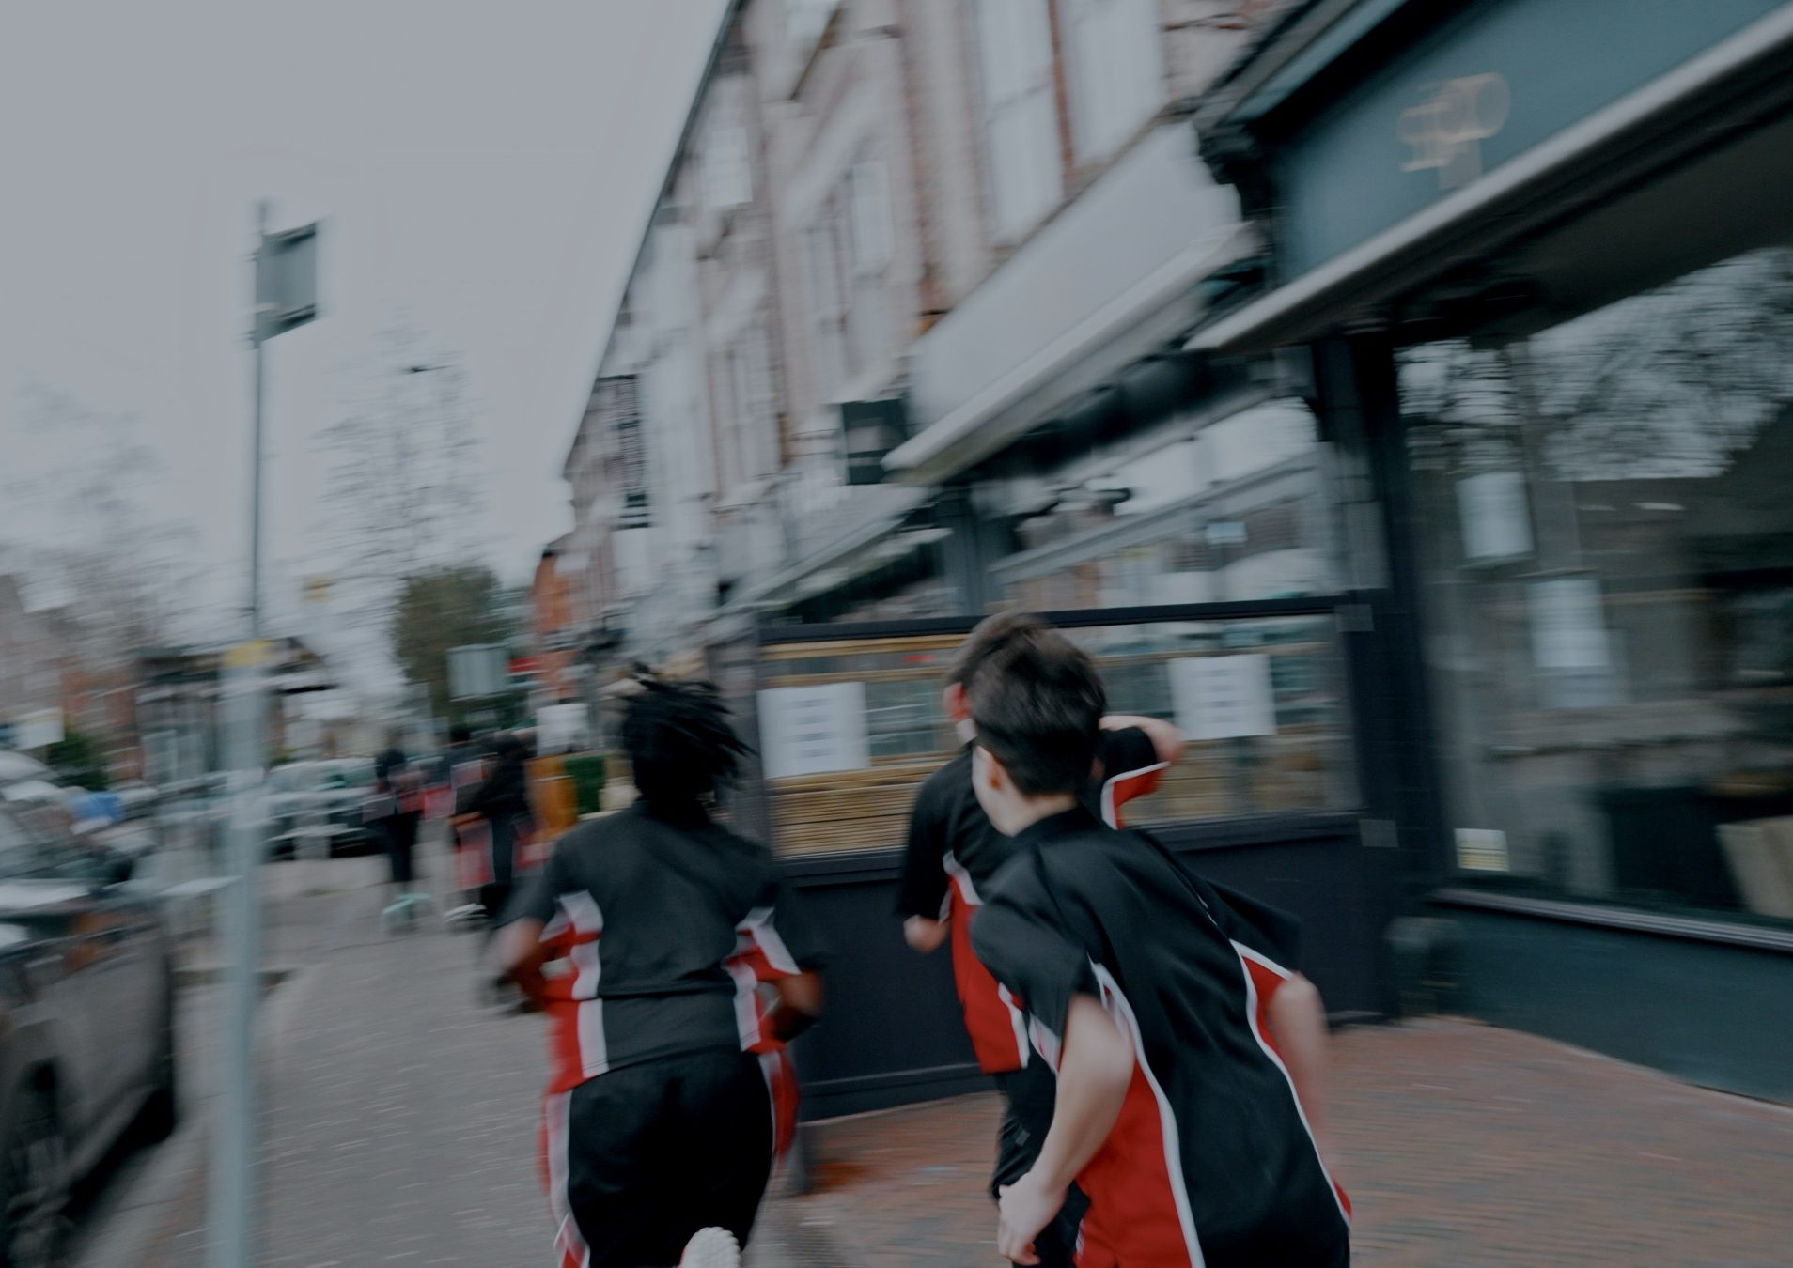
DHS BTEC SPORT · COMPONENT 1
Task 1.
Increasing participation in regular sport or physical activity
NAME:
TEACHER:
Task 1: Monday 7 December

Slide 2
TASK 1: TWO HALVES, 24 MARKS
Task 1 is the biggest task in Component 1. Both halves are answered for one participant, who is described in the paper. Everything in this booklet is aimed at answering for them.
TASK 1a
TASK 1b
Activities and provision
Barriers and methods
Which activities suit the participant, and which sector should provide them.
What stops this participant taking part, and what would actually work.
12 marks
12 marks
The marking ladder. Both halves are marked on the same four bands:
MB1 · 1–3 | MB2 · 4–6 | MB3 · 7–9 | MB4 · 10–12
basic · little relevance to the participant | partially developed · some relevance | mostly developed · mostly relevant | well-developed · specific relevance to this participant
The word that decides your band is relevance. Generic answers that would fit anybody sit in the bottom two bands, however much you write.
DHS BTEC Sport · Component 1 · Task 1
Page 2

Slide 3
TYPES OF SPORT AND PHYSICAL ACTIVITY
Complete the definitions, then add the benefits of taking part in each.
Type | Definition | Benefits of taking part
Sport | c__________ activities that involve physical e________, have r______ and regulations and a N________ G________ B______
Outdoor activities | activities carried out o________ or in recreation areas that are a____________
Physical fitness activities | activities to increase f________
Sport splits into two kinds. Name them, with an example of each:
DHS BTEC Sport · Component 1 · Task 1
Page 3

Slide 4
WHO PROVIDES SPORT: THE THREE SECTORS
Complete each sector, then add its four characteristics: funding source, aims, quality of provision, accessibility.
Public
Private
Voluntary
local a____________ and s______ provision
organisations who aim to make a p______
activities provided by v____________ who have a common i________ in the sport or activity
Characteristic | Public | Private | Voluntary
Funding source
Aims
Quality of provision
Accessibility
DHS BTEC Sport · Component 1 · Task 1
Page 4

Slide 5
ADVANTAGES AND DISADVANTAGES TO THE PARTICIPANT
Five things to compare between sectors. Choose one activity someone could do in all three, then compare:
Activity: ____________________________
Comparison point | Public | Private | Voluntary
Types and range of activities
Types and range of equipment
Cost of participation
Access to the activity
Additional products and services
Additional products and services means things like a creche, refreshments, hire of equipment, or access to a sport sector professional such as a sports therapist.
DHS BTEC Sport · Component 1 · Task 1
Page 5

Slide 6
PROVIDERS NEAR YOU
Every place within reach where someone could take part. Sort them by sector and say how you know.
Provider | Sector | How you know | What they offer
DHS BTEC Sport · Component 1 · Task 1
Page 6

Slide 7
TYPES OF PARTICIPANT, AND WHAT THEY NEED
Complete the age brackets:
Primary school aged children
Adolescents
Adults
Older adults
aged ____ to ____
aged ____ to ____
aged ____ to ____
aged ____ and up
Disabilities the spec names: v________, h________ and p________. Long-term health conditions: a________, type 2 d__________, high b______ p________, and c________ h______ d________ (CHD).
Now the three kinds of need. Fill in as many as you can:
Physical health needs
Social health needs
Mental health needs
DHS BTEC Sport · Component 1 · Task 1
Page 7

Slide 8
READING THE PARTICIPANT
Marcus is 68 and recently retired. He has type 2 diabetes, lives alone, and has not exercised regularly for twenty years. He does not drive.
Every need you write must be evidenced by words in the scenario. Quote the words that tell you it is there.
Need | Type: physical, social or mental | The words in the scenario that evidence it
A need you might guess at but cannot evidence, and why you would leave it out:
DHS BTEC Sport · Component 1 · Task 1
Page 8

Slide 9
WHAT, HOW AND WHY
Naming an activity earns almost nothing. The marks are in how it works and why that matters for this participant. Choose three activities for Marcus, from at least two different activity types.
Activity (what) | How it works for them | Why that matters for this participant
Check: underline every phrase that names something specific to your participant. Fewer than three per activity means the answer is still generic.
DHS BTEC Sport · Component 1 · Task 1
Page 9

Slide 10
WHAT TASK 1A REQUIRES
Suitable activities for the participant, justified: how and why each one meets their specific needs.
The type of provision that would deliver them, with its characteristics.
The advantages and disadvantages of that sector, for this participant and these activities.
Relevance to the participant in every section, not just the introduction.
BAND 4 CHECKLIST
☐ Activities: what, how, why
☐ Needs evidenced from the scenario
☐ Provision has its own section
☐ Sector characteristics given
☐ Advantages AND disadvantages
☐ Participant named throughout
The most common way to lose marks. A strong activities section followed by provision covered in a sentence or two. Work with only a brief provision section is capped at the top of Band 2, however good the activities are. Give provision its own heading and at least three of the five comparison points.
My target band for Task 1a:
DHS BTEC Sport · Component 1 · Task 1
Page 10

Slide 11
MODEL ANSWER: TASK 1A
Marcus, 68, retired, type 2 diabetes, lives alone, twenty years without regular exercise, does not drive. Highlight the what, how and why in the first paragraph, and circle every mention of Marcus in the second.
ACTIVITIES
PROVISION
"Walking football would suit Marcus. It is a team sport played at low intensity with no running, which manages the impact on his joints at 68 and lets him rebuild fitness gradually after twenty years away from regular exercise. It also meets his social health needs: he lives alone, so a weekly session with the same group of people gives him regular contact and decreases loneliness. Because type 2 diabetes is managed partly by regular moderate activity, two sixty-minute sessions a week move him towards the government guideline of 150 minutes of moderate activity without a sudden jump in intensity."
"The local authority leisure centre is public sector provision, funded by the council rather than run for profit, so its aim is participation across the community rather than income. That matters for Marcus in three ways. Cost of participation is low and there is usually a concessionary rate for people over 60, so price is not a reason to stop going. Access is good, because council centres are placed in residential areas and served by bus routes, which he needs as he does not drive. The range of activities is broad, so if walking football does not suit him he can move to another session without joining somewhere new. The disadvantage is that public centres are busiest after work and the equipment is not always as new as a private gym's, though as a retired participant Marcus can attend at quieter times."
DHS BTEC Sport · Component 1 · Task 1
Page 11

Slide 12
TASK 1A PRACTICE
Priya is 34, works full time in an office and has two children aged 4 and 6. She has asthma. She wants to be more active but says she has no time to herself and has not played sport since school. Choose three suitable activities for Priya and justify each one. Then choose the provision that would suit her and give its advantages and disadvantages. (12 marks)
Continue on paper if you need more space.
Band awarded: Named gap for next time:
DHS BTEC Sport · Component 1 · Task 1
Page 12

Slide 13
BARRIERS TO PARTICIPATION
Five groups of barrier. Complete each one:
Group | The barriers in this group
Cost of participation | c__________ · e____________ · t____________
Access to the activity | l__________ of the activity · limited accessible t______________ · r__________ · the t______ of activity available
Time | lack of time due to other commitments: f________ · s______ · w______
Personal barriers
Cultural barriers
There are seven personal barriers and three cultural barriers in the specification. Fill in as many as you can from memory, then check.
DHS BTEC Sport · Component 1 · Task 1
Page 13

Slide 14
WHICH BARRIERS, AND WHY
Naming a barrier earns almost nothing. The marks are in how it occurs and why it stops this participant. Three barriers from three different groups:
Participant: ____________________________
Barrier and group | How it occurs for them | Why it stops them taking part
One barrier this participant does NOT face, and why it does not apply:
DHS BTEC Sport · Component 1 · Task 1
Page 14

Slide 15
METHODS TO ADDRESS THE BARRIERS
Complete the methods for each group of barrier:
Barrier group | Methods that address it
Cost | d____________ pricing · h______ of equipment · free c____ p________
Access | public transport d__________ · c______ hire · free parking · t________ days · staff t________ · increased range of provision · r______ · assistive technology: pool hoist, Braille signage, hearing loops
Time | c________ facilities · extended o________ hours
Personal
Cultural
A method has to be feasible: the participant could actually use it, and the provider could actually offer it.
DHS BTEC Sport · Component 1 · Task 1
Page 15

Slide 16
WHAT TASK 1B REQUIRES
Model answer: Marcus. Highlight how it occurs, why it stops him, how the method works, why it suits him:
BAND 4 CHECKLIST
☐ Barriers: how each occurs
☐ Barriers: why each stops them
☐ Methods: how each works
☐ Methods: why each suits them
☐ Feasible, not just possible
☐ Participant named throughout
"One barrier for Marcus is personal: he has had an extended time off from participation, twenty years, so he expects to be the least able person there. This stops him taking part because someone who expects to be the worst in the room often does not attend at all, and one missed session becomes a habit.
A feasible method is a taster day aimed at over-60s beginners. It works because everyone there is at the same starting point, so he is not comparing himself to established players, and it is one session rather than a commitment, which lowers the risk of turning up. A general beginners' session would help less, because the age range would be wide and he would still expect to be the slowest."
The most common way to lose marks. Strong barriers, then methods listed a line each. Methods named without how they work or why they suit the participant sit in Band 2.
My target band for Task 1b:
DHS BTEC Sport · Component 1 · Task 1
Page 16

Slide 17
TASK 1B PRACTICE
Priya: 34, full time office work, two children aged 4 and 6, asthma, no sport since school. Explain three barriers to participation that Priya faces, from three different groups, and give a method to overcome each one. (12 marks)
Continue on paper if you need more space.
Band awarded: Named gap for next time:
DHS BTEC Sport · Component 1 · Task 1
Page 17

Slide 18
PRACTICE PARTICIPANTS
Task 1 gives you one participant. The way to get quick at reading one is to practise on many. Six here, and none of them are like each other.
Isla, 9
Kofi, 15
Ravi, 47
Plays for a primary school netball team. Small for her age and still learning the rules. Sessions are 45 minutes after school.
County-level 200m sprinter. Has a hearing impairment and uses hearing aids, which he removes to compete.
Office worker with high blood pressure, told by his GP to become more active. Has not exercised since his twenties. Plays badminton once a week.
Nadia, 61
Tom, 24
Amara, 13
Uses a wheelchair following a spinal injury eight years ago. Has recently taken up wheelchair basketball at a local club.
Registered blind. Runs with a guide runner three times a week and wants to enter a half marathon.
Has asthma, triggered by cold air. Wants to join the school football team but has stopped attending winter training.
Pick a different participant each time you practise. The more people you write for, the faster you get at reading a new one.
Practice tasks:
1. Choose three suitable activities for one of them, and justify each with what, how and why.
2. Choose the provision that would suit them, with its characteristics and its advantages and disadvantages.
3. For a second participant, write three barriers from three different groups, and a feasible method for each.
DHS BTEC Sport · Component 1 · Task 1
Page 18

Slide 19
TASK 1 KNOWLEDGE ORGANISER
A1 Types and providers
A2 Participants and needs
A3 and A4 Barriers and methods
Sport: competitive, physical exertion, rules and regulations, National Governing Body. Team and individual.
Outdoor activities: adventurous, outdoors or in recreation areas.
Physical fitness activities: to increase fitness.
Sectors: public (local authority and school, community aim), private (profit), voluntary (volunteers, common interest).
Characteristics: funding source, aims, quality of provision, accessibility.
Compare on: range of activities, equipment, cost, access, additional products and services.
Ages: 5–11, 12–17, 18–49, 50 and up.
Disabilities: visual, hearing, physical.
Conditions: asthma, type 2 diabetes, high blood pressure, coronary heart disease.
Physical needs: fitness, body composition, sleep, immunity, symptoms of conditions.
Social needs: meet people, friends, fun, leadership and team working, decrease loneliness.
Mental needs: stress, work life balance, depression risk, mood, self-confidence and self-esteem.
Cost: clothing, equipment, transport. Methods: discounts, hire, free parking.
Access: location, transport, resources, what is available. Methods: transport discounts, cycle hire, parking, taster days, staff training, more provision, ramps, assistive technology.
Time: family, school, work. Methods: creche, extended hours.
Personal: body image, confidence, parental influence, limited or lapsed participation, low fitness, health concerns. Methods: private changing, comfortable clothing, varied images, parent and child sessions, campaigns.
Cultural: single sex sessions, clothing norms, role models. Methods: women only sessions, diverse staff, cultural awareness training.
Task 1a: activities (what, how, why) plus provision in its own section, with advantages and disadvantages. Task 1b: barriers (how it occurs, why it stops them) plus feasible methods (how it works, why it suits them). Task 1 is sat on Monday 7 December.
DHS BTEC Sport · Component 1 · Task 1
Page 19

