Slide 1
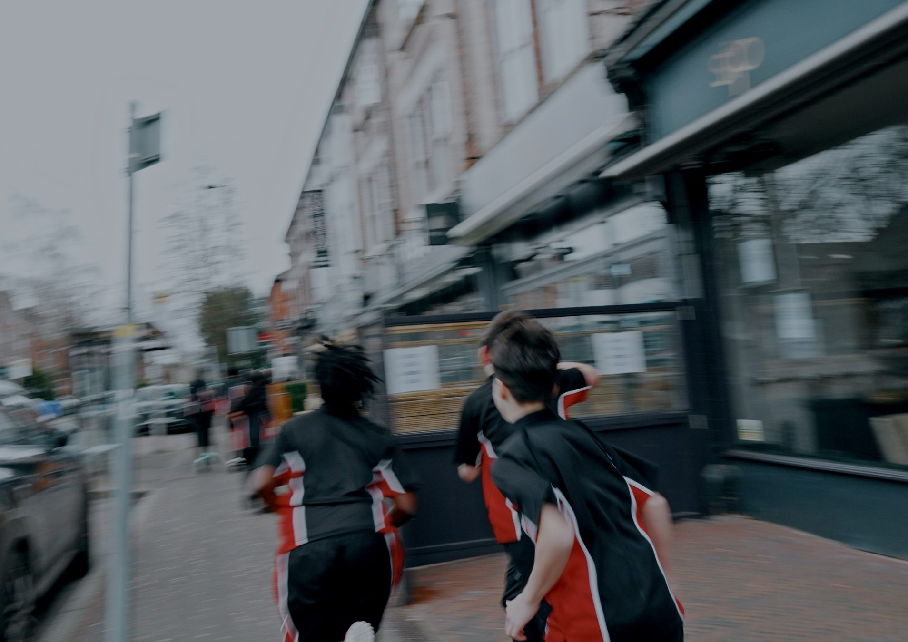
DHS BTEC SPORT · COMPONENT 1
Task 2.
Equipment and technology required for participants to use
NAME:
TEACHER:
Task 2: Monday 22 February

Slide 2
THREE QUESTIONS, AND THEY STACK
B1 lists eight categories of equipment. B2 gives what technology has done to those same eight. B3 gives the limitations. Learn the eight once and you have learned most of the outcome.
B1
B2
B3
What equipment do participants use?
What has technology done to each of those eight?
What are the limitations of that technology?
Task 2, sat Monday 22 February. A presentation of 10–15 slides, 12 marks. Two strands, and BOTH are needed:
Strand | What it asks for
1 · Clothing and equipment | justify the clothing and equipment choices, with specific relevance to the participant in the paper and their chosen activity
2 · Technology | justify the technology choices, naming the technological developments, with benefits and limitations, again specific to that participant
Two ways answers get capped: covering only one strand, and being relevant to the sport but not to the participant. A broad list of items with generic justifications still sits in Band 2.
DHS BTEC Sport · Component 1 · Task 2
Page 2

Slide 3
THE EIGHT CATEGORIES: 1 TO 4
Complete each category, then add a real example you have found in the department.
Category | What the specification lists | An example from our department
1 Clothing | sports k____ · w____________ clothing · training clothing, e.g. b____
2 Footwear | t____________ · s____________ boots · sport-specific footwear
3 Sport-specific equipment | participation e.g. ________ · travel-related e.g. ________ · scoring e.g. ____________ · fitness training e.g. ____________
4 Protection and safety | m______, h______, e____ and b______ protection · f____________ devices. First aid: ice packs, bandages, d________________
DHS BTEC Sport · Component 1 · Task 2
Page 3

Slide 4
THE EIGHT CATEGORIES: 5 TO 8
Category | What the specification lists | An example from our department
5 Assistive equipment | a w____________, for example an adapted wheelchair for wheelchair tennis
6 Facilities | indoor e.g. ____________ and ______ · outdoor e.g. ____________, climbing wall, artificial snow domes
7 Officiating equipment | w________ · m____________ · e________
8 Performance analysis | s______ w________ · h______ r____ m____________ · a______________
The sentence that earns marks. Not "studded boots", but: "studded boots for playing hockey on grass in winter, because the studs grip a soft, wet surface and reduce her risk of slipping when she changes direction." Item, participant, activity, conditions, reason.
DHS BTEC Sport · Component 1 · Task 2
Page 4

Slide 5
JUSTIFY IT FOR THE PARTICIPANT
Naming an item earns very little. The marks are in why this participant, doing this activity, in these conditions, needs it.
Participant and activity: ____________________________
Item | Category | Why THIS participant needs it for THIS activity
Check: could any of your reasons be copied onto a different participant unchanged? If so, it is not yet specific.
DHS BTEC Sport · Component 1 · Task 2
Page 5

Slide 6
WHAT TECHNOLOGY DID: CATEGORIES 1 TO 4
Same eight categories, now the technological developments. Naming the item is B1. Saying what technology changed about it, and the effect, is B2.
Category | The technological development | How it helps the participant
1 Clothing | improved t________________ · designed to improve a______________
2 Footwear | sport-specific new designs or materials · improved g____ · r________
3 Sport-specific equipment | new materials for l____________ and s____________, including c____________ materials · new designs to improve performance
4 Protection and safety | improved protection design · l________ weight · improved performance, e.g. the shape of cycle helmets
DHS BTEC Sport · Component 1 · Task 2
Page 6

Slide 7
WHAT TECHNOLOGY DID: CATEGORIES 5 TO 8
Category | The technological development | How it helps the participant
5 Assistive equipment | p______________ · sport-specific w______________ · equipment supporting visual and hearing impairments
6 Facilities | facilities that s__________ environments to replicate competition elsewhere · a__ w________ surfaces · surfaces that reduce injury risk
7 Officiating | c____________ assisted systems · v______ assisted decision making
8 Performance analysis | a______ cameras · G__ · applications · s________ on sports clothing or equipment
The difference that decides the band. "She uses a tennis racquet" is equipment. "Composite materials make the racquet lighter and stronger, so she can swing faster with more control" is a technological development. Only the second earns the technology marks.
DHS BTEC Sport · Component 1 · Task 2
Page 7

Slide 8
THE LIMITATIONS OF TECHNOLOGY
Five limitations. An answer that only says technology is brilliant is half an argument.
Limitation | What the specification says | An example from our own lesson
Time | setting up, using the equipment, compiling d____, giving f__________ to the participant
Access | e__________ and unfair advantages, as not all participants have access
Cost | the i________ cost and the follow-up m______________
Accuracy | the d____ provided by the equipment may not be accurate
Usability | specific t________ is required
Benefits and limitations together is what comprehensive means. Give both, for the same technology, for the same participant.
DHS BTEC Sport · Component 1 · Task 2
Page 8

Slide 9
ARGUE BOTH SIDES
The shape that scores. "A GPS tracker would show her how far she covers in a session, so she can see her aerobic endurance improving. But the cost and the training needed to read the data may put it out of reach for a beginner training alone, so a simple heart rate monitor would suit her better." Benefit, limitation, and a judgement, all for the same participant.
Technology | The benefit for this participant | The limitation for this participant | Would you recommend it? Why?
DHS BTEC Sport · Component 1 · Task 2
Page 9

Slide 10
MODEL ANSWER: TASK 2
Leah plays hockey as a defender, on grass, in winter. Highlight the equipment, the technological development, the benefit and the limitation. Then circle every mention of Leah.
CLOTHING AND EQUIPMENT
TECHNOLOGY
"Leah would need studded boots for playing hockey on grass in winter. The studs grip a soft, wet surface, which reduces her risk of slipping when she changes direction, and as a defender she turns and reaches constantly. Modern boots also use lighter synthetic materials than older leather ones, so she carries less weight over a full match and tires less quickly late on, which matters because she plays the whole seventy minutes."
"She would also use a GPS tracker. Sensors in the vest record the distance she covers and her speed, so her coach can show her exactly how much ground she loses in the final quarter and set training around it.
The limitation is cost and the training needed to read the data, so at club level she may only get access to it occasionally rather than every week."
DHS BTEC Sport · Component 1 · Task 2
Page 10

Slide 11
TASK 2 PRACTICE
Marcus is 68 and recently retired, with type 2 diabetes. He has joined a walking football session at his local leisure centre twice a week, and does not drive. Justify the sports clothing, equipment and technology Marcus would need to take part. (12 marks)
BAND 4 CHECKLIST
☐ Clothing and footwear
☐ Sport-specific equipment
☐ Protection or safety
☐ Technology strand too
☐ Developments named
☐ Benefits AND limitations
☐ Marcus named throughout
Band awarded: Named gap for next time:
DHS BTEC Sport · Component 1 · Task 2
Page 11

Slide 12
SELF-TEST
Cover your notes. Mark it against the knowledge organiser on the next page.
1. Name all eight equipment categories.
2. Name the four kinds of sport-specific equipment.
3. Give two technological developments in sports clothing.
4. What has changed about sport-specific equipment, and why does it help?
5. Name the five limitations of using technology.
6. Which strands must a Task 2 answer cover?
DHS BTEC Sport · Component 1 · Task 2
Page 12

Slide 13
TASK 2 KNOWLEDGE ORGANISER
B1 The eight categories
B2 The same eight, with technology
B3 Limitations, and Task 2
Clothing: sports kit · waterproof · training clothing, e.g. bibs.
Footwear: trainers · studded boots · sport-specific.
Sport-specific equipment: participation, e.g. balls and rackets · travel-related, e.g. kayak · scoring, e.g. goalposts · fitness training, e.g. dumbbells.
Protection and safety: mouth, head, eye and body protection · floatation devices. First aid: ice packs, bandages, defibrillator.
Assistive: a wheelchair, e.g. adapted for wheelchair tennis.
Facilities: indoor, e.g. sports halls and gyms · outdoor, e.g. pitches, climbing wall, artificial snow domes.
Officiating: whistle · microphone · earpiece.
Performance analysis: smart watches · heart rate monitors · applications.
Clothing: improved thermoregulation · designed to improve aerodynamics.
Footwear: new designs or materials · improved grip · rebound.
Sport-specific: new materials for lightness and strength including composites, e.g. tennis racquet · new designs to improve performance, e.g. golf driver.
Protection: improved design · lighter weight · improved performance, e.g. aerodynamic cycle helmets.
Assistive: prosthetics · sport-specific wheelchairs · equipment supporting visual and hearing impairments.
Facilities: simulated environments · all weather surfaces · surfaces that reduce injury risk.
Officiating: computer assisted systems · video assisted decision making.
Performance analysis: action cameras · GPS · applications · sensors on clothing or equipment.
The five limitations:
· time: setting up, using, compiling data, giving feedback
· access: not all participants have it, creating unfair advantages
· cost: initial and maintenance
· accuracy of the data
· usability: specific training required.
Task 2, 12 marks, a presentation of 10–15 slides, Monday 22 February.
Justify clothing and equipment AND technology, for the participant in the paper.
Covering only one strand caps the mark. Relevance to the sport but not the participant sits in Band 2. Name the technological developments, and give benefits with limitations.
Eight categories, learned once. Then what technology did to each. Then the limitations. Justify everything for the participant in the paper, not just the sport.
DHS BTEC Sport · Component 1 · Task 2
Page 13

