Slide 1
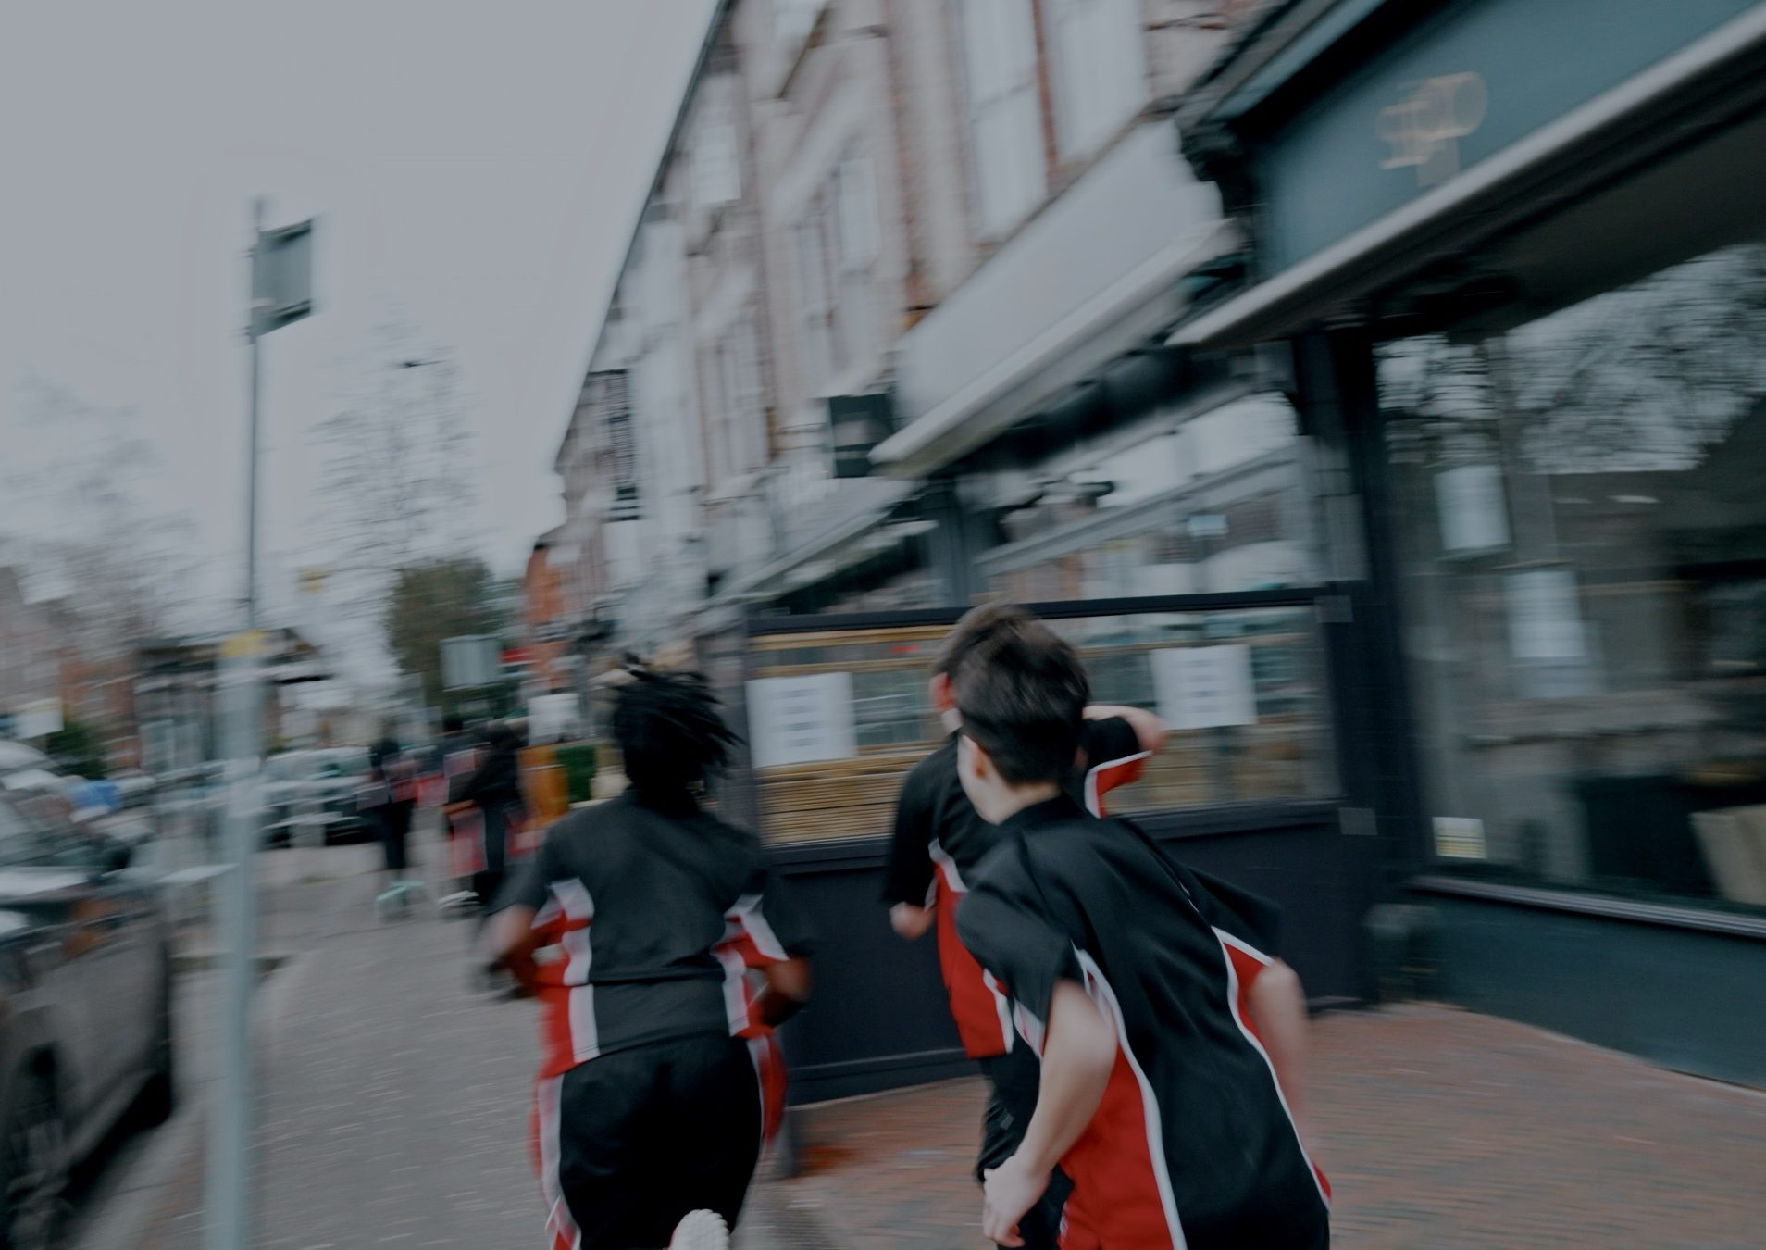
DHS BTEC SPORT · COMPONENT 1
Task 3.
Preparing participants to take part in sport and physical activity
NAME:
TEACHER:
Year 10 · Weeks 1–4 · Task 3a: Fri 9 Oct

Slide 2
TASK 3: WHAT AND WHEN
Task 3 is worth 24 of Component 1's 60 marks, and it is the first task you sit. This booklet is your workbook for the four teaching weeks and your planning tool for the task itself.
WEEKS 1–4
WEEKS 5–7
WEEK 10
Learn it
Task 3a: written plan
Task 3b: delivery
Plan, adapt and deliver warm-ups. Every lesson builds the skill.
Sat Fri 9 Oct under supervision. About 2 hours, 12 marks.
Filmed Wed 4 & Thu 5 Nov. You deliver your warm-up. 12 marks.
Every warm-up has three phases. The colours below follow the phases through this booklet:
1 · Pulse raiser
2 · Mobilisers
3 · Preparation stretches
A Task 3 plan missing any phase is capped, no matter how good the rest is. Every answer is written for the participant in the paper. Linking your choices to them, by name, is where the marks are.
DHS BTEC Sport · Component 1 · Task 3
Page 2

Slide 3
WHAT IS A WARM-UP?
Complete the definition: a warm-up is a period of p___________ for exercise or performance, using g_________ activity that readies the body for what is about to be asked of it.
What could happen to a performer who skips the warm-up? Give three risks:
Label the three phases in order, then add one example activity for each:
1
2
3
Phase:
Phase:
Phase:
Example:
Example:
Example:
DHS BTEC Sport · Component 1 · Task 3
Page 3

Slide 4
PULSE RAISER ACTIVITIES
Complete the definition: activities that g__________ increase in i__________ to increase the h_______ r______. A pulse raiser should last 3–5 minutes and finish close to the pace of the activity.
Activity bank: jogging · skipping · high knees · heel flicks · side-steps · runs at 25% / 50% / 75% pace · sport-specific movements (dribbling, passing patterns, court movements)
Design a 4-minute pulse raiser for a sport of your choice. Build the intensity in steps:
Sport:
Order | Activity and description | Time | One teaching point
1
2
3
4
DHS BTEC Sport · Component 1 · Task 3
Page 4

Slide 5
CARDIORESPIRATORY RESPONSES
The cardiorespiratory system is the heart, blood vessels and lungs. Complete all five responses to the pulse raiser, then explain why each one helps the performer.
Response | Why it helps the performer
1. Increased h_______ r______
2. Increased b____________ r______
3. Increased d________ of b____________
4. Increased supply of o_________ to the working m_________
5. Increased removal of c________ d__________
Check: which two responses are about oxygen getting IN, and which is about waste getting OUT?
DHS BTEC Sport · Component 1 · Task 3
Page 5

Slide 6
MUSCULOSKELETAL RESPONSES
Complete the three responses to the pulse raiser: increased t____________ of the muscles · increased p__________ of the muscles · reduced risk of muscle s________. Key term: pliability means the quality of being easily bent; flexibility.
Exam practice. Tom is a footballer. He plays for his local team and has been asked by his coach to lead the warm-up for his squad this Saturday. Identify three pulse-raiser exercises Tom could use, and explain the effect of the pulse raiser on the cardiorespiratory and musculoskeletal systems. (6 marks)
PASS correct activities and responses named
MERIT described and linked to the body system
DISTINCTION every choice justified for this participant and activity
DHS BTEC Sport · Component 1 · Task 3
Page 6

Slide 7
STRUCTURING A SCENARIO ANSWER
1 · Define the phase, in spec language
"A pulse raiser is an activity that gradually increases in intensity to raise the heart rate. Rafael's group would start with a gentle jog around the court, build into side-steps, then high knees, finishing with sprints to the key at 75% pace, basketball movements he already knows, which suits his confidence with invasion games. During this his heart rate and breathing rate increase, and he breathes more deeply, so more oxygen reaches his working muscles and carbon dioxide is removed faster, meaning he can play at full intensity from tip-off. At the same time his muscle temperature rises and his muscles become more pliable, reducing his risk of a strain when he jumps for a rebound, which matters because Rafael plays on hard indoor courts."
2 · Describe named exercises with a teaching point
3 · Cardiorespiratory response, and why it helps
4 · Musculoskeletal response, and why it helps
5 · Link to this participant and this activity, by name
Model answer: Rafael, 12, city school, loves basketball. Highlight where each of the five steps appears, and circle every link to Rafael:
Notes:
Count the links to Rafael: Fewer than three means the answer is not yet Band 4.
DHS BTEC Sport · Component 1 · Task 3
Page 7

Slide 8
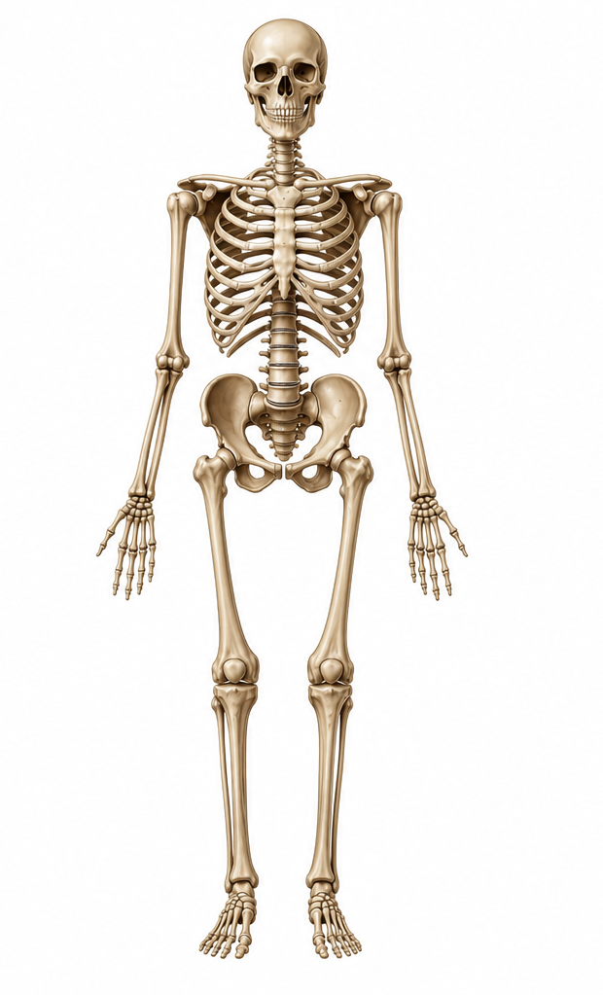
MOBILISERS: OILING THE JOINTS
Complete the definition: activities that take the j_______ through their r_______ of m___________, starting with s________ movements and making these b________ as the warm-up progresses.
Joint | Mobiliser exercise, small to big
1 · Shoulders
2 · Elbows
3 · Wrists | wrist circles and waves
4 · Hips
5 · Knees
6 · Ankles | ankle rolls, both ways
1
2
3
4
5
6
The body's response. Musculoskeletal: increased production of s__________ f________ in the joints, which lubricates them and increases range of movement. Cardiorespiratory: a slight drop in heart rate and breathing rate, because intensity is lower than the pulse raiser. That drop is normal. Say it in answers.
DHS BTEC Sport · Component 1 · Task 3
Page 8

Slide 9
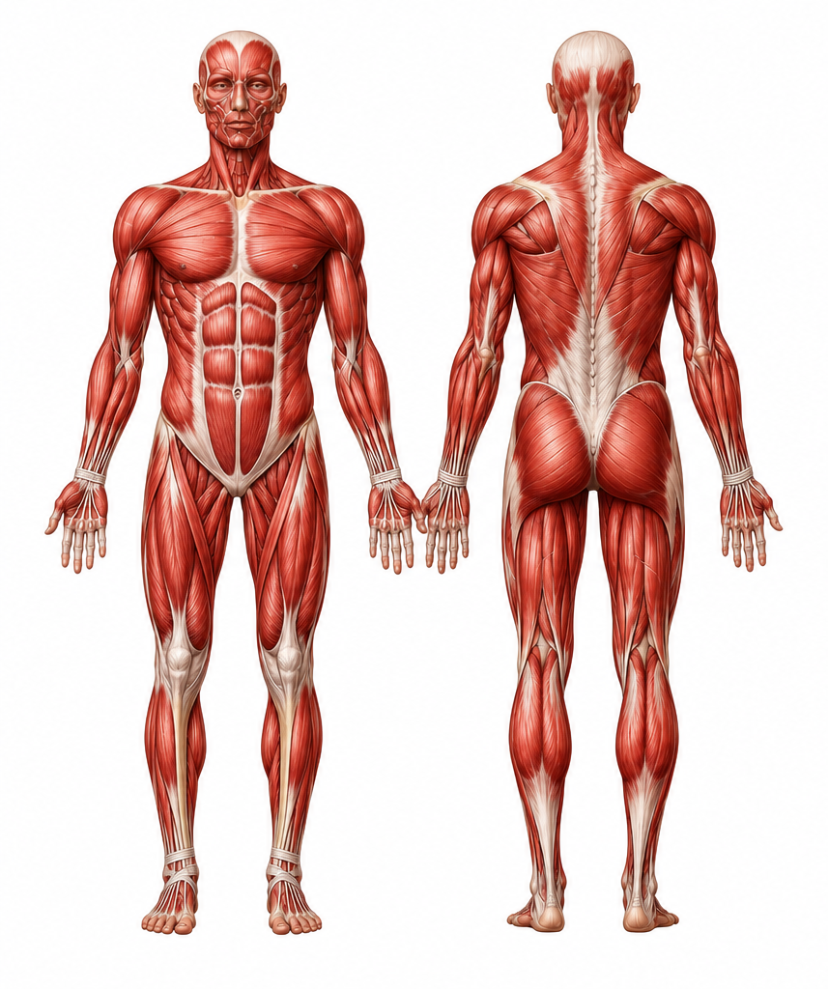
THE ELEVEN MUSCLES
Word bank: deltoids · biceps · triceps · abdominals · obliques · erector spinae · hip flexors · gluteus maximus · quadriceps · hamstrings · gastrocnemius
Write the muscle for each numbered marker:
1.
7.
2.
1
8.
2
7
3.
3
9.
4
8
4.
5
9
10.
6
10
5.
11.
11
6.
Look, cover, check: 90 seconds. Score: / 11
FRONT
BACK
DHS BTEC Sport · Component 1 · Task 3
Page 9

Slide 10
TYPES OF STRETCH
Preparation stretches are activities to stretch the main muscles that will be used in the physical activity. Complete the grid:
Static
Dynamic
What it means:
What it means:
Example:
Example:
Simple
Compound
What it means:
What it means:
Example:
Example:
Responses to the stretch phase. Complete:
Cardiorespiratory: static stretches make heart rate and breathing rate d______ f_________ · dynamic stretches keep them e__________.
Musculoskeletal: muscles are fully e____________, so they are less likely to t______ during the sport or activity session.
DHS BTEC Sport · Component 1 · Task 3
Page 10

Slide 11
YOUR STRETCH BANK
One stretch per muscle, with its key point in a few words. You will reuse this bank in your Task 3a plan, so choose stretches you can actually demonstrate. S/D = static or dynamic. S/C = simple or compound.
Muscle | Stretch: name it and its key point | S/D | S/C
Deltoids
Biceps
Triceps
Abdominals
Obliques
Erector spinae
Hip flexors
Gluteus maximus
Quadriceps
Hamstrings
Gastrocnemius
DHS BTEC Sport · Component 1 · Task 3
Page 11

Slide 12
THE RESPONSES TABLE
This table is the physiology behind Task 3a. Fill it in from memory, then check against your notes and correct in a different colour.
 | Cardiorespiratory responses | Musculoskeletal responses
Pulse raiser
Mobilisers
Preparation stretches
Scores: pulse raiser has 5 CR + 3 MS · mobilisers 2 CR + 1 MS · stretches 2 CR + 1 MS. How many of the 14 did you get?
DHS BTEC Sport · Component 1 · Task 3
Page 12

Slide 13
ADAPTING FOR DIFFERENT PARTICIPANTS
Warm-ups are adapted four ways. Complete each with what it means and who needs it:
Intensity
Impact
Timing
Type of stretch
For each participant, write the two most important adaptations and why:
Participant | Adaptations and reasons
68-year-old, returning to exercise
9-year-old beginners
Participant with a hearing impairment
DHS BTEC Sport · Component 1 · Task 3
Page 13

Slide 14
EXAM PRACTICE: ALEX
Alex is a 63-year-old retired woman with high blood pressure. She used to cycle, play rugby and snowboard, but has been inactive since her diagnosis and wants to return to gentle exercise. Plan the pulse raiser for Alex's warm-up and justify two adaptations you have made for her. (6 marks)
Name the adaptation type (intensity, impact, timing, stretch type) and the reason it suits Alex: both her age and her blood pressure.
PASS correct activities and responses named
MERIT described and linked to the body system
DISTINCTION every choice justified for this participant and activity
DHS BTEC Sport · Component 1 · Task 3
Page 14

Slide 15
ADAPTING TO THE PHYSICAL ACTIVITY
A warm-up becomes specific to an activity three ways: use equipment from the activity · use movements from the activity · stretch the muscles the activity uses most.
Plan the sport-specific layer for two different activities:
 | Activity 1: | Activity 2:
Equipment in the warm-up
Movements from the activity
Three muscles to stretch, and why those
Generic warm-ups cap marks. Specific to the participant and the activity reaches the top of the grid.
DHS BTEC Sport · Component 1 · Task 3
Page 15

Slide 16
EXAM PRACTICE: DORIS (TIMED, 15 MINUTES)
Doris is an 80-year-old woman who walks daily and wants to join a gentle aqua-aerobics class at her local pool. Write a plan for Doris's full warm-up: pulse raiser, mobilisers and preparation stretches. Explain the effects on her cardiorespiratory and musculoskeletal systems, and justify your adaptations. (9 marks)
Five steps · all three phases · Doris in every paragraph. Continue on paper if you need more space.
Band awarded: Target for next time:
DHS BTEC Sport · Component 1 · Task 3
Page 16

Slide 17
DELIVERING A WARM-UP: ORGANISATION
Six decisions are made before any delivery. Complete each one: s________ (areas used) · e____________ · organisation of p_______________ · t________ · d_________________ · p____________ (where you stand).
Draw your delivery space from above. Mark participants, equipment, where you stand for each phase, and where the camera goes in November:
Check: could someone else run your session from this drawing alone?
DHS BTEC Sport · Component 1 · Task 3
Page 17

Slide 18
SUPPORTING PARTICIPANTS AS THEY TAKE PART
While participants warm up, the leader is o__________ them, providing i______________, providing t__________ p________ and providing f____________.
Build your teaching-point bank. One cue, five words or fewer, that fixes the most common mistake:
Exercise | Common mistake | Your cue (5 words or fewer)
Jogging
High knees
Arm swings
Hip circles
Quadriceps stretch
Walking lunge
Test them in the practical: your partner performs the exercise badly on purpose. Does your cue fix it?
DHS BTEC Sport · Component 1 · Task 3
Page 18

Slide 19
WHAT TASK 3A REQUIRES
A warm-up plan for your chosen activity, for the participant in the paper. About 2 supervised hours, 12 marks.
All three phases: pulse raiser, mobilisers, preparation stretches. Missing one caps the mark.
Activities described in enough detail that someone else could run them.
Every choice justified: the effect on the cardiorespiratory and musculoskeletal systems.
Specific relevance to the participant and the activity, in every section, not just the introduction.
BAND 4 CHECKLIST
☐ All 3 phases, fully detailed
☐ Every activity justified
☐ CR and MS effects for each phase
☐ Participant named throughout
☐ Activity-specific choices
☐ Adaptations with reasons
Use this on every draft.
Timeline. Week 5: plan against the released paper · Weeks 6–7: type up and practice runs · Task 3a sat Fri 9 Oct · Task 3b filmed Wed 4 & Thu 5 Nov.
DHS BTEC Sport · Component 1 · Task 3
Page 19

Slide 20
WARM-UP PLAN · 1 · PULSE RAISER
Activity and description | Time | Teaching points | CR effect | MS effect
Why these choices suit the participant and the activity (name them):
DHS BTEC Sport · Component 1 · Task 3
Page 20

Slide 21
WARM-UP PLAN · 2 · MOBILISERS AND STRETCHES
Mobilisers: small movements first, bigger as you go.
Activity and description | Joints / muscles | Teaching points | CR + MS effects
Preparation stretches: the muscles this activity uses.
Activity and description | Joints / muscles | Teaching points | CR + MS effects
Adaptations made for this participant, and why:
DHS BTEC Sport · Component 1 · Task 3
Page 21

Slide 22
PRACTICE SCENARIO: SAMANTHA
Samantha is a 26-year-old single mother of two young children. She works full-time, is lacking self-confidence, and misses spending time with friends. She has chosen to try a weekly netball session.
Complete the full plan template on pages 20 and 21 for Samantha's netball warm-up.
Use the Band 4 checklist on page 19 as you write, not after.
Swap booklets: your partner circles every link to Samantha and counts them.
Fewer than three links per section? Rewrite the weakest part before the end of the lesson.
Links to Samantha counted: Band your partner would award: Your target:
PASS correct activities and responses named
MERIT described and linked to the body system
DISTINCTION every choice justified for this participant and activity
Next lesson this plan is banded. Planning week starts Monday: you will do this again against the real released paper.
DHS BTEC Sport · Component 1 · Task 3
Page 22

Slide 23
DELIVERY CHECKLIST: PRACTICALS AND TASK 3B
Every Friday practical builds towards the filmed delivery on Wed 4 & Thu 5 Nov. Tick what the leader showed each week:
The leader... | P1 | P2 | P3 | P4 | Task 3b
organised space and equipment before starting
used clear demonstrations
positioned where everyone could see and hear
observed participants and adjusted
gave clear instructions
gave teaching points during activities
gave feedback afterwards: a strength and an improvement
Film check: voice up, face visible, participants clearly led. You only get credit for what the camera can see and hear.
DHS BTEC Sport · Component 1 · Task 3
Page 23

Slide 24
PRACTICE PARTICIPANTS
Task 3a gives you one participant. The way to get quick at reading one is to practise on many. Six here, and none of them are like each other.
Isla, 9
Kofi, 15
Ravi, 47
Plays for a primary school netball team. Small for her age and still learning the rules. Sessions are 45 minutes after school.
County-level 200m sprinter. Has a hearing impairment and uses hearing aids, which he removes to compete.
Office worker with high blood pressure, told by his GP to become more active. Has not exercised since his twenties. Plays badminton once a week.
Nadia, 61
Tom, 24
Amara, 13
Uses a wheelchair following a spinal injury eight years ago. Has recently taken up wheelchair basketball at a local club.
Registered blind. Runs with a guide runner three times a week and wants to enter a half marathon.
Has asthma, triggered by cold air. Wants to join the school football team but has stopped attending winter training.
Pick a different participant each time you practise. The more people you write for, the faster you get at reading a new one.
Practice tasks:
1. Plan a full warm-up for one of them: all three phases, with timings and teaching points.
2. Write the two adaptations that matter most for them, and say why each one suits them.
3. For a second participant, write only the pulse raiser, and justify every choice with a body-system effect.
DHS BTEC Sport · Component 1 · Task 3
Page 24

Slide 25
TASK 3 KNOWLEDGE ORGANISER
Pulse raiser
Mobilisers
Preparation stretches
Gradual intensity increase to raise heart rate · 3–5 min.
CR: heart rate, breathing rate, depth of breathing, oxygen supply, CO2 removal, all increased.
MS: muscle temperature up, pliability up, strain risk down.
Joints through their range of movement, small to big.
CR: slight drop in heart rate and breathing rate.
MS: synovial fluid production up, joints lubricated, range of movement up.
Main muscles of the activity · static or dynamic · simple or compound.
CR: static drops heart rate further, dynamic keeps it elevated.
MS: muscles fully extended, less likely to tear.
Adapt: intensity · impact · timing · type of stretch, for the participant and the activity. Specific to the activity: its equipment, its movements, its muscles.
Deliver: space, equipment, organisation of participants, timing, demonstrations, positioning · then observe, instruct, give teaching points, give feedback. Answer structure: define · describe · CR · MS · link.
DHS BTEC Sport · Component 1 · Task 3
Page 25

