Slide 1
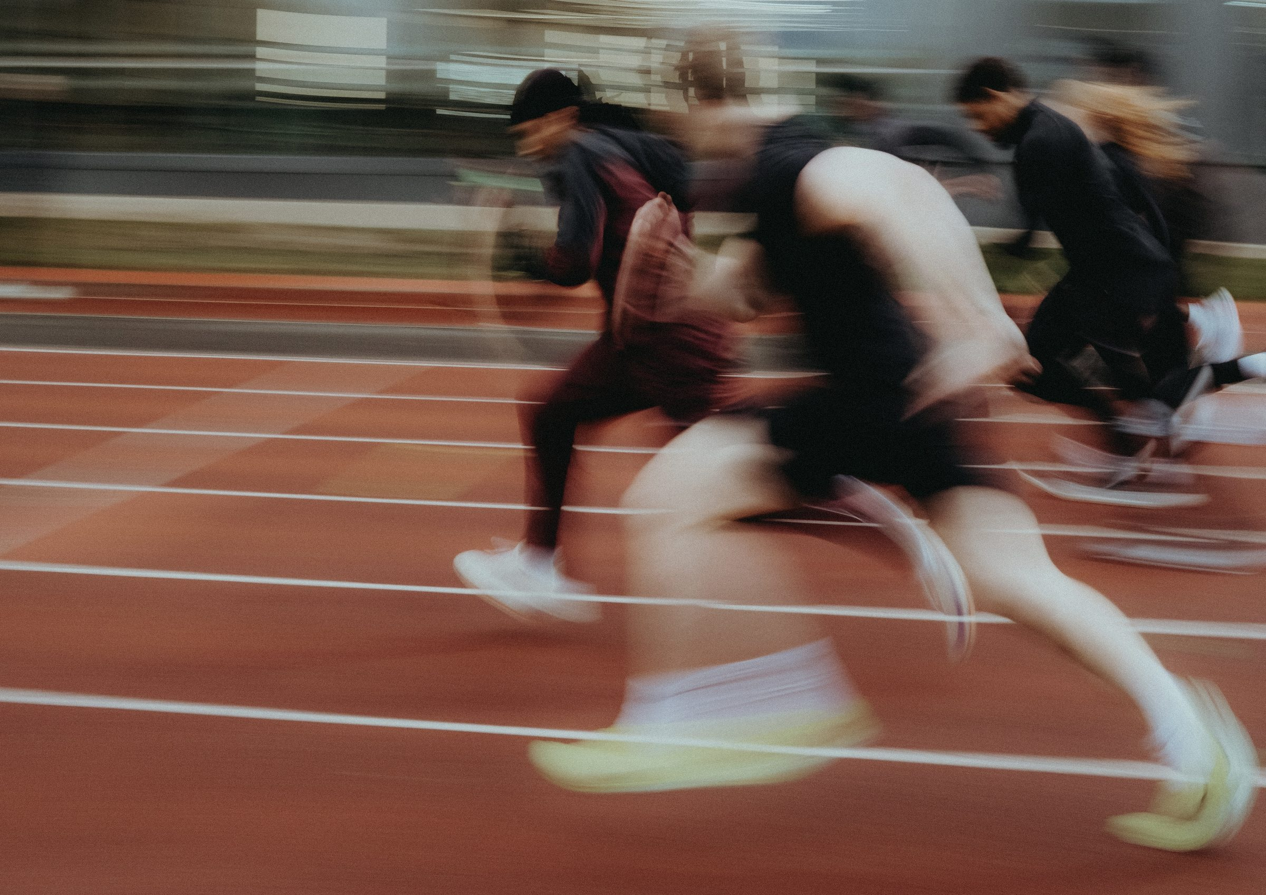
DHS BTEC SPORT · COMPONENT 2
Task 1: Components of fitness.
NAME: TEACHER:
12 marks · written response · Learning outcome A · sat Thu 8 Oct

Slide 2
WHAT TASK 1 ASKS
Produce a written response so that prospective new members understand the components of fitness required for participation in a chosen team sport.
Every component, defined
All eleven: six physical and five skill-related, in spec language.
Its use in the chosen sport
Where in play the sport actually uses it. Name the moment.
Its impact on performance
What changes when it is strong, and what changes when it is weak.
Approximately 2–3 pages of A4
Images may support the writing. They do not replace it.
Approximately 1 hour, supervised
You bring nothing in. The band is decided by omissions.
MB1 basic · MB2 partially developed · MB3 mostly developed · MB4 well-developed with no omissions.
DHS BTEC Sport · Component 2 · Task 1
Page 2

Slide 3
THE ELEVEN COMPONENTS
Complete each definition in spec language. These eleven are the whole of Task 1's knowledge.
Component
Definition
Aerobic endurance
the ability of the c________________ system to supply o________ and n__________ to the muscles to sustain low to medium intensity work and d______ f__________
Muscular endurance
the m___________ system continuing to contract at light to moderate intensity to allow r____________ movements throughout a long event or game
Muscular strength
the m___________ f________ a muscle or muscle group can generate to improve f___________ movements
Speed
d___________ divided by t______
Flexibility
the r________ of m________ possible at a joint, allowing improvements in t____________
Body composition
the relative ratio of f____ mass to f____-f______ mass in the body
Power
the product of s________ and s___________, allowing e____________ movements
Agility
the ability to c________ d____________ quickly to out-manoeuvre an o___________
Reaction time
the time between a s___________ and the start of a r____________
Balance
maintaining c________ of m______ over a b______ of s___________: static or dynamic
Coordination
moving t____ or more body parts at the same time s___________ and efficiently
DHS BTEC Sport · Component 2 · Task 1
Page 3

Slide 4
THE TRACKING GRID
Chosen sport: ______________________. For every component: where the sport uses it, and the impact on performance. Tick as each one lands in your writing.
Component
Use in the chosen sport
Impact on performance
✓
Aerobic endurance
Muscular endurance
Muscular strength
Speed
Flexibility
Body composition
Power
Agility
Reaction time
Balance
Coordination
DHS BTEC Sport · Component 2 · Task 1
Page 4

Slide 5
THE THREE-PART PARAGRAPH
Every one of the eleven paragraphs has the same three parts. Highlight them in the model below.
1 · Define the component
In spec language. The key words carry the mark.
2 · Show its use in the chosen sport
A named moment of play, with real detail. Not sport in general.
3 · Explain the impact on performance
Both ways: what a strong player does, what a weak one does.
Model, aerobic endurance in football
“Aerobic endurance is the ability of the cardiorespiratory system to supply oxygen and nutrients to the muscles to sustain low to medium intensity work and delay fatigue. In football, a central midfielder relies on aerobic endurance to keep moving between both boxes for the full ninety minutes, covering over ten kilometres in a match. A player with strong aerobic endurance still arrives in time to press and tackle in the final ten minutes. A player with poor aerobic endurance slows late in the game, arrives late to challenges and gives away possession.”
Circle every mention of football in the model. That is what applying it to the sport looks like.
DHS BTEC Sport · Component 2 · Task 1
Page 5

Slide 6
TASK 1 PRACTICE
Practice sport: ______________________. All eleven components, the three-part paragraph every time, tracking grid on page 4 ticked as you go. Continue on paper.
MB1
MB2
MB3
MB4
basic account · some omissions
partially developed · few omissions
mostly developed · minor omissions
well-developed · no omissions
Band awarded: Named gap for next time:
DHS BTEC Sport · Component 2 · Task 1
Page 6

Slide 7
SELF-TEST
Cover the answers. Write your responses in your book, then check against the teacher deck.
1
Name the six components of physical fitness.
2
Name the five components of skill-related fitness.
3
What are the three parts of every Task 1 paragraph?
4
What decides the mark band on this task?
5
How long is the response, and how long do you get?
Anything you cannot answer from memory is this week's revision list.
DHS BTEC Sport · Component 2 · Task 1
Page 7

