Slide 1
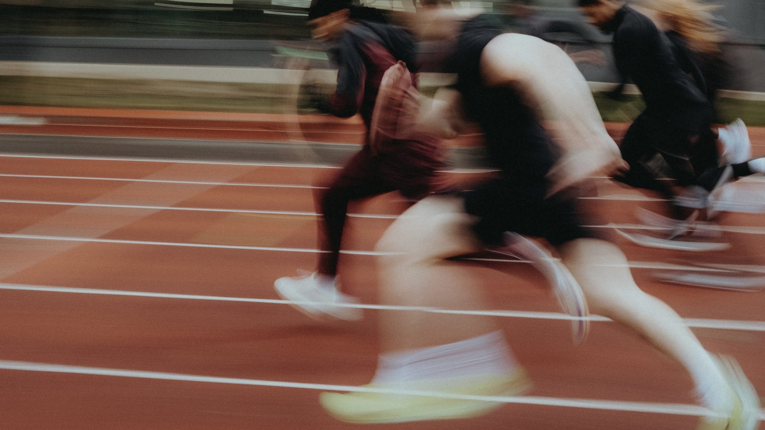
DHS BTEC SPORT · COMPONENT 2
Task 1: Components of fitness.
Produce a written response so that prospective new members understand what each of the components of fitness are, their use in the chosen team sport, and the impact they have on performance in that team sport.
12 marks · written response · Learning outcome A · sat Thu 8 Oct

Slide 2
TASK 1
What this task asks.
THE DEMAND
The written response must cover, for the chosen team sport:
how each of the components of fitness will be used during participation
the impact of each of those components on performance.
THE MARK BANDS
MB1
basic account · some omissions
MB2
partially developed · few omissions
MB3
mostly developed · minor omissions
EVIDENCE REQUIRED
A written response of approximately 2–3 pages of A4, which can include supporting images.
Approximately 1 hour of supervised time.
MB4
well-developed · no omissions
Eleven components in total: six physical, five skill-related. The band is decided by omissions, so a component covered without its impact still costs marks.
DHS BTEC Sport · Component 2 · Task 1
What this task asks

Slide 3
LESSON 1
Components of physical fitness
By the end of this lesson…
Define all six components of physical fitness in spec language
Pick out the components a given team sport relies on
Explain the impact of each component on performance
DHS BTEC Sport · Component 2 · Task 1
Lesson 1

Slide 4
RETRIEVAL
Do now.
In your book, full sentences, on your own. 5 minutes.
1.
Name as many components of physical fitness as you can. There are six.
ANSWERS · REVEAL AFTER 5 MIN
1.
Aerobic endurance · muscular endurance · muscular strength · speed · flexibility · body composition
2.
Name as many skill-related components as you can. There are five.
2.
Power · agility · reaction time · balance · coordination
3.
Define one component of your choice in spec language.
3.
Check yours against the definitions on the next slide
DHS BTEC Sport · Component 2 · Task 1
Lesson 1

Slide 5
LEARN
The six components of physical fitness.
Aerobic endurance
the ability of the cardiorespiratory system to supply oxygen and nutrients to the muscles to sustain low to medium intensity work and delay fatigue
Muscular endurance
the ability of the muscular system to continue contracting at light to moderate intensity to allow repetitive movements throughout a long event or game
Muscular strength
the maximum force a muscle or muscle group can generate to improve forceful movements
Speed
distance divided by time, to reduce the time taken to move the body or a body part
Flexibility
the range of motion possible at a joint to allow improvements in technique
Body composition
the relative ratio of fat mass to fat-free mass in the body, varying between sports
Learn these in spec language. A paraphrase that loses the key words loses the mark.
DHS BTEC Sport · Component 2 · Task 1
Lesson 1

Slide 6
APPLY
Components in the sport.
Take the chosen team sport. Which three physical components does it rely on most?
THE SENTENCE SHAPE
For each one, say exactly where in play it is used. Name the moment, not the sport in general.
Define it in spec language.
Show its use in the chosen sport.
For each one, write the impact both ways: what a strong player does, and what a weak one does.
Explain the impact on performance.
Repeat, with no omissions.
DHS BTEC Sport · Component 2 · Task 1
Lesson 1

Slide 7
LESSON 2
Components of skill-related fitness
By the end of this lesson…
Define all five skill-related components in spec language
Tell static balance from dynamic balance
Write a full Task 1 paragraph with the impact included
DHS BTEC Sport · Component 2 · Task 1
Lesson 2

Slide 8
RETRIEVAL
Do now.
In your book, full sentences, on your own. 5 minutes.
1.
Define muscular strength.
ANSWERS · REVEAL AFTER 5 MIN
1.
The maximum force a muscle or muscle group can generate to improve forceful movements
2.
Define aerobic endurance.
2.
The cardiorespiratory system supplying oxygen and nutrients to sustain low to medium intensity work, delaying fatigue
3.
Speed is distance divided by what?
3.
Time
DHS BTEC Sport · Component 2 · Task 1
Lesson 2

Slide 9
LEARN
The five components of skill-related fitness.
Power
the product of speed and strength, allowing explosive movements
Agility
the ability to change direction quickly to out-manoeuvre an opponent
Reaction time
the time between a stimulus and the start of a response, for quick decisions in fast-paced sport
Balance
maintaining the centre of mass over a base of support: static in held positions, dynamic on the move
Coordination
moving two or more body parts at the same time smoothly and efficiently, for effective technique
Balance splits two ways: static is a held position, dynamic is on the move. Both need a sporting example.
DHS BTEC Sport · Component 2 · Task 1
Lesson 2

Slide 10
EXAM PRACTICE
Write it like Task 1.
Pick one physical and one skill-related component for the chosen sport.
WHAT THE BAND TURNS ON
For each: define it, show where the sport uses it, explain the impact on performance.
Every component covered.
Every use located in the sport.
Two full paragraphs, the three-part shape each time. Twelve minutes.
Every impact explained.
No omissions.
DHS BTEC Sport · Component 2 · Task 1
Lesson 2

Slide 11
LESSON 3
What Task 1 requires
By the end of this lesson…
Know what the task asks and how the grid rewards it
Use the three-part paragraph every time
Band a model answer against the real grid
DHS BTEC Sport · Component 2 · Task 1
Lesson 3

Slide 12
RETRIEVAL
Do now.
In your book, full sentences, on your own. 5 minutes.
1.
Name the six components of physical fitness.
ANSWERS · REVEAL AFTER 5 MIN
1.
Aerobic endurance · muscular endurance · muscular strength · speed · flexibility · body composition
2.
Name the five skill-related components.
2.
Power · agility · reaction time · balance · coordination
3.
What does the grid mean by omissions?
3.
Components, uses or impacts left uncovered for the chosen sport
DHS BTEC Sport · Component 2 · Task 1
Lesson 3

Slide 13
LEARN
The Band 4 checklist.
1
All six physical components
2
All five skill-related components
defined in spec language
defined in spec language
3
Use shown in the chosen sport
4
Impact on performance explained
a named moment of play, not sport in general
for every component, strong and weak
5
2–3 pages of A4
6
No omissions
images may support but do not replace the writing
the band is decided by what is missing
The same list is on booklet page 2. Tick it as you write, not at the end.
DHS BTEC Sport · Component 2 · Task 1
Lesson 3

Slide 14
LEARN
Model paragraph, banded.
WHY THIS IS BAND 4
“Aerobic endurance is the ability of the cardiorespiratory system to supply oxygen and nutrients to the muscles to sustain low to medium intensity work and delay fatigue. In football, a central midfielder relies on aerobic endurance to keep moving between both boxes for the full ninety minutes, covering over ten kilometres in a match. A player with strong aerobic endurance still arrives in time to press and tackle in the final ten minutes, when matches are often decided. A player with poor aerobic endurance slows late in the game, arrives late to challenges and gives away possession, so their team defends more and creates less.”
Definition in spec language
Use located in real play, with detail
Impact given both ways, strong and weak
Everything tied to the chosen sport
Eleven paragraphs of this shape is a Band 4 response.
DHS BTEC Sport · Component 2 · Task 1
Lesson 3

Slide 15
LESSON 4
Task 1 full practice
By the end of this lesson…
Produce a complete response against a practice sport
Track coverage of all eleven components as you write
Band your own work against the real grid
DHS BTEC Sport · Component 2 · Task 1
Lesson 4

Slide 16
RETRIEVAL
Do now.
In your book, full sentences, on your own. 5 minutes.
1.
What are the three parts of a Task 1 paragraph?
ANSWERS · REVEAL AFTER 5 MIN
1.
Define in spec language · use in the chosen sport · impact on performance
2.
How many components in total, and how many of each type?
2.
Eleven: six physical, five skill-related
3.
What earns Band 4 on this grid?
3.
A well-developed account of use and impacts, with no omissions
DHS BTEC Sport · Component 2 · Task 1
Lesson 4

Slide 17
APPLY
The full run.
Practice sport: netball. Write the full response: all eleven components, defined, used, impacted.
Tick the tracking grid on booklet page 4 as each component lands.
Forty-five minutes writing, then band a partner's work against the grid on booklet page 2.
Anything below your target band gets rewritten before the task fortnight.
DHS BTEC Sport · Component 2 · Task 1
Lesson 4

Slide 18
LESSON 5
Task 1 mock
By the end of this lesson…
Sit the task under timed, silent conditions
Apply the tracking grid at pace
Leave with a banded script and one named gap
DHS BTEC Sport · Component 2 · Task 1
Lesson 5

Slide 19
EXAM PRACTICE
Mock conditions.
A fresh practice sport, unseen until now.
WHAT YOU MAY BRING
Timed to the real allocation of approximately one hour. Silence, no notes.
Nothing.
Your script comes back with a band and one named gap to close.
The paper and your own knowledge.
The task is supervised.
DHS BTEC Sport · Component 2 · Task 1
Lesson 5

Slide 20
LESSON 6
Closing the gaps
By the end of this lesson…
Fix your named gap from the mock
Rehearse the definitions to automaticity
Confirm you are ready for the supervised sit
DHS BTEC Sport · Component 2 · Task 1
Lesson 6

Slide 21
APPLY
Readiness check.
Definitions: all eleven, spec language, from memory. Booklet page 7 clean.
SAT
Paragraph shape: define, use, impact, both ways, every time.
Thu 8 October
Coverage habit: the tracking grid drawn from memory before writing starts.
Approximately 1 hour
Supervised, no notes
2–3 pages of A4
DHS BTEC Sport · Component 2 · Task 1
Lesson 6

Slide 22
Booklet answers.
One slide per booklet page. The page number is on each slide.

Slide 23
BOOKLET PAGE 3
Components of physical fitness.
Aerobic endurance
the cardiorespiratory system to supply oxygen and nutrients to the muscles to sustain low to medium intensity work and delay fatigue
Muscular endurance
the muscular system to continue contracting at light to moderate intensity to allow repetitive movements throughout a long event or game
Muscular strength
maximum force a muscle or muscle group can generate to improve forceful movements
Speed
distance divided by time, to reduce the time taken to move the body or a body part
Flexibility
the range of motion possible at a joint to allow improvements in technique
Body composition
the relative ratio of fat mass to fat-free mass in the body, varying between sports
DHS BTEC Sport · Component 2 · Task 1
Booklet answers

Slide 24
BOOKLET PAGE 3
Components of skill-related fitness.
Power
the product of speed and strength, allowing explosive movements
Agility
the ability to change direction quickly to out-manoeuvre an opponent
Reaction time
the time between a stimulus and the start of a response, for quick decisions in fast-paced sport
Balance
maintaining the centre of mass over a base of support: static in held positions, dynamic on the move
Coordination
moving two or more body parts at the same time smoothly and efficiently, for effective technique
DHS BTEC Sport · Component 2 · Task 1
Booklet answers

Slide 25
BOOKLET PAGE 7
Self-test.
1
Six physical: aerobic endurance, muscular endurance, muscular strength, speed, flexibility, body composition
2
Five skill-related: power, agility, reaction time, balance, coordination
3
Define in spec language, show its use in the chosen sport, explain the impact on performance
4
Eleven components, each with a use and an impact, with no omissions
5
Approximately 2–3 pages of A4, in approximately one hour of supervised time
DHS BTEC Sport · Component 2 · Task 1
Booklet answers

Slide 26
Task 1 is done.
Task 1 comes back with a band and one named gap.
Task 2 evidence keeps building in practical lessons.
Next written task: Task 3, Officiating in sport, sat Wed 11 November.
Pearson deadline for marks and sampled work: Tue 15 December.
DHS BTEC Sport · Component 2 · Task 1

