Slide 1
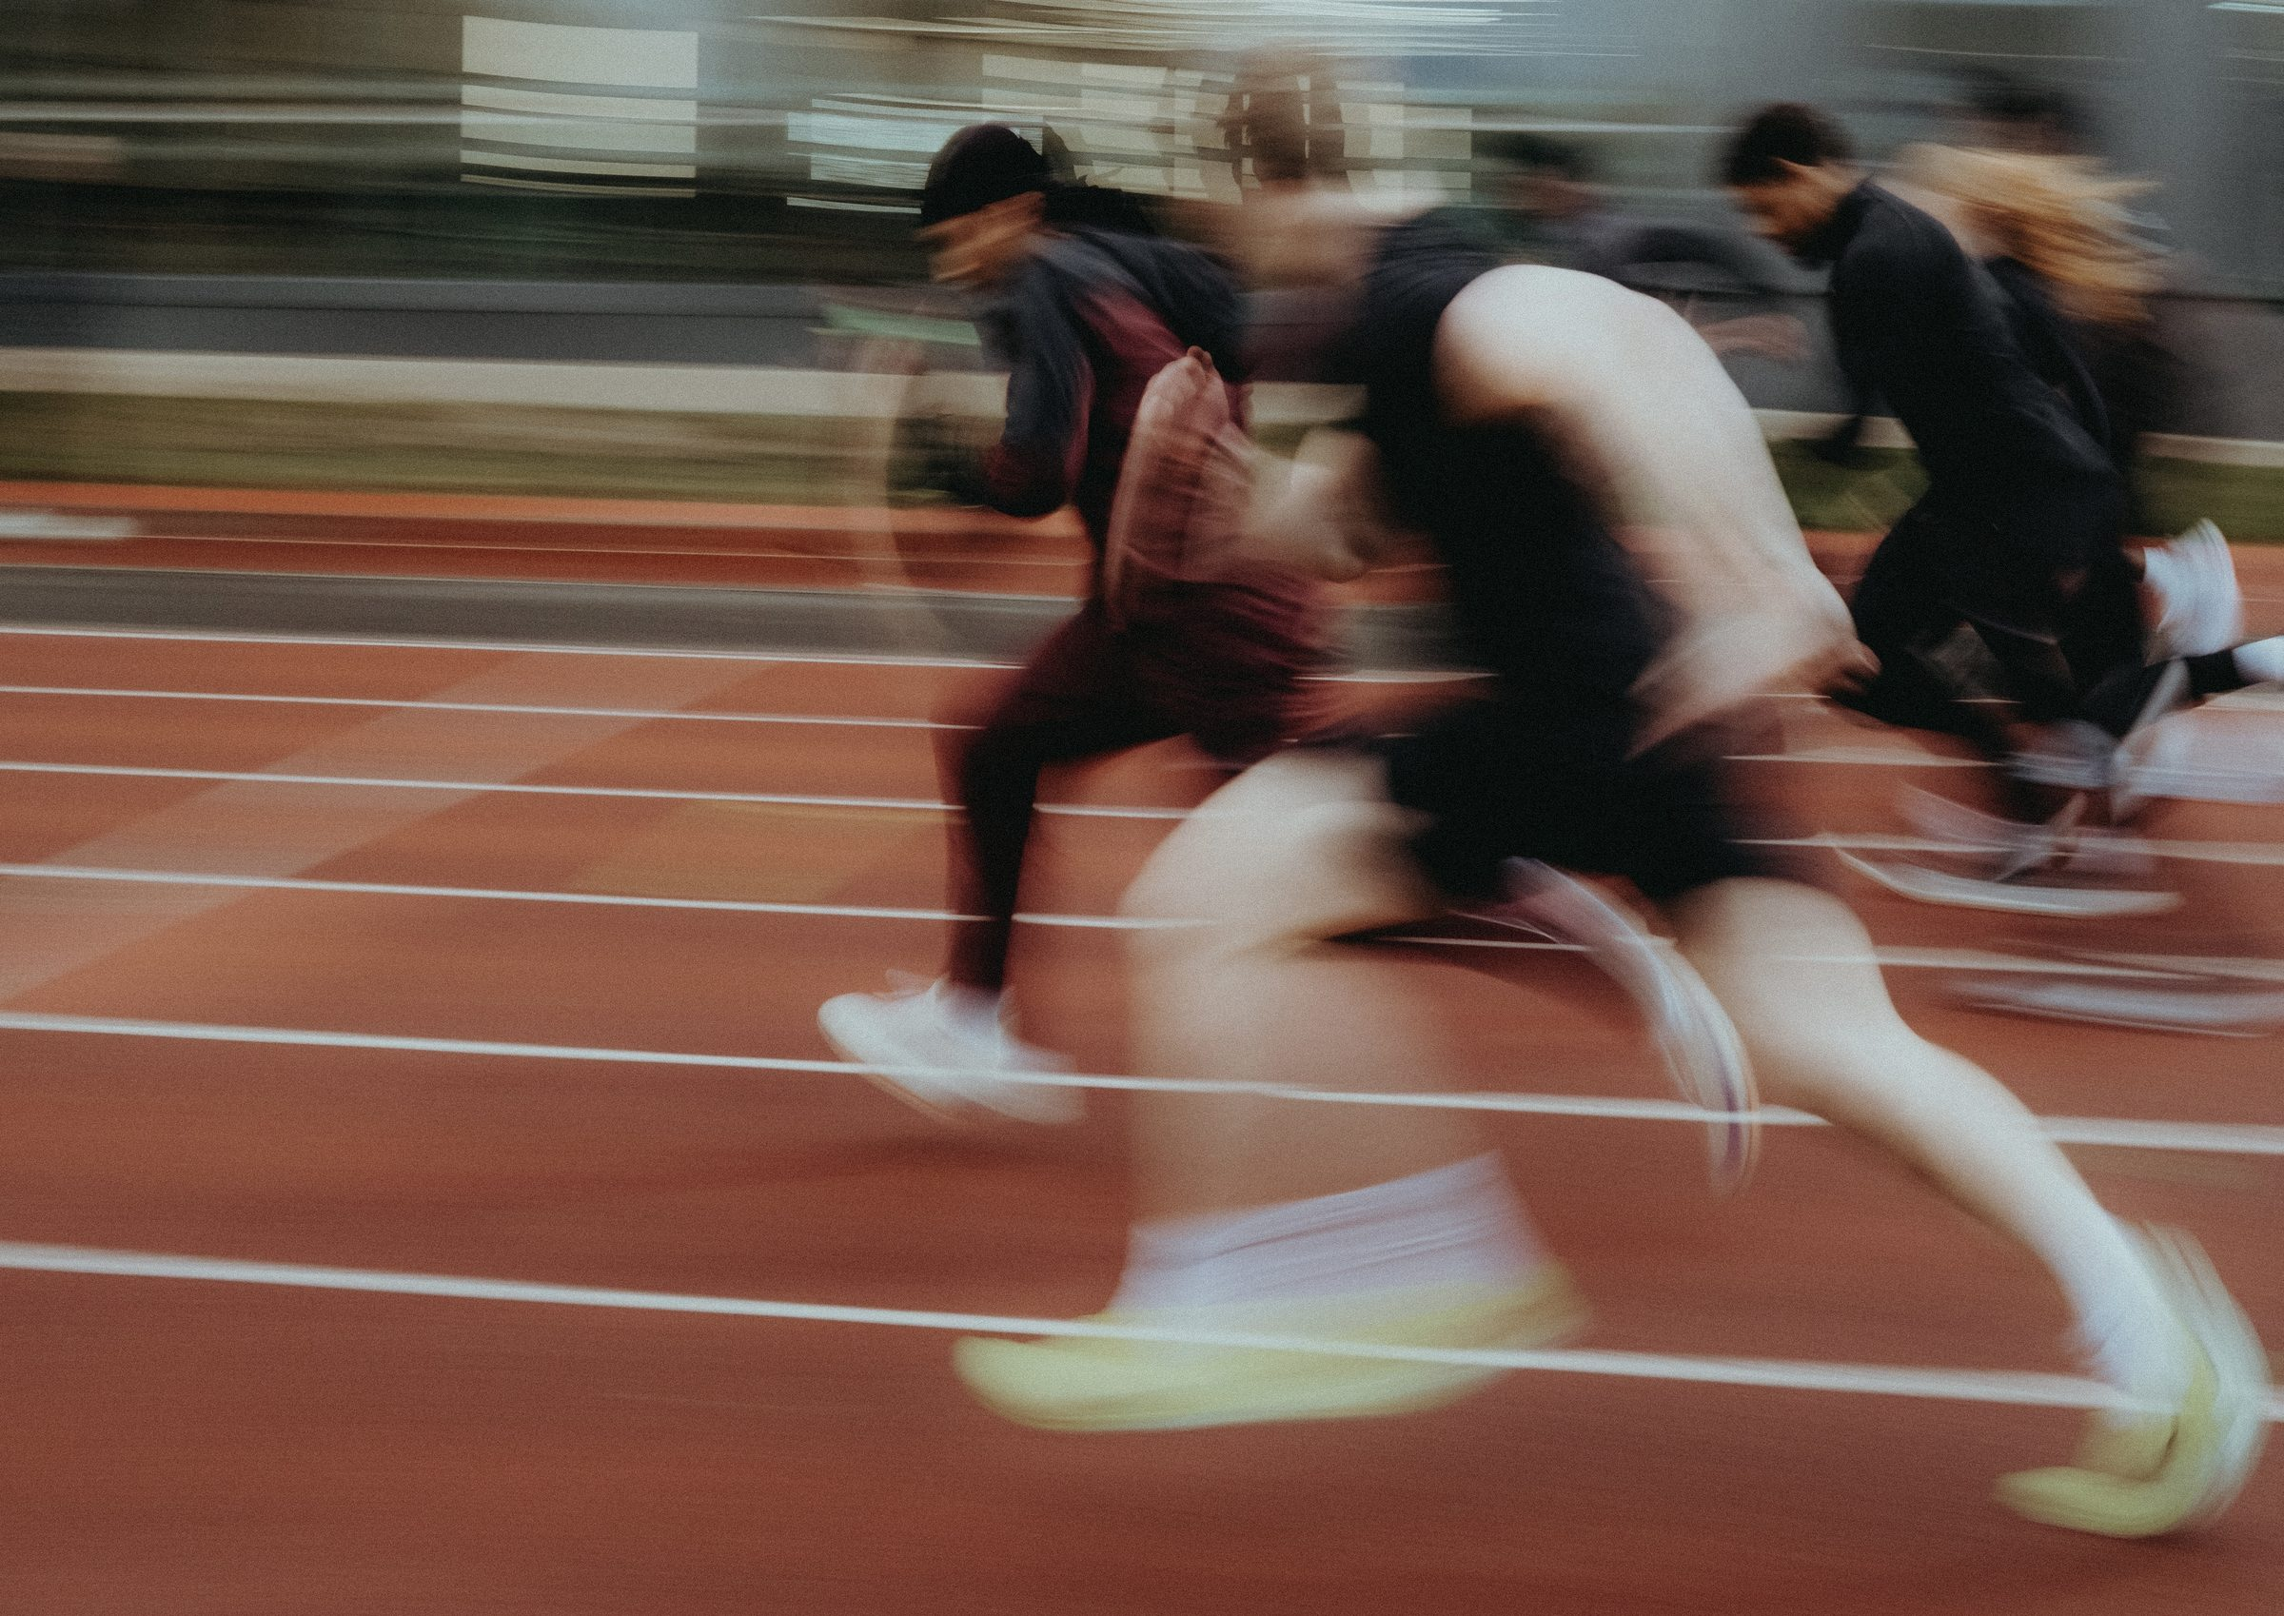
DHS BTEC SPORT · COMPONENT 2
Task 2: Participating in sport.
NAME: TEACHER:
12 marks · video evidence · Learning outcome B · filmed in lessons

Slide 2
WHAT TASK 2 ASKS
Produce a series of video clips demonstrating sports skills for your chosen sport.
At least three sports skills in isolated practices
One skill at a time, no opposition. Enough repetitions to show it was not luck.
Skills and strategies in a competitive situation
Match standard: proper numbers, a defined area of play, an official.
Approximately 15 minutes of video
Filmed in lessons across the term, not in one session.
Judged on accuracy, fluency and control
MB4 needs high levels of all three in BOTH situations, with strategies used effectively every time.
Nothing is written up for this task. It is assessed entirely on what the camera and the teacher see.
DHS BTEC Sport · Component 2 · Task 2
Page 2

Slide 3
EVIDENCE LOG
Chosen sport: ______________________. Fill this in as you go. A gap here is a gap in your marks.
Date
Technique or skill shown
Isolated or competitive
Strategy shown
Filmed?
DHS BTEC Sport · Component 2 · Task 2
Page 3

Slide 4
READINESS CHECK
Go through this with your teacher before the marks go in. Anything unticked is a gap.
Three skills, isolated
Each one filmed in a short clip, with enough repetitions to show consistency.
A competitive situation
Proper numbers, defined area, an official present.
Strategies on camera
You choosing the right option under pressure, more than once.
Sound on
Your teacher may need to hear the coaching point or the call.
Backed up
Clips off the camera and into the class folder, named and dated.
MB4: high levels of accuracy, fluency and control in both situations, strategies effective on all occasions.
DHS BTEC Sport · Component 2 · Task 2
Page 4

