Slide 1
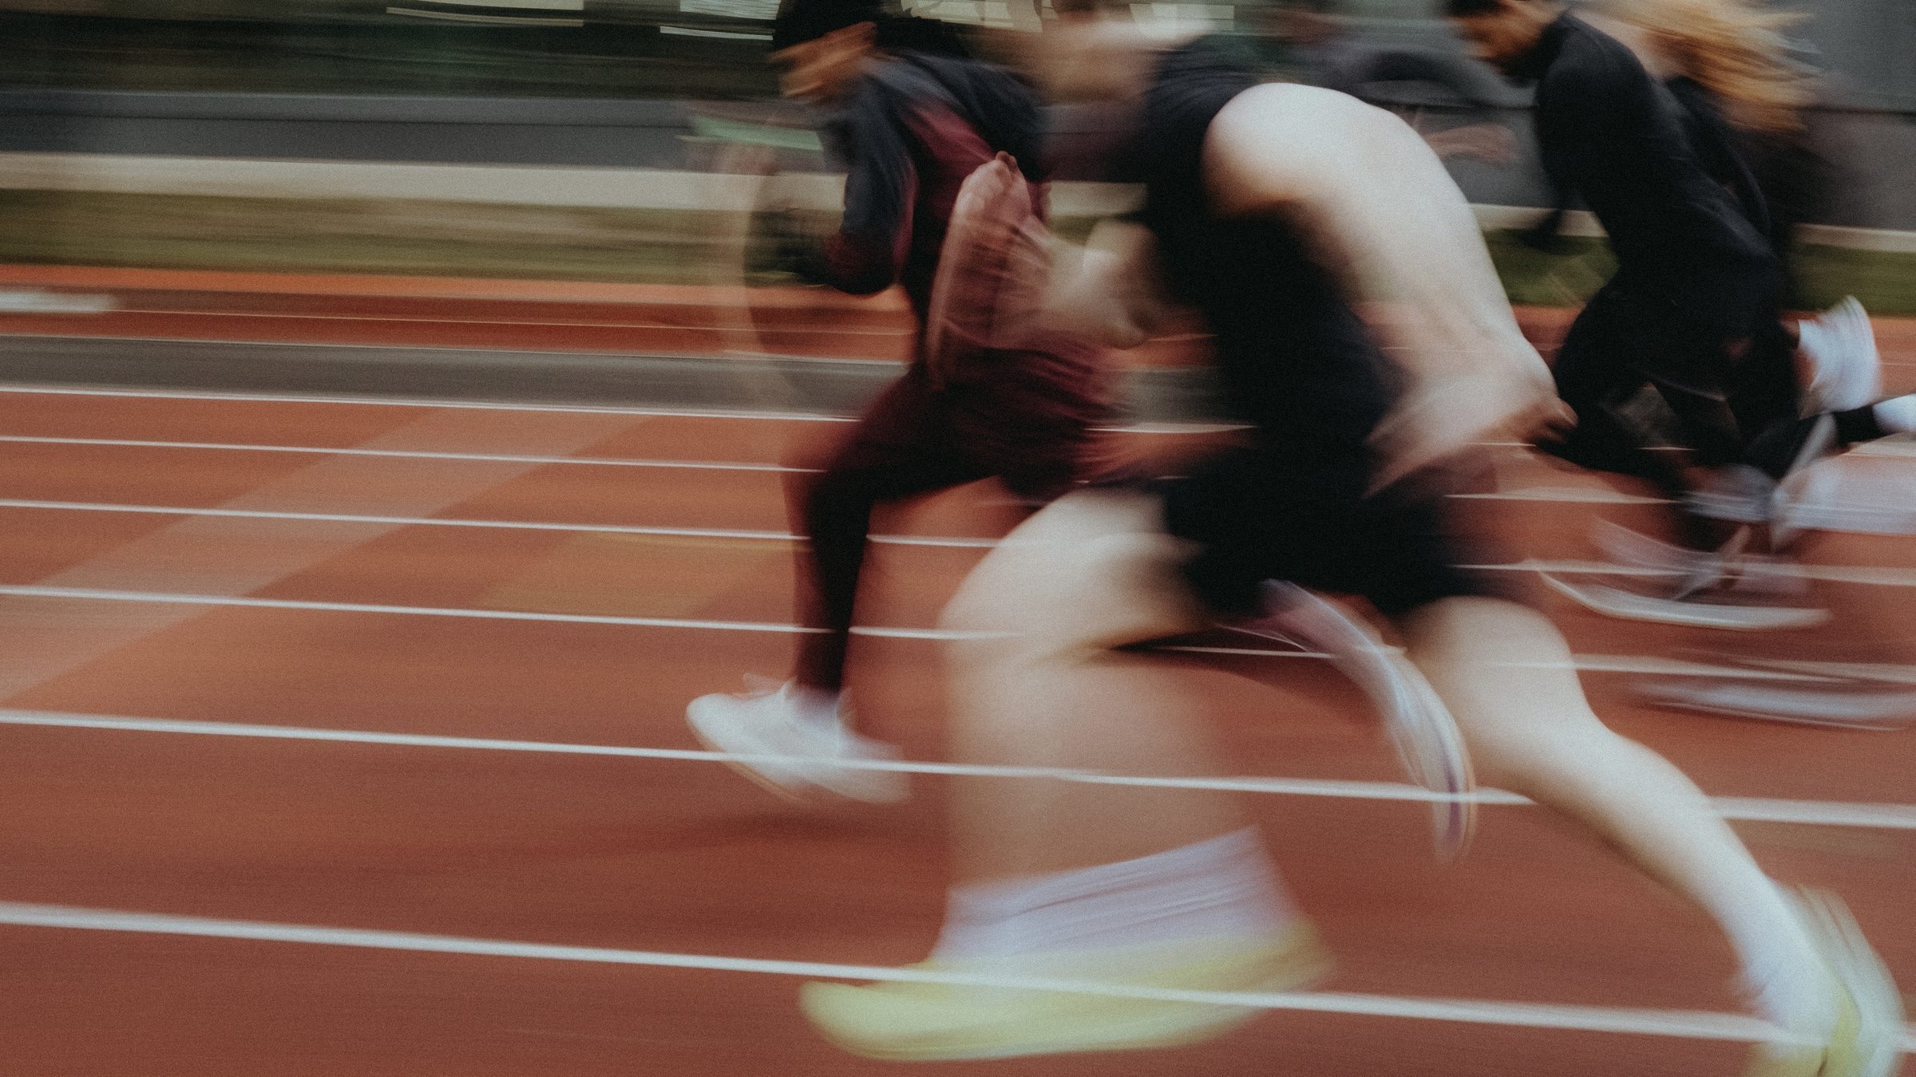
DHS BTEC SPORT · COMPONENT 2
Task 2: Participating in sport.
Produce a series of video clips demonstrating sports skills for the chosen sport in isolated practices, and sports skills and strategies in competitive situations.
12 marks · video evidence · Learning outcome B · filmed in lessons

Slide 2
TASK 2
What this task asks.
THE DEMAND
The clips must show, for the chosen sport:
at least three sports skills performed in isolated practices
sports skills and strategies performed in a competitive situation.
THE MARK BANDS
MB1
some accuracy, fluency and control
MB2
strategies on some occasions
MB3
mostly accurate, fluent and controlled
EVIDENCE REQUIRED
Video recordings lasting approximately 15 minutes.
A video camera with sound recording.
Approximately 1 hour of supervised time.
MB4
high levels in both situations, strategies effective on all occasions
This is the one task assessed entirely on what the camera and the teacher see. There is nothing to write up.
DHS BTEC Sport · Component 2 · Task 2
What this task asks

Slide 3
LEARN
What the camera has to catch.
Accuracy
the technique performed correctly, to its coaching points, repeatedly
Fluency
the movement smooth and unhurried, not snatched or broken up
Control
the player in charge of the ball, the body and the situation
Isolated practice
one skill at a time, no opposition, enough repetitions to show it is not luck
Competitive situation
proper numbers, a defined area of play, an official: match standard
Strategy
choosing the right option under pressure, and doing it again and again
MB4 needs high levels of all three, in BOTH situations, with strategies used effectively on all occasions.
DHS BTEC Sport · Component 2 · Task 2
The grid

Slide 4
APPLY
Session 1: isolated practices.
At least three sports skills, one at a time, filmed in short clips.
BEFORE YOU FILM
Enough repetitions of each to show consistency, not one lucky attempt.
Camera charged, card space checked.
Between drills, the student names the technique and the coaching point being shown.
Names visible or called on camera.
Date the clips as you go.
Film landscape, close enough to see the technique, with the sound on.
Back the footage up the same day.
DHS BTEC Sport · Component 2 · Task 2
Session 1

Slide 5
APPLY
Session 2: competitive situations.
Match standard: proper numbers, a defined area of play, and an official.
The camera needs techniques under pressure AND strategies being chosen.
Rotate the officiating role. It is live Task 3 preparation at the same time.
Log every clip in the booklet: date, skill, situation, strategy shown.
DHS BTEC Sport · Component 2 · Task 2
Session 2

Slide 6
APPLY
Session 3: closing the gaps.
Read the class tracker first. Whoever lacks competitive clips plays; whoever lacks isolated clips drills.
THE FILMING RULE
Target the missing evidence by name, not by running the session again for everybody.
Where a cohort is larger than 20,
a sample of at least 20 learners
Final check against the grid before the marks go in.
must be filmed.
Spec page 56.
DHS BTEC Sport · Component 2 · Task 2
Session 3

Slide 7
Task 2 is banked.
Clips logged, backed up, and checked against the grid.
The same competitive sessions feed Task 3: every decision you make as an official is a slide you will not have to invent.
Pearson deadline for marks and sampled work: Tue 15 December.
DHS BTEC Sport · Component 2 · Task 2

