Slide 1
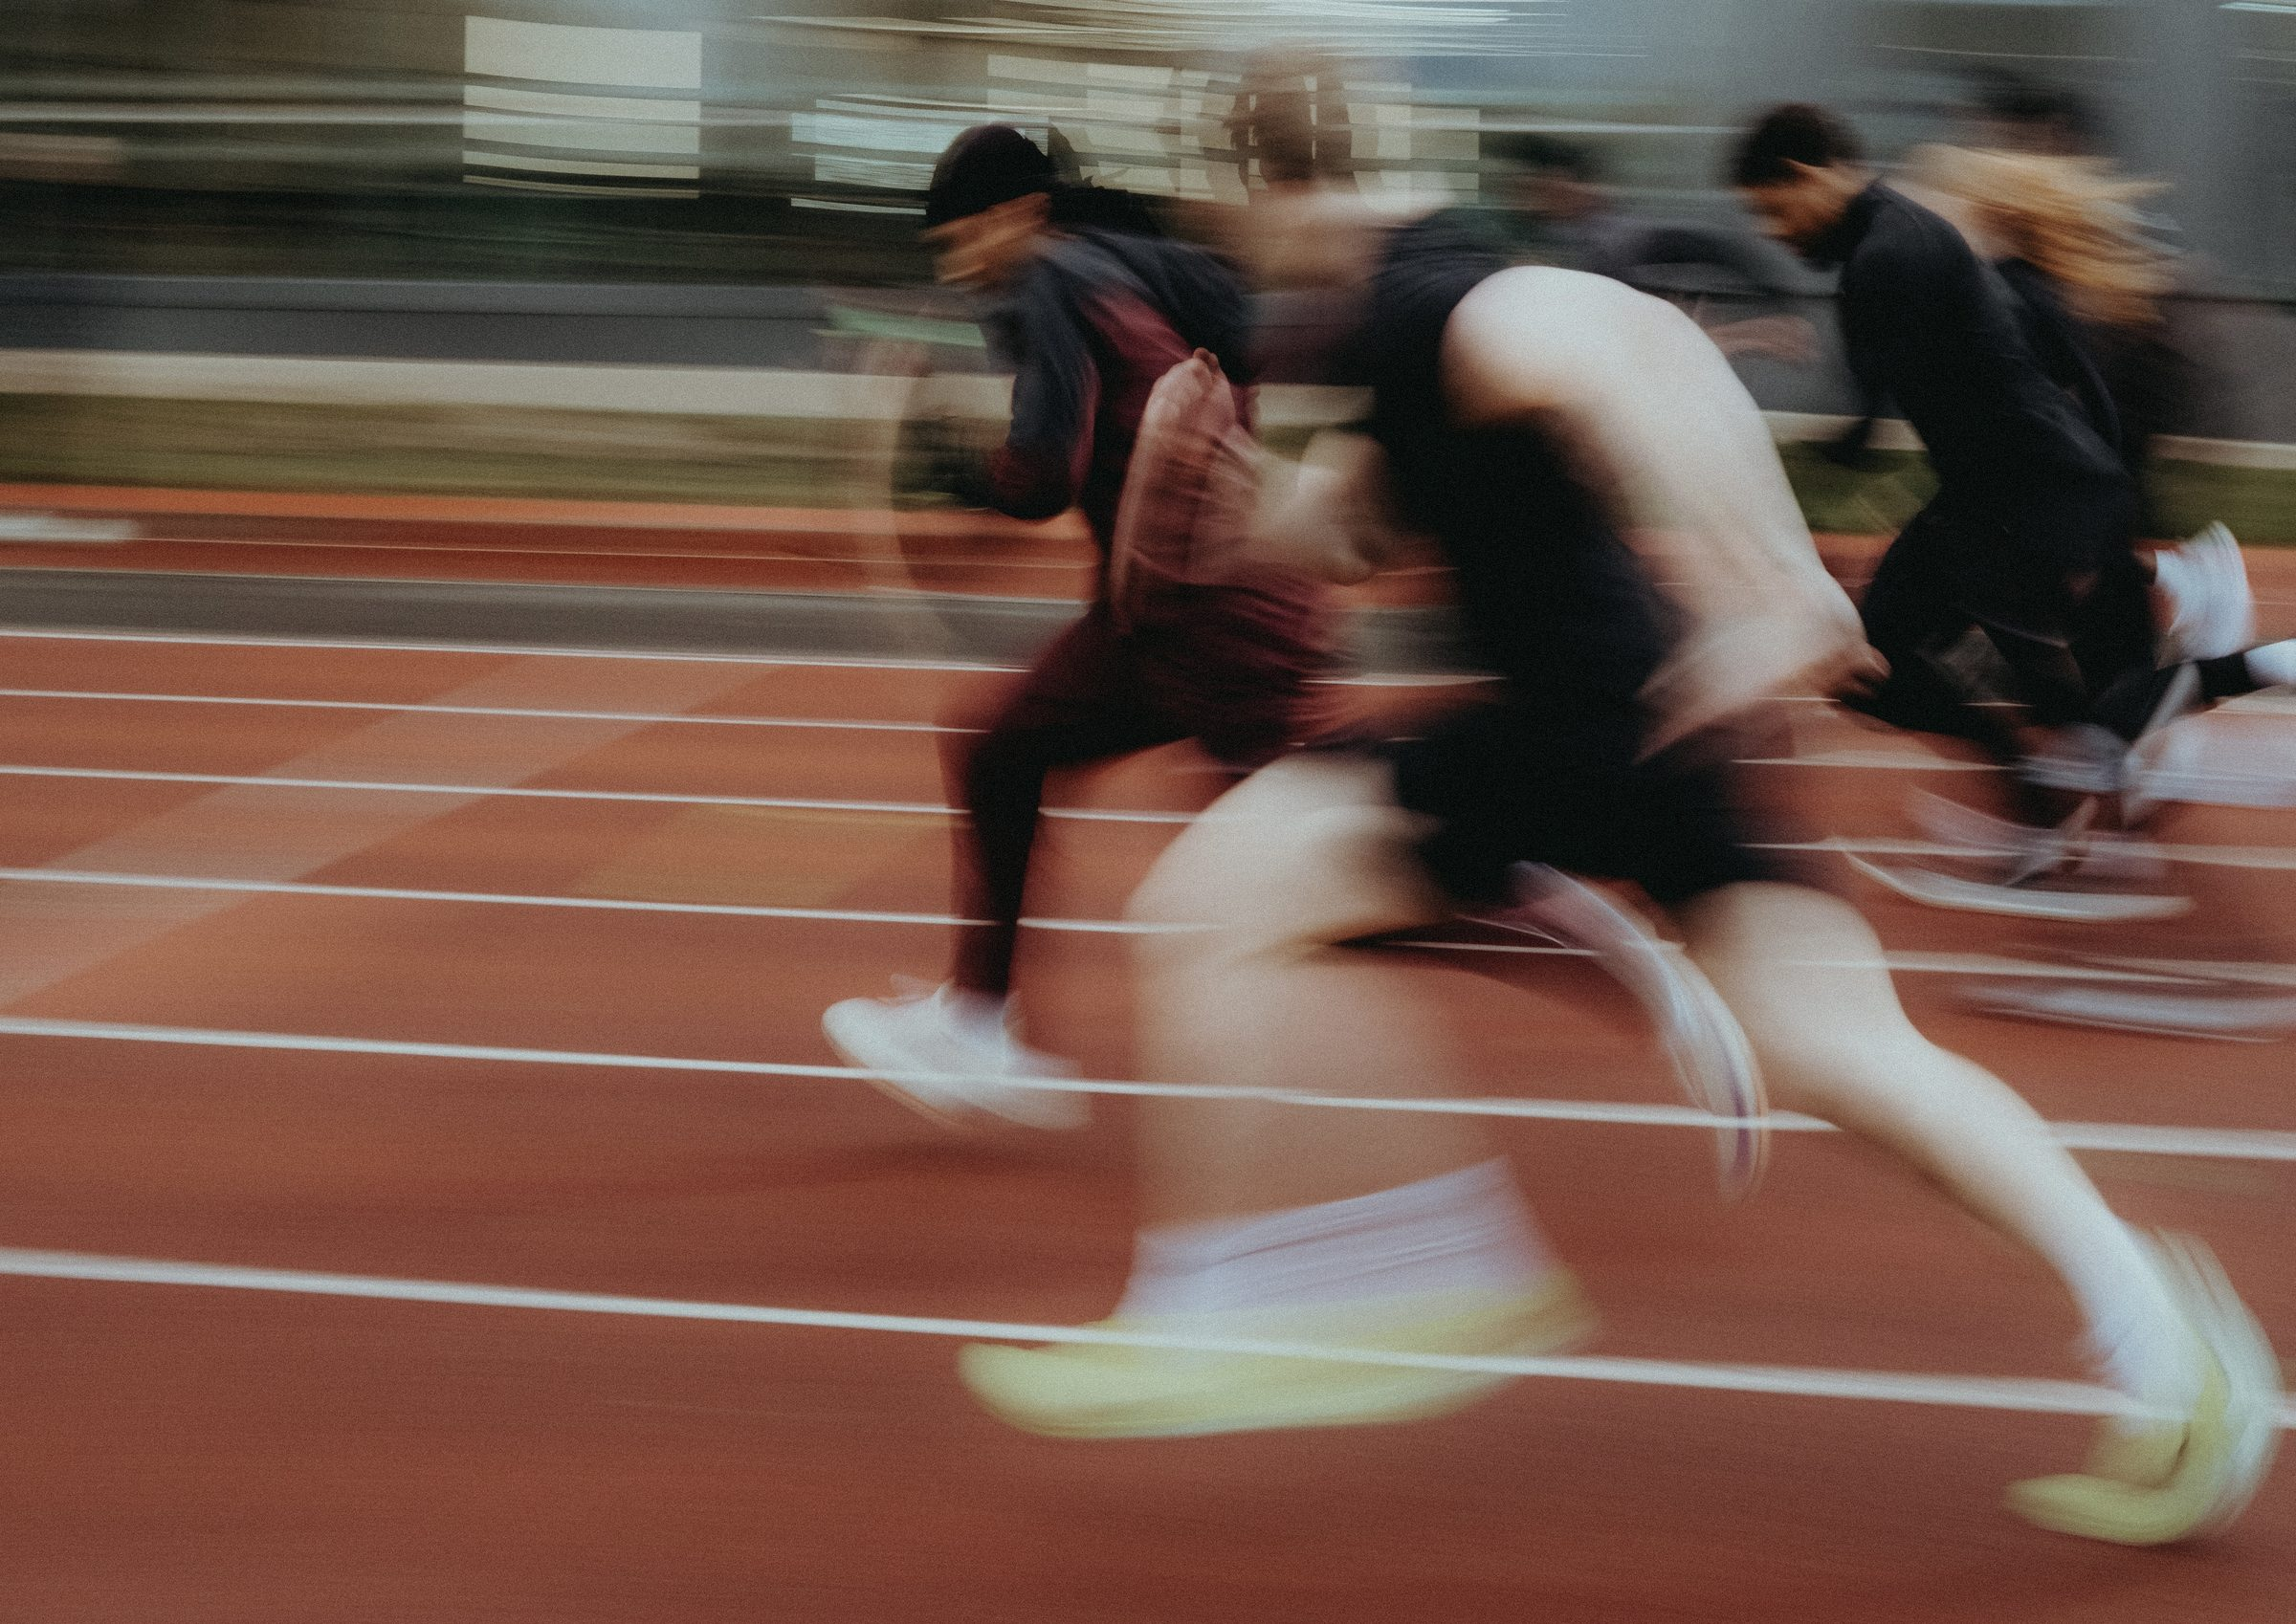
DHS BTEC SPORT · COMPONENT 2
Task 3: Officiating in sport.
NAME: TEACHER:
12 marks · presentation of 10–15 slides · Learning outcome B · sat Wed 11 Nov

Slide 2
WHAT TASK 3 ASKS
Produce a presentation to help prospective new members understand the officials and the rules for your chosen sport.
The officials
Their different roles and responsibilities in the chosen sport.
Length of time of play
The sport's real rules: periods, timings, stoppages, extra time.
The scoring system
The sport's real rules: how points are earned, values, winning, ties.
The official's actions
What they do to make sure those two rules are adhered to.
10–15 slides, approximately 1 hour
Text, images, up to 3 minutes of video, and slide notes.
Physical presentation is not required. If you do present, approximately 5–10 minutes.
DHS BTEC Sport · Component 2 · Task 3
Page 2

Slide 3
THE OFFICIALS IN YOUR SPORT
Chosen sport: ______________________. Not every sport uses all five. Fill in the ones yours does.
Official
Their role in this sport
Their two key responsibilities
Referee / umpire
Assistant referee / line umpire
Scorers / judges
Timekeepers
Video review officials
DHS BTEC Sport · Component 2 · Task 3
Page 3

Slide 4
THE SIX RESPONSIBILITIES
Every official carries all six. For each, write what it looks like in your chosen sport.
Responsibility
What it looks like in your sport
Appearance
Equipment
Fitness requirements
Effective communication
Control of players
Health and safety
DHS BTEC Sport · Component 2 · Task 3
Page 4

Slide 5
RULE AREA 1: LENGTH OF TIME OF PLAY
Real numbers, as the NGB states them. Get a partner to check every one against the rulebook.
Rule
Your sport's actual rule
What the official does
How long is a game?
How is it divided?
When does the clock stop?
Who controls the clock?
What happens at time?
Extra time
DHS BTEC Sport · Component 2 · Task 3
Page 5

Slide 6
RULE AREA 2: SCORING SYSTEM
Real numbers, as the NGB states them. Get a partner to check every one against the rulebook.
Rule
Your sport's actual rule
What the official does
How are points earned?
What is each worth?
Who records the score?
How is it signalled?
What decides the winner?
What happens in a tie?
DHS BTEC Sport · Component 2 · Task 3
Page 6

Slide 7
THE OFFICIAL'S ACTIONS
For each rule area above, the response needs the action and the reason. This is where the top band is won.
The signal
The standardised gesture or whistle that tells everyone the decision.
The communication
How the decision is made clear to both sides immediately.
The restart
How play begins again after the stoppage.
The sanction
The penalty, if the sport has one for that offence.
How it varies
When the same offence gets a different response: advantage played, repeated offences, severity.
Responsibilities listed is a low band. Responsibilities applied to real moments is the top of the grid.
DHS BTEC Sport · Component 2 · Task 3
Page 7

Slide 8
SLIDE PLAN
One line per slide, 10–15 slides in total. Tick that all three strands appear before you build.
Slide
What goes on it
Which strand
1
2
3
4
5
6
7
8
9
10
11
12
DHS BTEC Sport · Component 2 · Task 3
Page 8

Slide 9
SELF-TEST
Cover the answers. Write your responses in your book, then check against the teacher deck.
1
Name the five officials in sports competitions.
2
Name the six responsibilities of officials.
3
Which two rule areas does this task cover?
4
What does an official do when a rule is broken? Give four things.
5
What form does your evidence take, and how long do you get?
Anything you cannot answer from memory is this week's revision list.
DHS BTEC Sport · Component 2 · Task 3
Page 9

