Slide 1
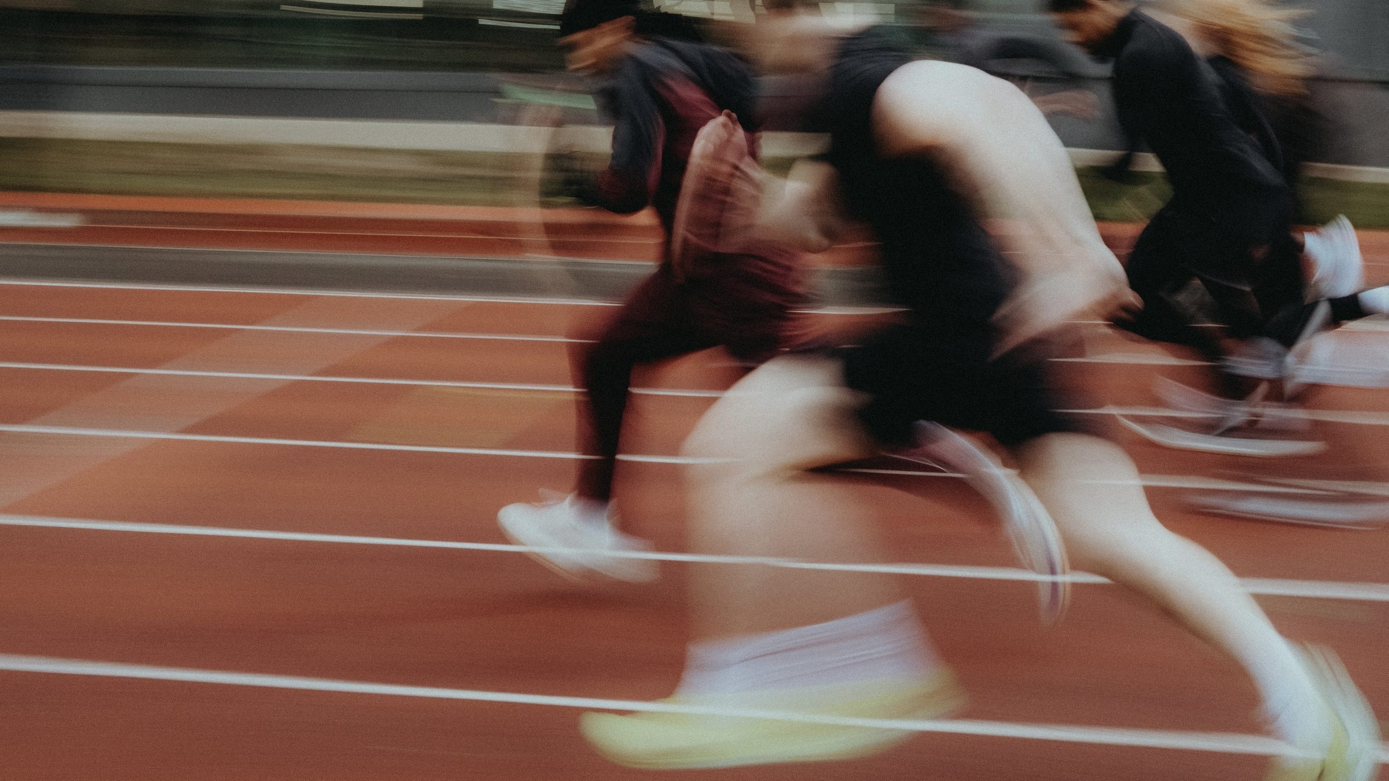
DHS BTEC SPORT · COMPONENT 2
Task 3: Officiating in sport.
Produce a presentation to help prospective new members understand the roles and responsibilities of the officials for your chosen sport, and the rules around the length of time of play and the scoring system.
12 marks · presentation of 10–15 slides · Learning outcome B · sat Wed 11 Nov

Slide 2
TASK 3
What this task asks.
THE DEMAND
The presentation covers three things, for the chosen sport:
the different roles and responsibilities of the officials
the rules and regulations around the length of time of play, and the scoring system
the actions officials take to make sure those two rules are adhered to.
THE MARK BANDS
MB1
basic account · some omissions
MB2
partially developed · few omissions
MB3
mostly developed · minor omissions
EVIDENCE REQUIRED
MB4
well-developed · no omissions
A presentation of approximately 10–15 slides: text, images, embedded audio or video of no more than 3 minutes, and slide notes.
Physical presentation is not required. If given, approximately 5–10 minutes.
Approximately 1 hour of supervised time.
The live paper names the two rule areas: LENGTH OF TIME OF PLAY and SCORING SYSTEMS. Both need the sport's real numbers.
DHS BTEC Sport · Component 2 · Task 3
What this task asks

Slide 3
LESSON 1
The officials and their responsibilities
By the end of this lesson…
Name the officials and their roles in competitions
Explain the six responsibilities every official carries
Map both onto the chosen sport
DHS BTEC Sport · Component 2 · Task 3
Lesson 1

Slide 4
RETRIEVAL
Do now.
In your book, full sentences, on your own. 5 minutes.
1.
Which task is assessed entirely on video evidence?
ANSWERS · REVEAL AFTER 5 MIN
1.
Task 2, Participating in sport
2.
What form does the Task 3 evidence take?
2.
A presentation of approximately 10–15 slides
3.
Which two rule areas does the paper name?
3.
The length of time of play, and the scoring system
DHS BTEC Sport · Component 2 · Task 3
Lesson 1

Slide 5
LEARN
The officials.
Referee / umpire
the main official: applies the laws, controls the game, awards sanctions
Assistant referee / line umpire
supports the main official on the lines: out of play, offside, close calls
Scorers / judges
record the score and, in judged sports, award the marks
Timekeepers
start, stop and signal playing time, including stoppages and extra time
Video review officials
review decisions on replay where the sport allows it, and advise the main official
Not every sport has all five. Name the ones your chosen sport actually uses, and say what each does in that sport.
DHS BTEC Sport · Component 2 · Task 3
Lesson 1

Slide 6
LEARN
The six responsibilities.
Appearance
correct kit, distinguishable from both teams, professional
Equipment
whistle, cards, watch, flags, communication kit: checked before play
Fitness requirements
keeping up with play so decisions are made close to the action
Effective communication
clear signals and explanations so both sides understand the decision at once
Control of players
applying the laws consistently to keep the game safe and fair
Health and safety
checking the playing area, equipment and players before and during play
Responsibilities listed is a low band. Responsibilities applied to real moments of the chosen sport is the top of the grid.
DHS BTEC Sport · Component 2 · Task 3
Lesson 1

Slide 7
APPLY
Map it onto the sport.
Name every official you would see at a competitive match in the chosen sport.
BOOKLET PAGES 3 AND 4
For each: their role in one sentence, then their two most important responsibilities in that sport.
The officials table and the
responsibilities table are your
Describe one moment where an official's decision changed a game you played or watched.
revision bank for this task.
Complete them for the chosen sport.
DHS BTEC Sport · Component 2 · Task 3
Lesson 1

Slide 8
LESSON 2
Length of time of play, and the scoring system
By the end of this lesson…
State the chosen sport's rules in both areas with NGB accuracy
Use the sport's real numbers, timings and terms
Explain how each rule works in a live game
DHS BTEC Sport · Component 2 · Task 3
Lesson 2

Slide 9
RETRIEVAL
Do now.
In your book, full sentences, on your own. 5 minutes.
1.
Name the officials in your chosen sport.
ANSWERS · REVEAL AFTER 5 MIN
1.
From booklet page 3, for your sport
2.
Name four of the six responsibilities.
2.
Any four: appearance · equipment · fitness requirements · effective communication · control of players · health and safety
3.
Why does an official need fitness? Give a sporting example.
3.
To keep up with play so decisions are made close to the action, for example a referee tracking a counter-attack
DHS BTEC Sport · Component 2 · Task 3
Lesson 2

Slide 10
LEARN
The two rule areas, in NGB depth.
Time · the game
how long a game lasts, and how it is divided: halves, quarters, sets or innings
Time · the clock
when it stops, who controls it, and what happens when time is up
Time · extra time
what happens if the scores are level at full time, and how long it runs
Scoring · the actions
how points are earned in the chosen sport, and what each one is worth
Scoring · the winner
what decides the winner at the end of the game
Scoring · a tie
what happens when the scores finish level
Two areas, six questions. Vague rules score low. Numbers, names and the NGB's own terms score.
DHS BTEC Sport · Component 2 · Task 3
Lesson 2

Slide 11
APPLY
Both areas, chosen sport, real numbers.
Write the chosen sport's actual rules in both areas: numbers, timings, values, as the NGB states them.
Swap with a partner. Every number gets checked against the rulebook.
Booklet pages 5 and 6 finished to presentation standard.
DHS BTEC Sport · Component 2 · Task 3
Lesson 2

Slide 12
LESSON 3
The actions officials take
By the end of this lesson…
Explain what the official does when each rule is broken
Give the signal, the restart and the sanction
Explain how the same offence can get a different response
DHS BTEC Sport · Component 2 · Task 3
Lesson 3

Slide 13
RETRIEVAL
Do now.
In your book, full sentences, on your own. 5 minutes.
1.
State one rule about the length of time of play, with its numbers.
ANSWERS · REVEAL AFTER 5 MIN
1.
Checked against booklet page 5
2.
State one rule about the scoring system, with its numbers.
2.
Checked against booklet page 6
3.
What three things do officials use to apply the rules?
3.
Signals · communication of decisions · positioning
DHS BTEC Sport · Component 2 · Task 3
Lesson 3

Slide 14
LEARN
What the official actually does.
1
The signal
2
The communication
the standardised gesture or whistle that tells everyone the decision
how the decision is made clear to both sides immediately
3
The restart
4
The sanction
how play begins again after the stoppage
the penalty, if the sport has one for that offence
5
Positioning
6
Variability
where the official stands to see the offence in the first place
when the same offence gets a different response: advantage, repeat offences, severity
The variability point is the stretch. MB4 responses explain when the same offence is treated differently, and why.
DHS BTEC Sport · Component 2 · Task 3
Lesson 3

Slide 15
LEARN
Model slide notes, banded.
WHY THIS REACHES MB4
“The referee is the main official in football and controls the match from inside the pitch. Their responsibility for control of players means applying the laws consistently: when a player commits a foul the referee signals with the whistle and arm, awards a free kick to the other team, and can caution with a yellow card if the foul is reckless. Effective communication matters here because the decision must be clear to players on both sides immediately, which is why signals are standardised. The same foul is not always treated the same way: if the fouled team keeps possession and an attack is on, the referee can play advantage and come back to the caution when play stops.”
The official named, the role located in the sport
Responsibilities applied, not just listed
The action given: signal, restart, sanction
The variability point: advantage
Slide notes carry this depth. The slide itself stays readable.
DHS BTEC Sport · Component 2 · Task 3
Lesson 3

Slide 16
LESSON 4
Building the presentation
By the end of this lesson…
Plan 10–15 slides that cover all three strands
Use slide notes to carry the depth
Check the coverage before you build
DHS BTEC Sport · Component 2 · Task 3
Lesson 4

Slide 17
LEARN
What 10 to 15 slides looks like.
1
Title and chosen sport
2
The officials
1 slide
3–4 slides: one per official, role and responsibilities applied
3
Length of time of play
4
Scoring system
2–3 slides: the rules with real numbers
2–3 slides: the rules with real numbers
5
The official's actions
6
Images, video, notes
3–4 slides: signal, restart, sanction, variability
images and up to 3 minutes of embedded footage may support
Physical presentation is not required. If you do present, approximately 5–10 minutes.
DHS BTEC Sport · Component 2 · Task 3
Lesson 4

Slide 18
APPLY
Plan it, then build it.
Fill in the slide plan on booklet page 8: one line per slide, and which strand it covers.
Check that all three strands appear before you build a single slide.
Depth goes in the notes. Text on the slide stays readable from the back of a room.
DHS BTEC Sport · Component 2 · Task 3
Lesson 4

Slide 19
LESSON 5
Timed practice
By the end of this lesson…
Produce a full response under timed conditions
Cover all three strands with no omissions
Leave with a band and a named gap
DHS BTEC Sport · Component 2 · Task 3
Lesson 5

Slide 20
EXAM PRACTICE
Full response, timed.
Timed to the real allocation of approximately one hour. Silence, no notes.
SAT
All three strands: officials applied, both rule areas with numbers, actions with variability.
Wed 11 November
Approximately 1 hour
Your work comes back with a band and one named gap to close.
Supervised
10–15 slides
DHS BTEC Sport · Component 2 · Task 3
Lesson 5

Slide 21
Booklet answers.
One slide per booklet page. The page number is on each slide.

Slide 22
BOOKLET PAGE 3
The officials.
Referee / umpire
the main official: applies the laws, controls the game, awards sanctions
Assistant referee / line umpire
supports the main official on the lines: out of play, offside, close calls
Scorers / judges
record the score and, in judged sports, award the marks
Timekeepers
start, stop and signal playing time, including stoppages and extra time
Video review officials
review decisions on replay where the sport allows it, and advise the main official
DHS BTEC Sport · Component 2 · Task 3
Booklet answers

Slide 23
BOOKLET PAGE 4
The six responsibilities.
Appearance
correct kit, distinguishable from both teams, professional
Equipment
whistle, cards, watch, flags, communication kit: checked before play
Fitness requirements
keeping up with play so decisions are made close to the action
Effective communication
clear signals and explanations so both sides understand the decision at once
Control of players
applying the laws consistently to keep the game safe and fair
Health and safety
checking the playing area, equipment and players before and during play
DHS BTEC Sport · Component 2 · Task 3
Booklet answers

Slide 24
BOOKLET PAGE 9
Self-test.
1
Referee/umpire · assistant referee/line umpire · scorers/judges · timekeepers · video review officials
2
Appearance · equipment · fitness requirements · effective communication · control of players · health and safety
3
The length of time of play, and the scoring system
4
The signal · the communication · the restart · the sanction · positioning · how it varies
5
A presentation of approximately 10–15 slides, in approximately one hour
DHS BTEC Sport · Component 2 · Task 3
Booklet answers

Slide 25
Task 3 is done.
Task 3 comes back with a band and one named gap.
Task 4's write-up runs from the footage already banked.
Then feedback rounds on every task, and final versions.
Pearson deadline for marks and sampled work: Tue 15 December.
DHS BTEC Sport · Component 2 · Task 3

