Slide 1
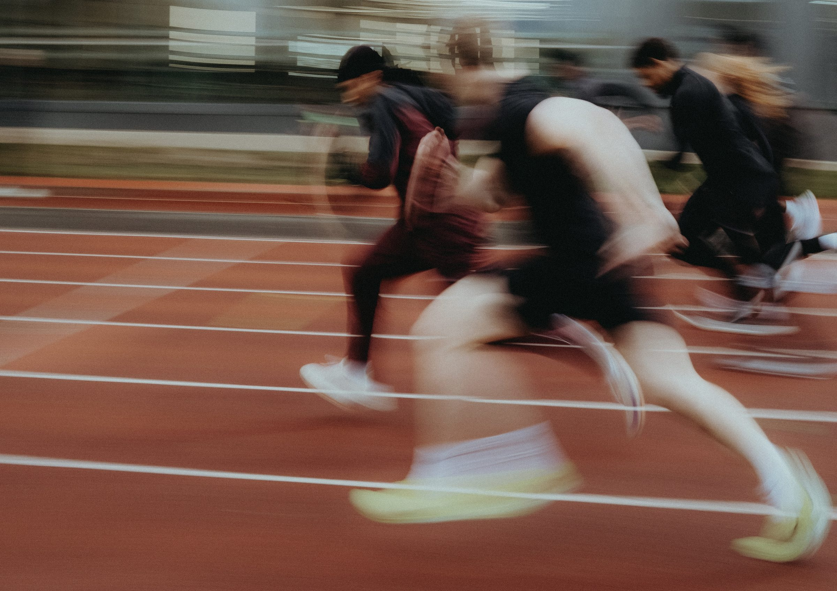
DHS BTEC SPORT · COMPONENT 2
Task 4: Improving participants' sports skills.
NAME: TEACHER:
24 marks · written plan and video · Learning outcome C · footage banked end of June

Slide 2
WHAT TASK 4 ASKS
The biggest task on the component: 24 of the 60 marks, in two halves.
The written plan
The drills and conditioned practices you used to develop one sports skill.
The justification
Why each drill develops the techniques of that skill in competition.
3–5 pages of A4
The drills you already filmed ARE the plan. The writing explains them.
The video, approximately 10 minutes
You demonstrating the techniques with teaching points, the drills running, and you supporting participants.
Approximately 1 hour, supervised
For the written half. The footage is already banked.
MB4: a fully detailed plan and a fully developed justification, specific to the techniques of the chosen skill.
DHS BTEC Sport · Component 2 · Task 4
Page 2

Slide 3
THE DRILL LADDER
Chosen sport: __________________. Chosen skill: __________________. Place each drill you delivered on the ladder.
Stage
What it means
Your drill at this stage
1 · Unopposed stationary
the technique in isolation: no pressure, no movement
2 · Introduction of travel
the same technique, now on the move
3 · Passive opposition
a defender present but not competing
4 · Active opposition
live pressure, game-real decisions
Conditioned practice
rule changes that force the focus skill
DHS BTEC Sport · Component 2 · Task 4
Page 3

Slide 4
DRILL PLANNER
One row per drill. The six organisation decisions, then the cues you actually gave on camera.
Drill
Space and equipment
Organisation and timing
Teaching points given
1
2
3
4
5
DHS BTEC Sport · Component 2 · Task 4
Page 4

Slide 5
WRITING THE JUSTIFICATION
Generic justifications name the drill. MB4 justifications name the technique.
Name the drill and its stage
Where it sits on the ladder, and why it sits there.
Name the techniques
The actual techniques of the skill. Elbows, feet, timing, contact point.
Explain why this stage develops them
What breaks down at this stage, and what the drill fixes.
Point at the footage
The moment on camera where you coached exactly that.
Model
“Drill 2 moves the chest pass from standing pairs into passing on the move. I chose it because the technique of a chest pass, stepping into the pass with elbows extending and thumbs driving through the ball, breaks down when players start travelling: the feet arrive late and the pass drifts. Adding travel forces players to time the step so the pass releases flat, which is exactly the fault I corrected on camera with the cue 'step, extend, snap'.”
Count the technique words in each of your paragraphs. Fewer than three and it is not there yet.
DHS BTEC Sport · Component 2 · Task 4
Page 5

Slide 6
YOUR JUSTIFICATIONS
One paragraph per drill, in the shape above. Continue on paper.
Technique words counted by: Band awarded:
DHS BTEC Sport · Component 2 · Task 4
Page 6

Slide 7
VIDEO EVIDENCE CHECK
Watch your clips against each requirement and tick it off by name. Anything missing goes on the catch-up list.
You demonstrating the techniques
Of the chosen skill, using key teaching points to support good practice.
The drills running
Participants taking part in your choice of drills to improve the skill.
You supporting participants
Observing, instructing, giving teaching points and feedback.
Approximately 10 minutes
With sound. Named, dated and backed up into the class folder.
Self-test: name the four drill stages · define a conditioned practice · name the six organisation decisions · name the four ways you support participants · state both evidence requirements.
DHS BTEC Sport · Component 2 · Task 4
Page 7

