Slide 1
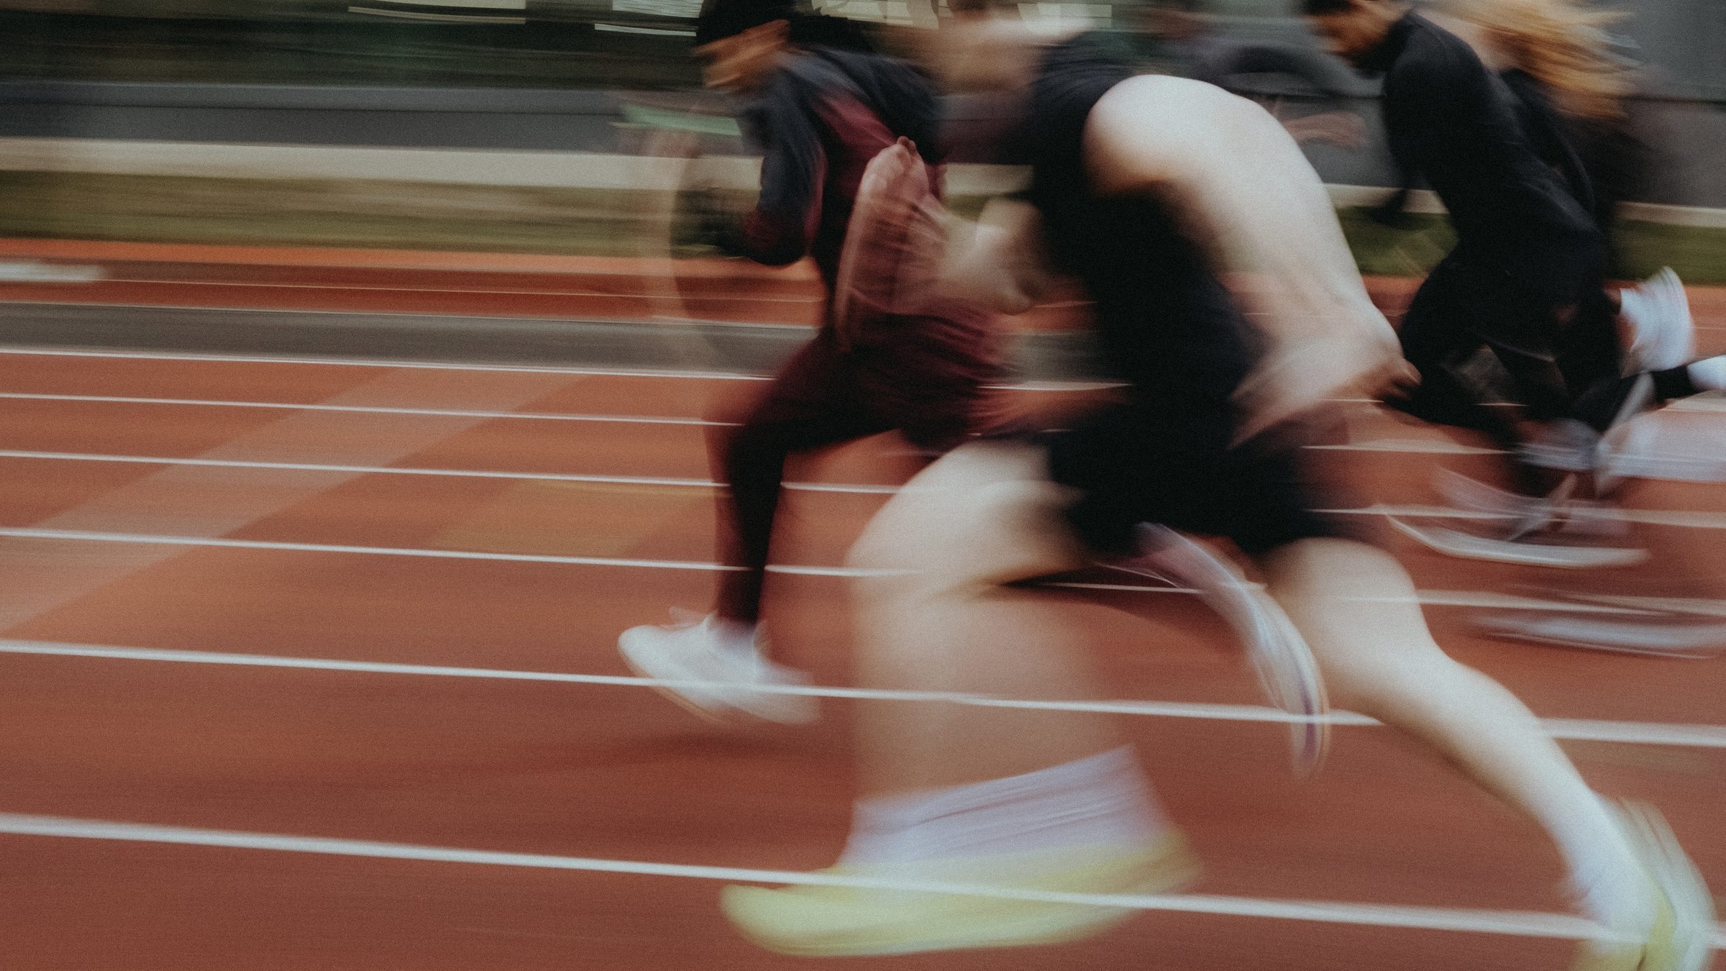
DHS BTEC SPORT · COMPONENT 2
Task 4: Improving participants' sports skills.
Produce a session plan of the drills and conditioned practices you will use to develop one sports skill, and video evidence of you delivering demonstrations and supporting participants through them.
24 marks · written plan and video · Learning outcome C · footage banked end of June

Slide 2
TASK 4
What this task asks.
THE DEMAND
The written response needs:
a plan of the drills and conditioned practices to develop the chosen skill
an account justifying each choice against the requirements of the skill in competition.
The video needs you demonstrating the techniques with key teaching points, the drills themselves, and you supporting participants through them.
THE MARK BANDS
MB1
basic plan, limited justification
MB2
partially detailed plan, some justification
MB3
mostly detailed plan, mostly relevant justification
EVIDENCE REQUIRED
MB4
fully detailed plan, fully developed justification specific to the techniques
A written response of 3–5 pages of A4.
Video recordings lasting approximately 10 minutes.
Approximately 1 hour of supervised time.
This is the biggest task on the component, worth 24 of the 60 marks. The video half is already filmed; the writing describes and justifies what the camera caught.
DHS BTEC Sport · Component 2 · Task 4
What this task asks

Slide 3
LESSON 1
Drills and conditioned practices
By the end of this lesson…
Name the four drill types and what a conditioned practice is
Plan the organisation of a drill
Connect the footage already banked to the plan this task needs
DHS BTEC Sport · Component 2 · Task 4
Lesson 1

Slide 4
RETRIEVAL
Do now.
In your book, full sentences, on your own. 5 minutes.
1.
What did the Task 4 filming catch you doing?
ANSWERS · REVEAL AFTER 5 MIN
1.
Delivering drills with demonstrations, teaching points and support to improve a participant's technique
2.
Name the four drill types, unopposed to opposed.
2.
Unopposed stationary · introduction of travel · passive opposition · active opposition
3.
What is a conditioned practice?
3.
Using rule changes to focus practice on one specific skill
DHS BTEC Sport · Component 2 · Task 4
Lesson 1

Slide 5
LEARN
The drill ladder.
Unopposed stationary
the technique in isolation: no pressure, no movement
Introduction of travel
the same technique, now performed on the move
Passive opposition
a defender is present but is not competing for the ball
Active opposition
live pressure and game-real decisions
Conditioned practices
rule changes that force the focus skill: two-touch only, must-dribble zones, no forward pass
A plan that climbs the ladder shows progression. A plan of four unopposed drills does not.
DHS BTEC Sport · Component 2 · Task 4
Lesson 1

Slide 6
APPLY
Organisation and support.
Six organisation decisions for every drill: space, equipment, organisation of participants, timing, demonstrations, positioning.
BOOKLET PAGE 4
Four ways you support participants: observing, giving instructions, giving teaching points, giving feedback.
The drill planner has a row
per drill and a column per
For each drill you delivered, write down all ten. That is the spine of the plan.
decision. Fill it in from
the footage.
DHS BTEC Sport · Component 2 · Task 4
Lesson 1

Slide 7
LESSON 2
From footage to plan
By the end of this lesson…
Know what the written plan requires
Inventory the footage against the drill ladder
Build the skeleton of the written plan
DHS BTEC Sport · Component 2 · Task 4
Lesson 2

Slide 8
RETRIEVAL
Do now.
In your book, full sentences, on your own. 5 minutes.
1.
Name the four drill types, unopposed to opposed.
ANSWERS · REVEAL AFTER 5 MIN
1.
Unopposed stationary · introduction of travel · passive opposition · active opposition
2.
Name the six organisation decisions for a drill.
2.
Space · equipment · organisation of participants · timing · demonstrations · positioning
3.
Name the four ways you supported participants.
3.
Observing · instructions · teaching points · feedback
DHS BTEC Sport · Component 2 · Task 4
Lesson 2

Slide 9
LEARN
What the written plan requires.
1
The chosen skill
2
Every drill placed on the ladder
one sports skill, named, for the chosen sport
and why it sits at that stage
3
Organisation for each drill
4
Teaching points for each drill
the six decisions, written out
the actual cues you gave on camera
5
The justification
6
3–5 pages of A4
why each drill develops the techniques of the chosen skill
the drills you filmed ARE the plan: the writing explains them
Planner on booklet page 4. Justification space on booklet pages 5 and 6.
DHS BTEC Sport · Component 2 · Task 4
Lesson 2

Slide 10
APPLY
Footage inventory.
List every drill from the session and place it on the ladder, unopposed to opposed.
For each: the space and equipment used, how the group was organised, the teaching points given.
Mark the strongest camera moments: a demonstration, a cue landing, a correction that worked.
Skeleton complete on booklet page 3 by the end of the lesson.
DHS BTEC Sport · Component 2 · Task 4
Lesson 2

Slide 11
LESSON 3
Justifying the drills
By the end of this lesson…
Write a justification that names the techniques of the skill
Band a model justification against the grid
Draft the justification for your first two drills
DHS BTEC Sport · Component 2 · Task 4
Lesson 3

Slide 12
RETRIEVAL
Do now.
In your book, full sentences, on your own. 5 minutes.
1.
Which drill type introduces a defender who is not competing?
ANSWERS · REVEAL AFTER 5 MIN
1.
Passive opposition
2.
What makes a justification MB4 rather than generic?
2.
It names the actual techniques of the skill, not just the drill
3.
How long is the written response?
3.
3–5 pages of A4
DHS BTEC Sport · Component 2 · Task 4
Lesson 3

Slide 13
LEARN
Model justification, banded.
WHY THIS REACHES MB4
“Drill 2 moves the chest pass from standing pairs into passing on the move. I chose it because the technique of a chest pass, stepping into the pass with elbows extending and thumbs driving through the ball, breaks down when players start travelling: the feet arrive late and the pass drifts. Adding travel forces players to time the step so the pass releases flat, which is exactly the technique fault I corrected on camera with the cue 'step, extend, snap'. Once passing on the move is fluent, drill 3 adds a passive defender so the passer must also pick a passing lane, developing the decision side of the technique without losing its shape.”
Names the drill and its ladder stage
Names the actual techniques of the skill
Explains why this stage develops them
Points at the footage: the cue on camera
Generic justifications name the drill. MB4 justifications name the technique.
DHS BTEC Sport · Component 2 · Task 4
Lesson 3

Slide 14
APPLY
Your first two justifications.
Write the justification for your first two drills, in the model's shape: drill and stage, the techniques by name, why this stage develops them, the footage moment.
Swap. Your partner circles every technique word and counts them.
Fewer than three technique words in a paragraph? Rewrite it before the end of the lesson.
DHS BTEC Sport · Component 2 · Task 4
Lesson 3

Slide 15
LESSON 4
The write-up
By the end of this lesson…
Produce the full written response under supervised conditions
Check every drill against the Band 4 list as you write
Finish with only polishing left
DHS BTEC Sport · Component 2 · Task 4
Lesson 4

Slide 16
RETRIEVAL
Do now.
In your book, full sentences, on your own. 5 minutes.
1.
What are the two halves of this task's evidence?
ANSWERS · REVEAL AFTER 5 MIN
1.
A written plan of 3–5 pages, and approximately 10 minutes of video
2.
Recite your teaching-point cues for the chosen skill.
2.
From your booklet page 4 planner
3.
Which of your drills shows active opposition, and what does it add?
3.
Your own answer: live pressure and game-real decisions
DHS BTEC Sport · Component 2 · Task 4
Lesson 4

Slide 17
APPLY
The write-up session.
Plan first: every drill with its stage, organisation and teaching points. Then the justifications.
WRITE WITH THE FOOTAGE
Tick the Band 4 list drill by drill, not at the end.
Every claim in the plan should
be visible in the clips.
A complete draft today. Polishing next lesson.
If the writing says you corrected
a technique, the camera shows it.
DHS BTEC Sport · Component 2 · Task 4
Lesson 4

Slide 18
LESSON 5
The video half
By the end of this lesson…
Know what the camera had to catch
Check the footage against the requirement
Flag anything that needs a catch-up session
DHS BTEC Sport · Component 2 · Task 4
Lesson 5

Slide 19
LEARN
What the video must show.
1
You demonstrating the techniques
2
The drills themselves
of the chosen skill, using key teaching points
participants taking part in your choice of drills
3
You supporting participants
4
Approximately 10 minutes
observing, instructing, giving teaching points and feedback
of recording, with sound
Where a cohort is larger than 20, a sample of at least 20 learners must be filmed. Spec page 56.
DHS BTEC Sport · Component 2 · Task 4
Lesson 5

Slide 20
APPLY
Footage check.
Watch your clips against the three requirements above. Tick each one off by name.
Anything missing goes on the catch-up list for the mop-up session.
Clips named, dated and backed up into the class folder.
DHS BTEC Sport · Component 2 · Task 4
Lesson 5

Slide 21
Booklet answers.
One slide per booklet page. The page number is on each slide.

Slide 22
BOOKLET PAGE 3
The drill ladder.
Unopposed stationary
the technique in isolation: no pressure, no movement
Introduction of travel
the same technique, now performed on the move
Passive opposition
a defender is present but is not competing for the ball
Active opposition
live pressure and game-real decisions
DHS BTEC Sport · Component 2 · Task 4
Booklet answers

Slide 23
BOOKLET PAGE 7
Self-test.
1
Unopposed stationary · introduction of travel · passive opposition · active opposition
2
A conditioned practice changes the rules to focus practice on one specific skill
3
Space · equipment · organisation of participants · timing · demonstrations · positioning
4
Observing · instructions · teaching points · feedback
5
A written response of 3–5 pages of A4, and approximately 10 minutes of video
DHS BTEC Sport · Component 2 · Task 4
Booklet answers

Slide 24
Task 4 is done.
The written plan and the footage tell one story.
Feedback rounds run on every task, then final versions of everything.
Pearson deadline for marks and sampled work: Tue 15 December.
DHS BTEC Sport · Component 2 · Task 4

