Slide 1
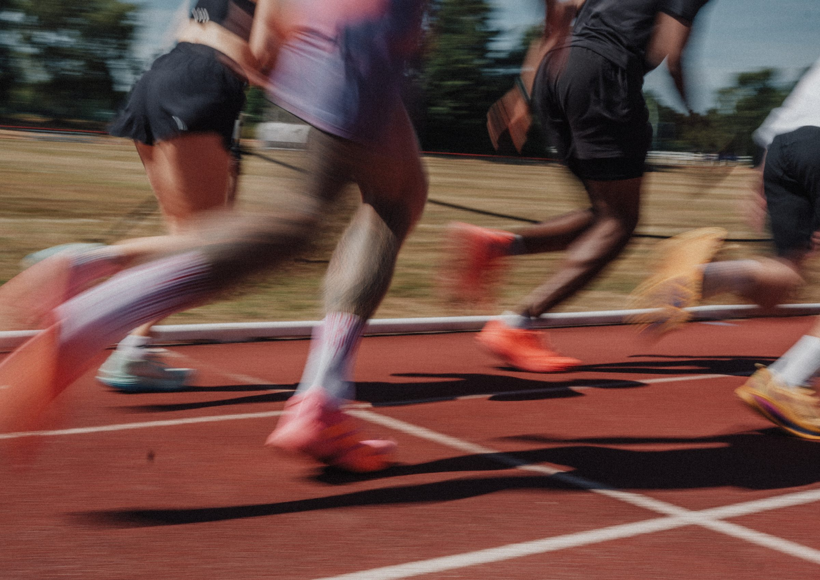
DHS BTEC SPORT · COMPONENT 3
Content area A.
Explore the importance of fitness for sports performance
NAME:
TEACHER:
Exam: Thu 6 May 2027

Slide 2
HOW THE EXAM AWARDS MARKS
Component 3 is the only exam. It is marked by someone who has never met you, using a mark scheme. Learning how that mark scheme works is worth as much as learning the content.
The mark scheme's own words: "Award 1 mark for identifying a correct reason and 1 mark for a linked expansion." "Must have the identification to be awarded the expansion."
Command verb | What it asks for | Usual marks
State, name, identify, give | recall from memory, or select the correct answer. No explanation needed | 1
Describe | two or more linked descriptive points on features, uses or processes. No reason needed | 2 to 3
Explain | a justification of the point: the reason, way, benefit or importance | 2 to 4
Complete the table by stating | one point that identifies, and a second that justifies or explains the first | 2 to 4
Assess, evaluate | weigh the factors and reach a supported judgement. Marked in levels | 6 to 9
Read the command verb first and decide the length before you write. Then on every question worth two or more marks: identify, then expand.
DHS BTEC Sport · Component 3 · Area A
Page 2

Slide 3
WHICH SPORTS NEED WHICH COMPONENTS
Complete each row with the sports and events that rely on the component. Use the specification's own examples where you can.
Component | The sports and events that need it, and what it lets the performer do
Aerobic endurance
Muscular endurance
Muscular strength
Speed
Flexibility
Body composition
Power
Agility
Reaction time
Balance
Coordination
DHS BTEC Sport · Component 3 · Area A
Page 3

Slide 4
IDENTIFY, THEN EXPAND
For each performer: name the component, then write the linked expansion that says what it lets them do in their sport. Two marks each time.
Worked example. Rachel is a cross-country runner racing for forty minutes. "Aerobic endurance (1) so she can keep running for the full forty minutes without fatiguing (1)."
Performer | Component (the identification) | What it lets them do in their sport (the linked expansion)
A 100m sprinter
A gymnast on the beam
A shot putter
A badminton player
A netball centre
Check: does every expansion name the sport? An expansion that would fit any performer is not linked.
DHS BTEC Sport · Component 3 · Area A
Page 4

Slide 5
THE BASIC PRINCIPLES: FITT
Complete each definition, then apply it to a performer of your choice.
Performer and sport: ____________________________
Letter | Definition | Applied to your performer
F Frequency | the number of training s________ completed over a period of time, usually per w______
I Intensity | how h______ an individual will train
T Time | how l______ an individual will train for
T Type | how an individual will train, by selecting a training m________ to improve a specific component of fitness
Intensity is how hard. Time is how long. Swapping them is the most common slip in this topic.
DHS BTEC Sport · Component 3 · Area A
Page 5

Slide 6
THE ADDITIONAL PRINCIPLES OF TRAINING
Seven principles. Complete each definition, then say what would go wrong for a performer if it were ignored.
Principle | Definition | What goes wrong without it
Progressive overload | training needs to be d____________ enough to cause the body to a______, improving performance
Specificity | training should meet the n______ of the s______, or the fitness goals to be developed
Individual differences | training should meet the needs of an i____________
Adaptation | changes to the b______ due to increased training l______
Reversibility | if training s______, or intensity is lowered, fitness gains are l______
Variation | altering types of training to avoid b__________ and maintain m____________
Rest and recovery | to allow the body to r________ and a______
DHS BTEC Sport · Component 3 · Area A
Page 6

Slide 7
EXAM PRACTICE: NAME AND APPLY
Mai's coach uses the additional principles of training to design a training programme for Mai, a high jumper. Complete the table by naming the additional principle represented by each letter, and describing how it would be applied to Mai's programme. (4 marks)
(i) Additional principle represented by a letter | (ii) Description of how it would be applied to Mai's programme
P O
S
How it is marked. 1 mark for naming each principle, 1 mark for describing how it is applied, and you must have the name to get the description mark. The real mark scheme accepted: "Progressive overload (1) training needs to be harder, for example increasing the weight, causing the body to adapt (1)" and "Specificity (1) training should be specific to your sport and the fitness goals to be developed (1)."
My mark: / 4
DHS BTEC Sport · Component 3 · Area A
Page 7

Slide 8
MEASURING INTENSITY: HEART RATE
HR max = 220 minus age
Work these out. Show the calculation every time: a wrong answer with the right method still earns method marks.
Performer | HR max (show your working) | 60% of HR max | 85% of HR max
Rachel is 16
Mai is 15
Adam is 17
Their coach is 42
A masters athlete is 55
DHS BTEC Sport · Component 3 · Area A
Page 8

Slide 9
TARGET ZONES AND TRAINING THRESHOLDS
Complete both zones with the percentages the mark scheme accepts, then say what training in each one develops.
Aerobic training zone
Anaerobic training zone
______ to ______ % of HR max
______ to ______ % of HR max
What it develops:
What it develops:
Now work out both zones for these performers:
Performer | HR max | Aerobic zone (bpm) | Anaerobic zone (bpm)
A 16-year-old runner
An 18-year-old sprinter
A 40-year-old cyclist
DHS BTEC Sport · Component 3 · Area A
Page 9

Slide 10
THE BORG RPE SCALE, 1RM AND 15RM
The Borg scale runs from ______ to ______ RPE × ______ = heart rate (bpm)
RPE reported | Heart rate (bpm) | Heart rate measured | RPE
11 |  | 140 bpm
14 |  | 170 bpm
18 |  | 90 bpm
Why would a coach use RPE as well as a heart rate monitor?
Repetition maximum. 1RM is the maximum weight that can be lifted ______ time, and measures muscular s____________. 15RM is the maximum weight that can be lifted ______ times, and is used for muscular e____________.
A performer's 1RM is 80kg. What weight would they lift at 70% of their 1RM? Show your working:
DHS BTEC Sport · Component 3 · Area A
Page 10

Slide 11
TECHNOLOGY, AND THE ANSWERS THAT SCORE NOTHING
Three technologies measure exercise intensity. Name each and say what it gives the performer or coach.
Technology | What it gives the performer or coach
H________ r______ m____________
S________ w__________
A______
THE MARK SCHEME REFUSES
On this exact question the examiner accepted heart rate monitor and refused all of these: "fitness tracker", "fitness band", "heart rate" on its own, and "sports vest". Name the device precisely. A nearly-right word scores zero.
Other answers you have met that the mark scheme refuses. Add to this list all year:
DHS BTEC Sport · Component 3 · Area A
Page 11

Slide 12
SELF-TEST
Cover your notes. Mark it against the knowledge organiser on the next page. This is exam content: it has to be automatic by May.
1. Which two components do events lasting more than 30 minutes need?
2. What do the four letters of FITT stand for?
3. Name all seven additional principles of training.
4. What is the formula for maximum heart rate?
5. State both training zones as percentages of HR max.
6. What is the range of the Borg scale, and how do you turn an RPE into a heart rate?
DHS BTEC Sport · Component 3 · Area A
Page 12

Slide 13
AREA A KNOWLEDGE ORGANISER
A1 Components and sports
A2 Principles of training
A3 Exercise intensity
Aerobic and muscular endurance: events over 30 minutes.
Muscular strength: force, e.g. throwing events.
Speed: fast movement, e.g. sprinting.
Flexibility: wide range of movement around a joint, e.g. gymnastics, martial arts.
Body composition: low body fat, e.g. gymnastics; high muscle mass, e.g. sprinters.
Power: explosive movement, e.g. gymnastics, basketball.
Agility: quick changes of direction, e.g. dodging, freestyle skiing.
Reaction time: quick decision or response to a stimulus.
Balance: control of the distribution of weight, or remaining upright and steady.
Coordination: two or more body parts, e.g. hand, eyes and tennis racquet.
FITT.
Frequency: sessions over a period of time, usually per week.
Intensity: how hard.
Time: how long.
Type: the training method chosen to improve a specific component.
Additional principles.
Progressive overload: demanding enough to cause the body to adapt.
Specificity: meets the needs of the sport or the fitness goals.
Individual differences: meets the needs of the individual.
Adaptation: changes to the body due to increased training loads.
Reversibility: gains are lost if training stops or intensity drops.
Variation: avoid boredom, maintain motivation.
Rest and recovery: allow the body to recover and adapt.
HR max = 220 − age.
Aerobic training zone: 50 to 85% of HR max.
Anaerobic training zone: 80 to 100% of HR max.
Borg RPE scale: 6 to 20.
RPE × 10 = heart rate in bpm.
1RM: maximum weight lifted once, for muscular strength.
15RM: maximum weight lifted fifteen times, for muscular endurance.
Technology: heart rate monitors, smart watches, apps.
On every question worth two or more marks: identify, then give a linked expansion that names the performer's sport. Without the identification, the expansion usually scores nothing.
DHS BTEC Sport · Component 3 · Area A
Page 13

