Slide 1
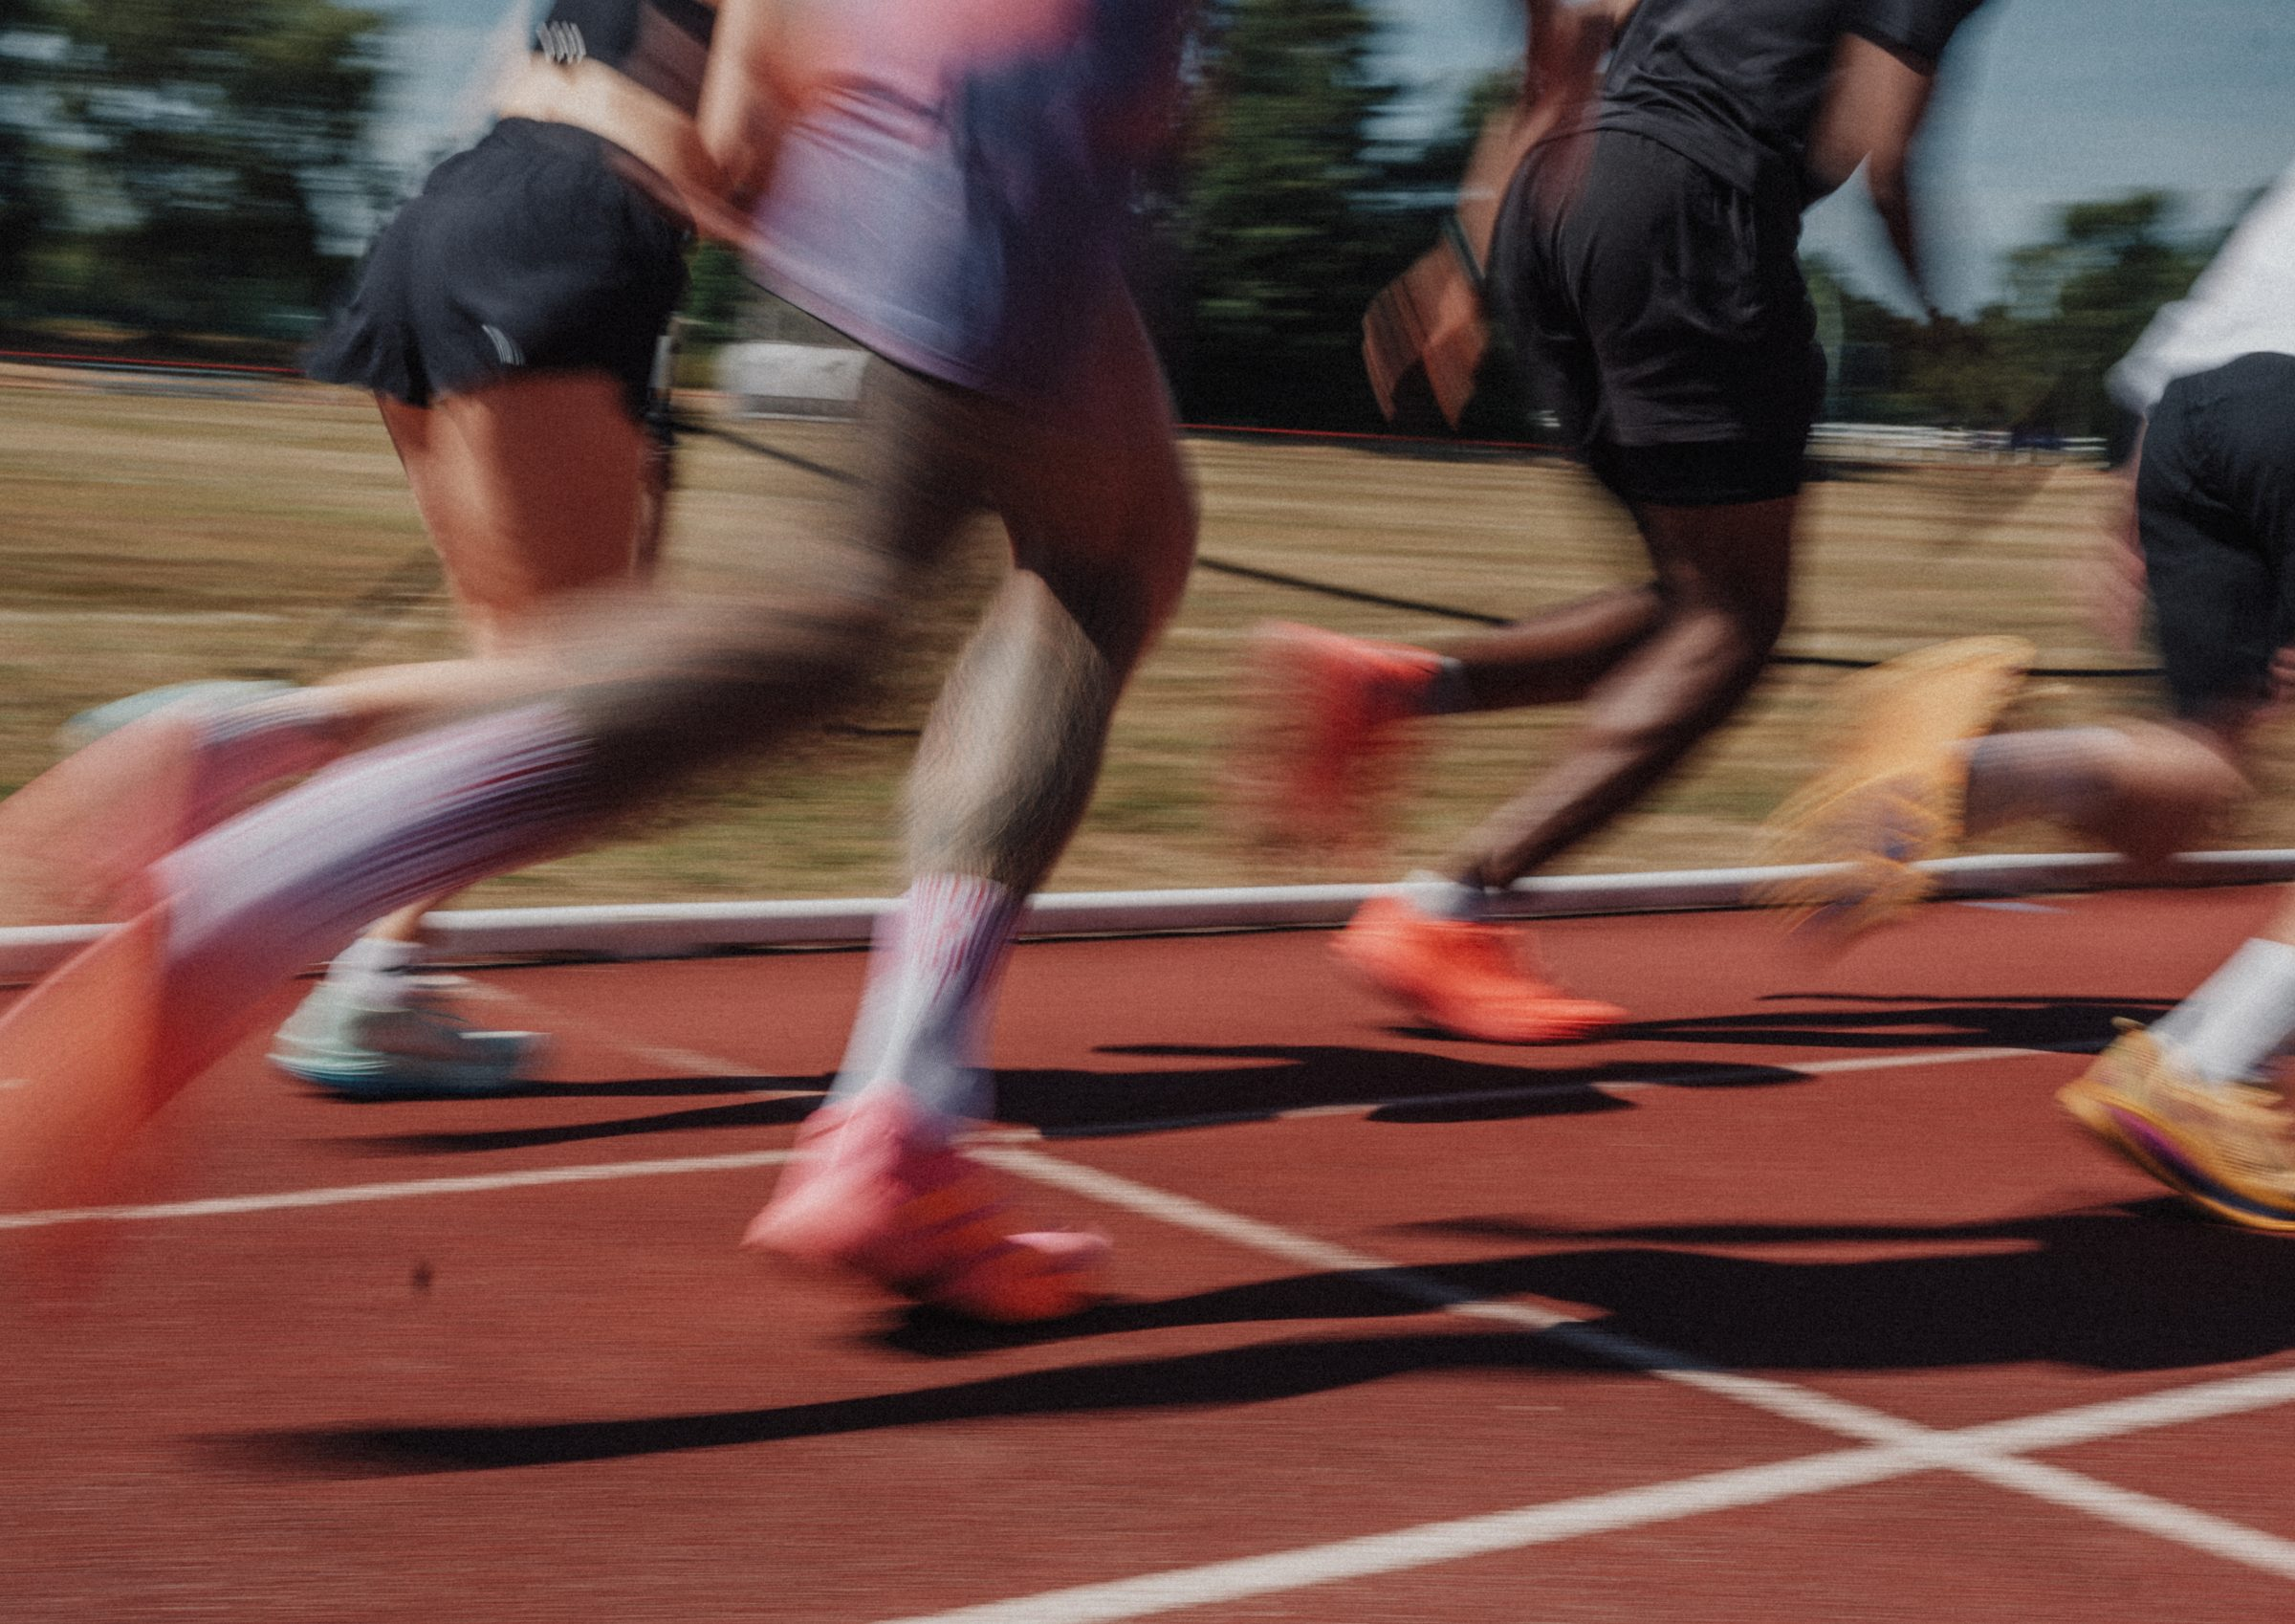
DHS BTEC SPORT · COMPONENT 3
Content area B.
Investigate fitness testing to determine fitness levels
NAME:
TEACHER:
Exam: Thu 6 May 2027

Slide 2
WHY WE TEST, AND WHAT HAPPENS FIRST
Five reasons a coach carries out fitness testing. Write each one, then what the coach can do with it:
Reason for testing | What it lets the coach do
The four pre-test procedures. Complete each, and say why it is done:
Procedure | Why it is done
C____________ of equipment
Complete i__________ consent
Complete the P______ (write out what the letters stand for)
Participant pre fitness test c______
DHS BTEC Sport · Component 3 · Area B
Page 2

Slide 3
RELIABILITY, VALIDITY AND PRACTICALITY
These three get mixed up, and the exam has asked students to pick the right one from a list. Define each precisely:
Reliability
Validity
Practicality
The five factors that affect reliability. Write each one, and how it would change a result:
Factor | How it would change the result
DHS BTEC Sport · Component 3 · Area B
Page 3

Slide 4
TESTS: AEROBIC AND MUSCULAR ENDURANCE
Write the protocol as separate steps. A three-mark describe question needs at least four steps, so give yourself room.
Component and test | How the test is carried out, step by step
Aerobic endurance Multi-stage fitness test (bleep test)
Aerobic endurance 12-minute Cooper run or swim
Muscular endurance One-minute press-up or sit-up
Muscular endurance Timed plank test
The other two aerobic endurance tests are the Y______ test and the H________ step test.
DHS BTEC Sport · Component 3 · Area B
Page 4

Slide 5
TESTS: FLEXIBILITY, SPEED, STRENGTH, BODY COMPOSITION
Component | The tests | How the main test is carried out, step by step
Flexibility
Speed
Muscular strength
Body composition
Body composition, precisely. BMI = weight in kg ÷ height in m squared. BIA passes an electric current through the body to measure body fat and muscle mass. Waist to hip ratio = waist ÷ hip circumference.
DHS BTEC Sport · Component 3 · Area B
Page 5

Slide 6
ONE MARK PER STEP
A real exam question: "Describe how the standing long or broad jump test is carried out." (3 marks). The mark scheme gave one mark for each protocol point, from twelve possible points.
Twelve points the mark scheme accepted. Tick the four you would write:
☐ Tape measure laid on the floor
☐ Stands on or behind a line
☐ Feet slightly or shoulder width apart
☐ Jumps from a standstill
☐ Takes off with two feet
☐ Bends their knees
☐ Swings their arms
☐ Jumps forward
☐ Jumps as far as possible
☐ Lands on two feet
☐ Does not fall backwards
☐ Measured from take-off line to back of heels
Now write a full protocol for a test of your choice, as separate numbered steps:
Test: ____________________________
Could your partner run the test from your steps alone, without asking a single question?
DHS BTEC Sport · Component 3 · Area B
Page 6

Slide 7
TESTS: SKILL-RELATED COMPONENTS
Component | The tests | How the main test is carried out, step by step
Agility
Balance
Coordination
Power
Reaction time
DHS BTEC Sport · Component 3 · Area B
Page 7

Slide 8
MY RESULTS
Record every test you perform. You will use your own data to write recommendations later, and again in content areas C and D.
Date | Test | Component measured | My score | Rating from normative data
DHS BTEC Sport · Component 3 · Area B
Page 8

Slide 9
READING RESULTS AGAINST NORMATIVE DATA
One mark, and it is the easiest in the paper. Use the table's own words for the rating, and check the row twice.
Sit and reach normative data
Give the rating for each score:
Score | Rating
over 14cm | Excellent
14cm to 11cm | Above average
10.9cm to 7cm | Average
6.9cm to 4cm | Below average
under 4cm | Poor
5.2 cm
12.0 cm
16.5 cm
7.0 cm
3.9 cm
Two of those scores sit close to a boundary. Which two, and how did you decide?
Write the rating exactly as the table writes it. "Below average" earns the mark. "Quite bad" or "needs work" does not.
DHS BTEC Sport · Component 3 · Area B
Page 9

Slide 10
ANALYSE, THEN RECOMMEND
Three steps, every time: compare the score to normative data, analyse what it means for this performer, then recommend a training method that would improve it.
Performer and sport: ____________________________
Test and score | 1 · Rating from the table | 2 · What it means for this performer in their sport | 3 · Recommendation, and why it would work
A recommendation has to name a real training method. "Train harder" is not a recommendation.
DHS BTEC Sport · Component 3 · Area B
Page 10

Slide 11
AREA B EXAM PRACTICE
Adam is a badminton player completing fitness testing.
(a) State one reason why fitness testing is important. (1)
(b) Describe how the sit and reach test is carried out. (3)
(c) Explain what the Bioelectrical Impedance Analysis test does. (2)
My mark: / 6 One thing to revise tonight:
DHS BTEC Sport · Component 3 · Area B
Page 11

Slide 12
SELF-TEST
Cover your notes. Mark it against the knowledge organiser on the next page.
1. Give two reasons why fitness testing is carried out.
2. Name the four pre-test procedures.
3. Define reliability, and define validity.
4. Name the four tests for aerobic endurance.
5. Name the two tests for agility.
6. What are the three steps from a test result to a recommendation?
DHS BTEC Sport · Component 3 · Area B
Page 12

Slide 13
AREA B KNOWLEDGE ORGANISER
B1 Why and how we test
B2 Physical tests
B3 and B4 Skill tests and results
Reasons: baseline data for monitoring and improving performance · design training programmes · determine if training is working · something to aim for · goal setting aims.
Pre-test: calibration of equipment · informed consent · PAR-Q (Physical Activity Readiness Questionnaire) · participant pre fitness test check.
Reliability: results are consistent. Affected by calibration, motivation of the participant, testing conditions (inside vs outside), experience of the tester, compliance with the standardised procedure.
Validity: measures what it says it measures.
Practicality: cost, time to set up, perform and analyse, number tested at once.
Aerobic endurance: multi-stage fitness test (bleep, 20m) · Yo-Yo · Harvard step · 12-minute Cooper run or swim.
Muscular endurance: one-minute press-up · one-minute sit-up · timed plank.
Flexibility: sit and reach · calf muscle · shoulder flexibility.
Speed: 30 metre sprint · 30 metre flying sprint.
Muscular strength: grip dynamometer · 1 Rep Max.
Body composition: BMI (kg ÷ m²) · BIA (electric current, measures fat and muscle mass) · waist to hip ratio.
Agility: Illinois agility run · T Test.
Balance: stork stand · Y balance.
Coordination: alternate-hand wall toss · stick flip.
Power: vertical jump · standing long or broad jump · Margaria-Kalamen.
Reaction time: ruler drop · online reaction time test.
Interpreting results: compare to normative published data and give the rating in the table's words · analyse what it means for this performer · recommend a training method that would improve the weakness.
Describe questions: one mark per protocol step.
Reliability is consistency. Validity is measuring the right thing. Practicality is cost and time. The exam has asked you to tell them apart.
DHS BTEC Sport · Component 3 · Area B
Page 13

