Slide 1
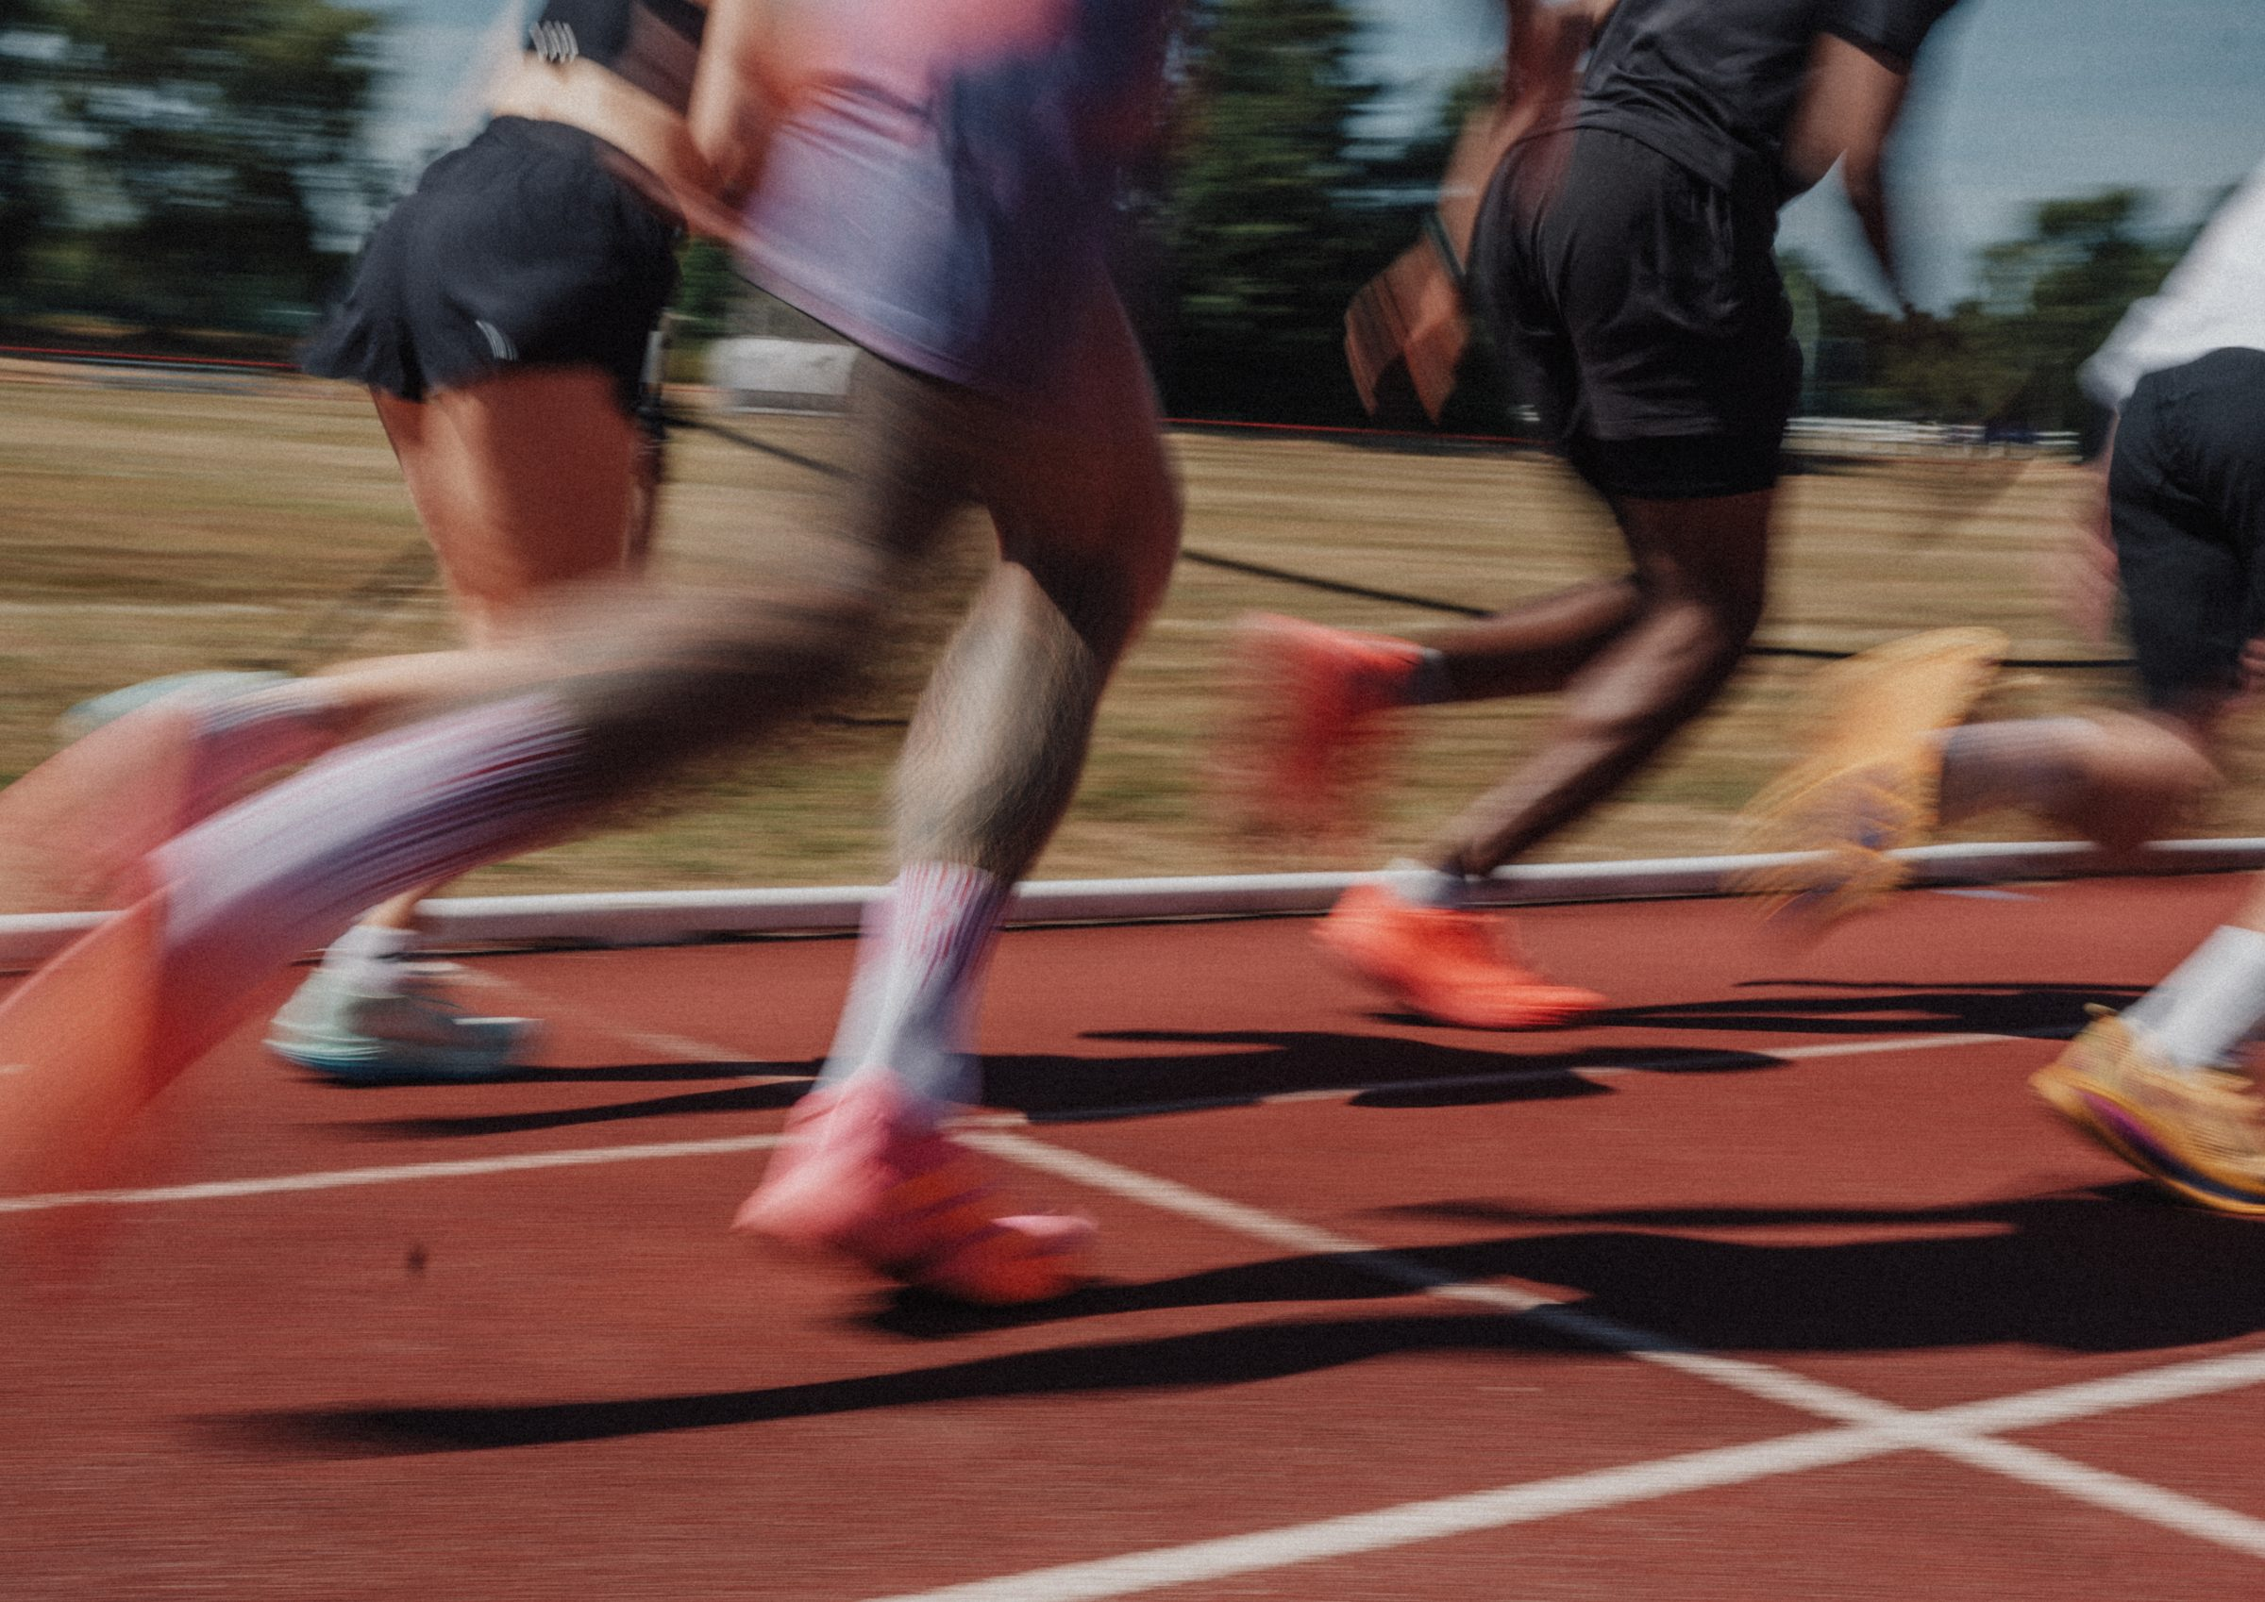
DHS BTEC SPORT · COMPONENT 3
Content area C.
Investigate different fitness training methods
NAME:
TEACHER:
Exam: Thu 6 May 2027

Slide 2
AROUND EVERY TRAINING SESSION
Complete both, then write why each part is done. You already know the warm-up from Component 1.
 | What it involves | Why it is done
Warm-up, before training
Cool down, after training
A real two-mark question. "Explain the importance of one component of a cool down." The mark scheme wanted the component named and a linked reason: "stretching (1) to return the muscles to their pre-exercise length (1)". It refused "rest and recovery", and refused "remove lactic acid" when it was attached to stretching instead of to the pulse-lowering activity. The reason has to belong to the component you named.
DHS BTEC Sport · Component 3 · Area C
Page 2

Slide 3
METHODS FOR AEROBIC ENDURANCE
Describe each method precisely. The details in bold in the specification are the ones that earn the mark.
Method | Describe it | How it develops aerobic endurance
Continuous training
Fartlek training
Interval training
Circuit training
How long must continuous training last, as a minimum? ____________ What does Fartlek vary? ____________________
DHS BTEC Sport · Component 3 · Area C
Page 3

Slide 4
METHODS FOR FLEXIBILITY, ENDURANCE AND STRENGTH
Component and method | Describe it
Flexibility Static active
Flexibility Static passive
Flexibility PNF (write out what it stands for)
Muscular endurance Free weights, machines, circuits
Muscular strength Free weights and machines
Same equipment, opposite settings. Muscular endurance: ________ reps, ________ loads. Muscular strength: ________ reps, ________ loads.
DHS BTEC Sport · Component 3 · Area C
Page 4

Slide 5
METHODS FOR SPEED
Method | Describe it
Acceleration sprints
Interval training
Resistance drills (name at least three)
Interval training appears twice in the specification. Complete the contrast:
For aerobic endurance
For speed
Rest periods: ________________
Work intensity: ______________
Rest periods: ________________
Work intensity: ______________
DHS BTEC Sport · Component 3 · Area C
Page 5

Slide 6
METHODS FOR SKILL-RELATED COMPONENTS
Component | Method | Describe it, with examples
Agility
Power
Balance
Coordination
Reaction time
One method appeared in a photograph-matching question. Which one, and what does it look like?
DHS BTEC Sport · Component 3 · Area C
Page 6

Slide 7
CHOOSING A METHOD, AND WHERE TO TRAIN
The eight things that make a method better or worse for a performer:
1.
2.
3.
4.
5.
6.
7.
8.
Provision: give two advantages and one disadvantage of each for someone who wants to train:
Sector | Advantages | Disadvantage
Public
Private
Voluntary
DHS BTEC Sport · Component 3 · Area C
Page 7

Slide 8
LONG-TERM EFFECTS ON THE BODY SYSTEMS
The most under-revised part of area C, and it appears in nearly every paper. Name the systems, then the adaptations.
Training type | Which body systems adapt | The adaptations
Aerobic endurance training
Flexibility training
Muscular endurance training
Muscular strength and power training
Speed training
Two technical words to spell: c________________ (more capillaries forming) and h______________ (the muscle or heart growing).
DHS BTEC Sport · Component 3 · Area C
Page 8

Slide 9
MATCH THE METHOD TO THE PERFORMER
Use your own fitness test results from area B. For each weakness, choose a method and justify it using the eight considerations.
Performer and sport | Component to improve | Method chosen | Why this method suits this performer
Me
A 100m sprinter
A marathon runner
A gymnast
DHS BTEC Sport · Component 3 · Area C
Page 9

Slide 10
THE SIX-MARK QUESTION
The biggest block of marks in the paper, and where most are lost. This is how it is marked:
Level | Marks | What it looks like
Level 1 | 1 to 2 | isolated knowledge with major gaps · few points relevant to the question · generic assertions and unsupported judgements
Level 2 | 3 to 4 | some accurate knowledge with minor gaps · some points relevant but the link is not always clear · partially supported judgements
Level 3 | 5 to 6 | mostly accurate and detailed knowledge · most points relevant with clear links · well-developed, logical, supported judgements
The sub-max rule. When a question names two components, each one has a maximum of three marks. A brilliant answer about only one of them cannot score more than 3 out of 6. Cover both, always.
The plan that works. Three points for each named component:
1. What the component is, in specification words
2. The test or training method that goes with it
3. What it lets this performer do in their sport, specifically
DHS BTEC Sport · Component 3 · Area C
Page 10

Slide 11
SIX-MARK PRACTICE
Adam is a badminton player. Assess the importance of flexibility and muscular endurance to his performance. (6 marks)
Plan first. Three points per component, then write:
Flexibility (3 marks max)
Muscular endurance (3 marks max)
Now write the answer:
My mark: / 6 Did I cover BOTH components? Yes / No
DHS BTEC Sport · Component 3 · Area C
Page 11

Slide 12
SELF-TEST
Cover your notes. Mark it against the knowledge organiser on the next page.
1. Name the four training methods for aerobic endurance.
2. Name the three types of stretching.
3. What load and repetitions develop muscular endurance, and what develop strength?
4. Which method develops agility, and which develops power?
5. Name the four adaptations from long-term aerobic endurance training.
6. Why must a six-mark answer cover both named components?
DHS BTEC Sport · Component 3 · Area C
Page 12

Slide 13
AREA C KNOWLEDGE ORGANISER
C1 to C3 The methods
C4 and C5 Choosing and providing
C6 Long-term effects
Warm-up: pulse raiser, mobility, stretch. Reduces injury risk, prepares the body.
Cool down: lower pulse and breathing to resting levels, remove lactic acid, stretch to return muscles to pre-exercise length.
Aerobic endurance: continuous (steady, moderate, 30 min minimum) · Fartlek (varied speeds and terrain) · interval (work then rest; fewer, shorter rests and lower intensity) · circuit (stations in succession, minimal rest).
Flexibility: static active (internal force) · static passive (partner or object, external force) · PNF (isometric contractions to inhibit the stretch reflex).
Muscular endurance: high reps, low loads. Muscular strength: low reps, high loads. Free weights and fixed resistance machines for both.
Speed: acceleration sprints · interval (short, high intensity, more rest) · resistance drills (hills, parachutes, sleds, bungee, bands).
Skill-related: SAQ for agility · plyometrics for power · reduced base of support for balance · two or more body parts for coordination · quick responses for reaction time.
Eight things to weigh: number who can take part · cost of equipment · ease of set up · access to the venue · risk of injury if performed incorrectly · effectiveness for the performer · specificity to the component · replicating the demands of the sport.
Public: cheap or subsidised, council funded, accessible to everyone, local, wide range of activities. Busier at peak times, older equipment.
Private: newer equipment, specialist machines, quieter, extra services such as personal training. Most expensive, membership may be needed.
Voluntary: low cost, shared interest, social. Limited equipment and opening hours.
Aerobic endurance, cardiovascular and respiratory: cardiac hypertrophy · decreased resting heart rate · increased strength of respiratory muscles · capillarisation around the alveoli.
Flexibility, muscular and skeletal: increased range of movement at a joint · increased flexibility of ligaments and tendons · increased muscle length.
Muscular endurance, muscular: capillarisation around the muscle tissues · increased muscle tone.
Strength and power, muscular and skeletal: muscle hypertrophy · increased tendon and ligament strength · increased bone density.
Speed, muscular: increased tolerance to lactic acid.
Six-mark questions: each named component has a maximum of three marks, so cover both. Name the component, its method, and what it does for that performer in their sport.
DHS BTEC Sport · Component 3 · Area C
Page 13

