Slide 1
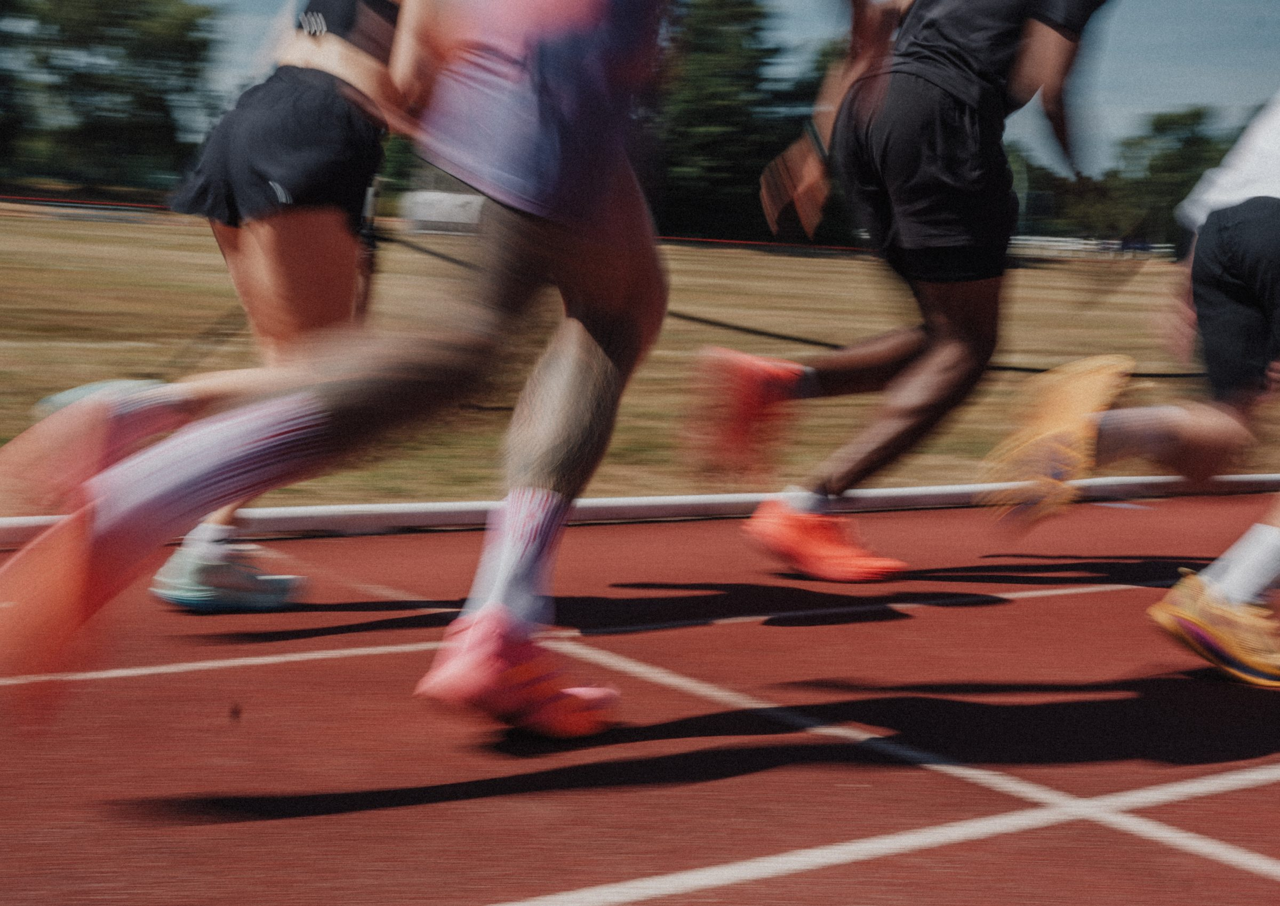
DHS BTEC SPORT · COMPONENT 3
Content area D.
Investigate fitness programming to improve fitness and sports performance
NAME:
TEACHER:
Exam: Thu 6 May 2027

Slide 2
EVERYTHING SO FAR, PUT TO WORK
A training programme needs all four content areas at once. This is where they meet.
FROM AREA A
FROM AREA B
FROM AREA C
AREA D
The components and principles
Your test results
The training methods
The programme and the motivation
The three parts of area D. Complete each heading as we work through:
Section | What it covers
D1 Personal information
D2 Programme design
D3 Motivation and goals
DHS BTEC Sport · Component 3 · Area D
Page 2

Slide 3
THE INFORMATION YOU NEED FIRST
Four things to find out before designing anything. Complete each definition, then collect it from a real performer.
What to find out | What it means | Your performer's answer
Aims | details of what they would like to a________ for the selected sport
Objectives | h____ they intend to meet their aims, naming a c____________ of fitness and a m________ of training
Lifestyle and physical activity history
Attitudes, the mind and personal motivation
The aim is WHAT they want to achieve. The objective is HOW, and it names a component and a method.
DHS BTEC Sport · Component 3 · Area D
Page 3

Slide 4
MY AIM AND MY OBJECTIVE
Use your own fitness test results from area B. The objective must name a component of fitness and a training method.
Performer and sport: ____________________________
My aim:
My objective (name the component and the method):
The test result that justifies this objective:
What my lifestyle allows: how many sessions a week, and when?
DHS BTEC Sport · Component 3 · Area D
Page 4

Slide 5
DESIGNING THE PROGRAMME
Four things every programme design must do. Complete each, then use them to build the week on the next page.
What the design must do | What that means in practice for your performer
Use the personal information
Select an appropriate training method for the component being improved
Apply the FITT principles
Apply the additional principles of training
Name the seven additional principles you must check the programme against:
DHS BTEC Sport · Component 3 · Area D
Page 5

Slide 6
MY TRAINING WEEK
One week of training. For every session: the method, the component it develops, and the FITT detail.
Day | Training method | Component developed | Intensity | Time
Monday
Tuesday
Wednesday
Thursday
Friday
Saturday
Sunday
Audit: does this week show progressive overload? ______ variation? ______ rest and recovery? ______ specificity? ______
Could your performer actually do this week, given their lifestyle? If not, what changes?
DHS BTEC Sport · Component 3 · Area D
Page 6

Slide 7
MOTIVATION
Motivation: the i____________ mechanisms and e____________ stimuli that a________ and d________ behaviour.
Intrinsic
Extrinsic
From ____________ the performer
From ____________ the performer
Examples:
Examples:
Four benefits of motivation for a sports performer:
1.
2.
3.
4.
How does goal setting influence motivation? Two things:
DHS BTEC Sport · Component 3 · Area D
Page 7

Slide 8
SMARTER GOALS
Seven letters in this specification. The last two are the ones people forget.
S
M
A
R
T
E
R
Weak goal: "I want to get fitter." Not specific, not measurable, no timescale.
SMARTER goal: "I will improve my bleep test score from level 7.4 to level 9.2 by the end of March, recorded in my training diary after each retest."
Now write your own, using your test results. Check it against all seven letters:
My short-term goal (between one day and one month):
My long-term goal (say the timescale):
DHS BTEC Sport · Component 3 · Area D
Page 8

Slide 9
SHORT-TERM AND LONG-TERM GOALS
Short-term goals
Long-term goals
Set over a s________ period of time: between ________ day and ________ month.
What they want to achieve in the l________ t______, and the best way of doing this.
A real two-mark question. "Adam's coach has set him a short-term goal. Describe one other type of goal that Adam's coach could set." The mark scheme gave: "Long-term goals (1) are set over a long period of time or timescale (1)." It accepted an example with an appropriate timescale, such as a season, and refused an example of a goal with no timescale at all.
Your turn. Describe a long-term goal for a performer, and make sure the timescale is in it:
Mark your own: did you name the type of goal (1) and give the timescale (1)? My mark: / 2
DHS BTEC Sport · Component 3 · Area D
Page 9

Slide 10
THE COMPLETE PROGRAMME
Everything together, for one performer. This is the synoptic task: it needs all four content areas.
Section | Your programme
The performer, their sport and their aim
Their test results, and the weakness you are targeting
The methods you have chosen, and why those ones
One short-term and one long-term goal, both with timescales
How you will keep them motivated
DHS BTEC Sport · Component 3 · Area D
Page 10

Slide 11
WHERE AREA D MARKS GO MISSING
The mistake | What to do instead
Describing a goal without a timescale
Swapping the aim and the objective
Stopping SMARTER at five letters
Defining motivation loosely
Exam practice. Answer these in full sentences:
(a) Describe one other type of goal a coach could set, other than a short-term goal. (2)
(b) Explain one benefit of motivation for a sports performer. (2)
DHS BTEC Sport · Component 3 · Area D
Page 11

Slide 12
SELF-TEST
Cover your notes. Mark it against the knowledge organiser on the next page.
1. What is the difference between an aim and an objective?
2. Name the four pieces of personal information needed to design a programme.
3. Define motivation, in specification words.
4. What is the difference between intrinsic and extrinsic motivation?
5. What do the seven letters of SMARTER stand for?
6. What timescale defines a short-term goal?
DHS BTEC Sport · Component 3 · Area D
Page 12

Slide 13
AREA D KNOWLEDGE ORGANISER
D1 and D2 Information and design
D3 Motivation
D3 Goals
Personal information needed:
· aims: details of what they would like to achieve for the selected sport
· objectives: how they intend to meet their aims, using an appropriate component of fitness and method of training
· lifestyle and physical activity history
· attitudes, the mind and personal motivation for training.
Programme design:
· use the personal information to aid design
· select an appropriate training method or activity for improving or maintaining the selected components of physical or skill-related fitness
· apply the FITT principles and the additional principles of training.
Motivation: the internal mechanisms and external stimuli that arouse and direct behaviour.
Types: intrinsic, from within the performer, such as enjoyment, satisfaction and pride. Extrinsic, from outside, such as trophies, medals, prize money, praise and selection.
Benefits of motivation on the sports performer:
· increase participation
· maintain training and intensity
· increased fitness
· improved performance.
Influence of goal setting on motivation:
· provides direction for behaviour
· maintains focus on the task in hand.
SMARTER:
S specific
M measurable
A achievable
R realistic
T time-related
E exciting
R recorded
Short-term goals: set over a short period of time, between one day and one month.
Long-term goals: what they want to achieve in the long term, and the best way of doing this.
The examiner's warning: a goal described without a timescale is refused. Always give the timescale.
A programme needs all four areas: the components from A, your test results from B, the methods from C, and the goals and motivation from D.
DHS BTEC Sport · Component 3 · Area D
Page 13

