Slide 1
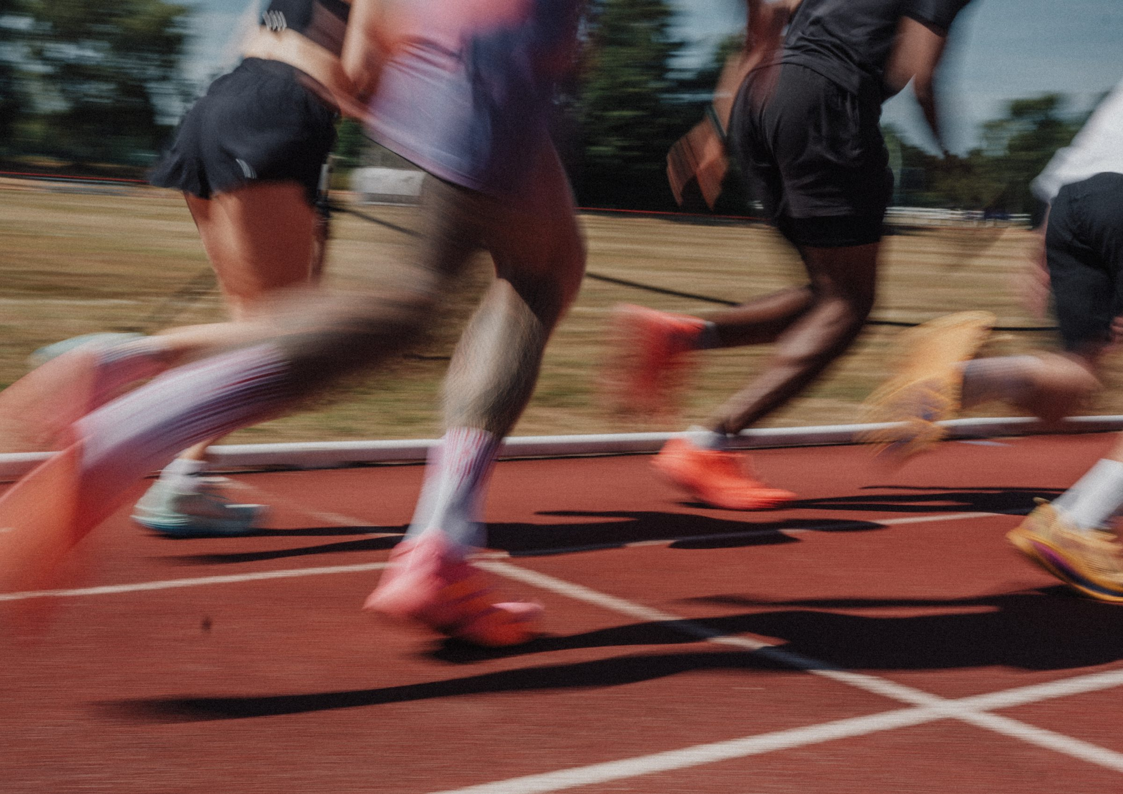
DHS BTEC SPORT · COMPONENT 3
Revision and exam technique.
Exam technique, the four content areas, and past-paper practice
NAME:
TARGET GRADE:
60 marks · 1 hour 30 · Thu 6 May 2027

Slide 2
READ THE COMMAND VERB FIRST
The verb tells you how much to write. Deciding the length before you start is what stops you running out of time at question 3.
Command verb | What it asks for | Marks | How long my answer should be
State, name, identify, give | recall or select. No explanation needed | 1
Describe | two or more linked descriptive points on features, uses or processes | 2 to 3
Explain | a justification: the reason, way, benefit or importance | 2 to 4
Complete the table by stating | one point that identifies, one that justifies it | 2 to 4
Assess, evaluate | weigh the factors, reach a supported judgement. Levels marked | 6 to 9
Total paper: 60 marks in 90 minutes. That is roughly a mark and a half a minute, including reading time.
DHS BTEC Sport · Component 3 · Revision
Page 2

Slide 3
IDENTIFY, THEN EXPAND
Every mark scheme, all year: "Award 1 mark for identifying a correct reason and 1 mark for a linked expansion. Must have the identification to be awarded the expansion."
 | The answer | Marks
Half an answer | "A heart rate monitor." | 1 of 2
A full answer | "A heart rate monitor (1), which measures how hard she is working during the session (1)." | 2 of 2
No identification | "It measures how hard she is working." | usually 0
Now you. Write full two-mark answers for these:
1. Explain one component of fitness a cross-country runner needs.
2. Explain what the Bioelectrical Impedance Analysis test does.
3. Describe one other type of goal a coach could set, other than short-term.
DHS BTEC Sport · Component 3 · Revision
Page 3

Slide 4
THE SIX-MARK QUESTION
Level | Marks | What it looks like
Level 1 | 1 to 2 | isolated knowledge with major gaps · few points relevant to the question · generic assertions, unsupported judgements
Level 2 | 3 to 4 | some accurate knowledge, minor gaps · some points relevant but the link is not always clear · partially supported judgements
Level 3 | 5 to 6 | mostly accurate and detailed · most points relevant with clear links · well-developed, logical, supported judgements
The sub-max rule. Two named components means a maximum of three marks each. Everything you know about one still caps at 3 out of 6.
The plan. Three points per component, every time:
Component 1 (3 marks max)
Component 2 (3 marks max)
1. what it is 2. its test or method 3. what it does for this performer
1. what it is 2. its test or method 3. what it does for this performer
DHS BTEC Sport · Component 3 · Revision
Page 4

Slide 5
ANSWERS THAT SCORE NOTHING
Every one of these was written into a real mark scheme as an answer that earns no marks. Add to the list every time you meet another.
What scores nothing | What to write instead
"Fitness tracker", "fitness band", "sports vest", or "heart rate" on its own | name the device: heart rate monitor, smart watch or app
"Rest and recovery" as a component of a cool down | the components are the pulse-lowering activity and the stretch
"Remove lactic acid" as the reason for stretching | that reason belongs to the pulse-lowering activity
A goal described without a timescale | one day to one month for short-term; a season for long-term
An impact linked to the wrong training method | check the method actually develops that component
The cheapest marks in the paper: knowing what not to write.
DHS BTEC Sport · Component 3 · Revision
Page 5

Slide 6
THE CALCULATIONS
Learn these to automatic. Show your working every time: a wrong answer with the right method can still earn marks.
Drill. Fill this in against the clock:
What | The rule
Maximum heart rate | 220 − age
Aerobic training zone | 50 to 85% of HR max
Anaerobic training zone | 80 to 100% of HR max
Borg RPE scale | runs 6 to 20 · RPE × 10 = heart rate in bpm
Body Mass Index | weight in kg ÷ height in metres squared
Age | HR max | 70% of HR max
15
17
22
38
54
More practice. Show your working:
1. A performer reports RPE 16. What is their approximate heart rate?
2. A 16-year-old trains at 80% of HR max. What is their training heart rate?
3. A performer weighs 70kg and is 1.75m tall. What is their BMI?
4. A performer's 1RM is 90kg. What weight is 60% of their 1RM?
DHS BTEC Sport · Component 3 · Revision
Page 6

Slide 7
AREA A RECALL
Cover your notes and fill this in. Then check against your area booklet and correct in a different colour.
Prompt | What I can remember
The eleven components of fitness, and a sport for each
FITT: what each letter means
The seven additional principles of training
HR max, and both training zones
The Borg scale, 1RM and 15RM
The three technologies that measure intensity
DHS BTEC Sport · Component 3 · Revision
Page 7

Slide 8
AREA B RECALL
Cover your notes and fill this in. Then check against your area booklet and correct in a different colour.
Prompt | What I can remember
Five reasons for fitness testing
The four pre-test procedures
Reliability, validity and practicality defined
The five factors that affect reliability
Every test for every physical component
Every test for every skill-related component
The three steps from a result to a recommendation
DHS BTEC Sport · Component 3 · Revision
Page 8

Slide 9
AREA C RECALL
Cover your notes and fill this in. Then check against your area booklet and correct in a different colour.
Prompt | What I can remember
Warm-up and cool down: what and why
The four aerobic endurance methods
The three stretching methods
Muscular endurance against muscular strength: loads and reps
The three speed methods
The methods for the five skill-related components
The long-term effects of each type of training
DHS BTEC Sport · Component 3 · Revision
Page 9

Slide 10
AREA D RECALL
Cover your notes and fill this in. Then check against your area booklet and correct in a different colour.
Prompt | What I can remember
Aim against objective
The four pieces of personal information
Motivation defined, in specification words
Intrinsic against extrinsic, with examples
SMARTER, all seven letters
Short-term and long-term goals, with timescales
DHS BTEC Sport · Component 3 · Revision
Page 10

Slide 11
MY PAST PAPER TRACKER
Log every paper by content area, not just the total. The area with the lowest percentage is where your revision goes next.
Paper | Date sat | A | B | C | D | Total / 60 | My weakest area, and what I did about it
Sample paper
January 2024
June 2024
January 2025
May 2025
January 2026
Mock
A total tells you nothing about what to revise. The breakdown does.
DHS BTEC Sport · Component 3 · Revision
Page 11

Slide 12
AFTER THE MOCK
The mock is only useful if you do something with it. Work through every question you lost marks on, using the mark scheme.
Question | Marks lost | Why I lost them | What I will write next time
My mock mark: / 60 My weakest content area: My one priority:
DHS BTEC Sport · Component 3 · Revision
Page 12

Slide 13
THE LAST WEEK
High frequency, short sessions. Long heavy revision the night before does less than sleep does.
When | Calculations drill | Knowledge organiser blanked | One six-marker planned and written | Refusals list read
Six days out
Five days out
Four days out
Three days out
Two days out
The day before
On the day. Read the command verb before every question. Identify, then expand, on everything worth two or more marks. Show every calculation. On the six-marker, cover both named components. Use the performer's name and their sport.
DHS BTEC Sport · Component 3 · Revision
Page 13

